Slide 1



„LOG IN BACK THE REAL LIFE”
Project ID: 2022-1-HU01-KA220-SCH-000087324
Funded by the European Union. Views and opinions expressed are however those of the author(s) only and do not necessarily reflect those of the European Union or the European Education and Culture Executive Agency (EACEA). Neither the European Union nor EACEA can be held responsible for them.

Slide 2

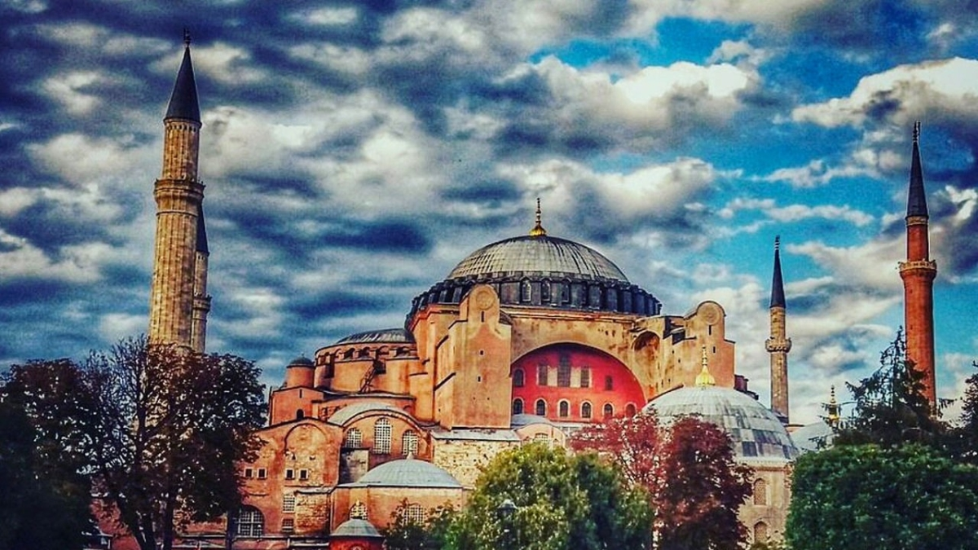

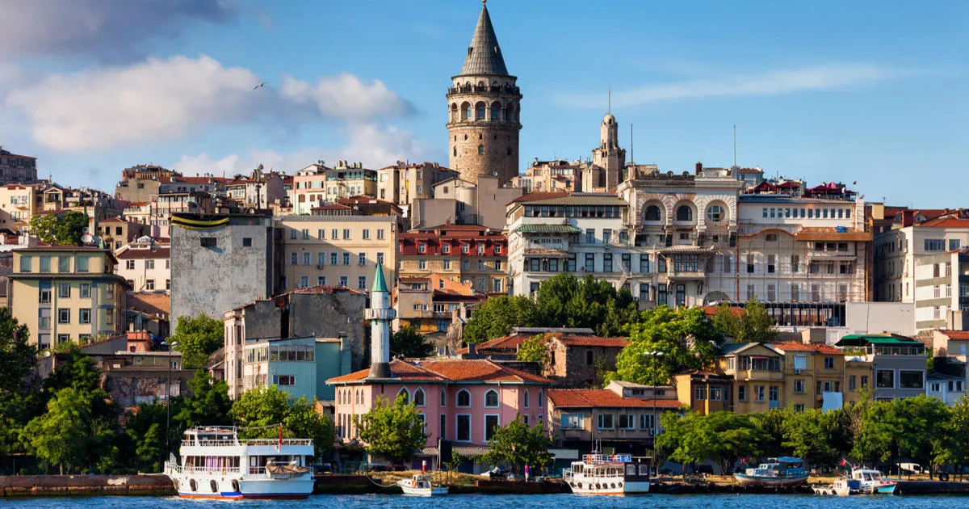
OUTDOOR ACTIVITIES IN TURKIYE

Slide 3
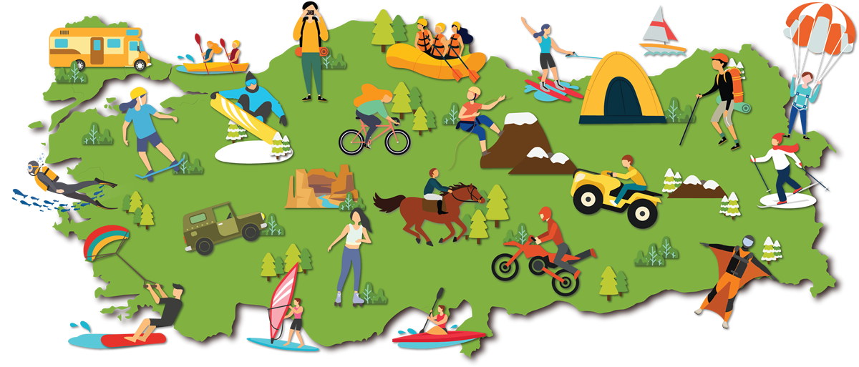
There are many outdoor activities in Türkiye. The unique natural riches of each region and the location of Türkiye provide a great advantage to our country in this regard.

Slide 4
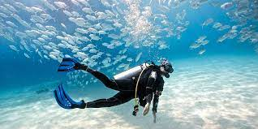
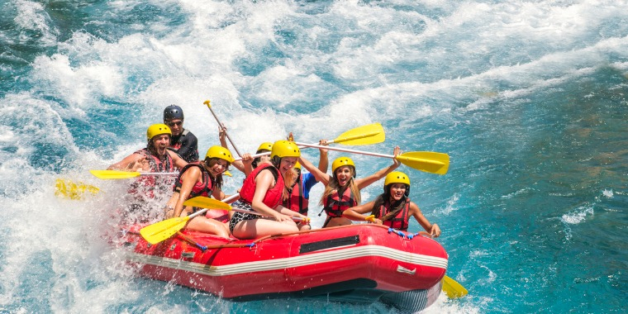
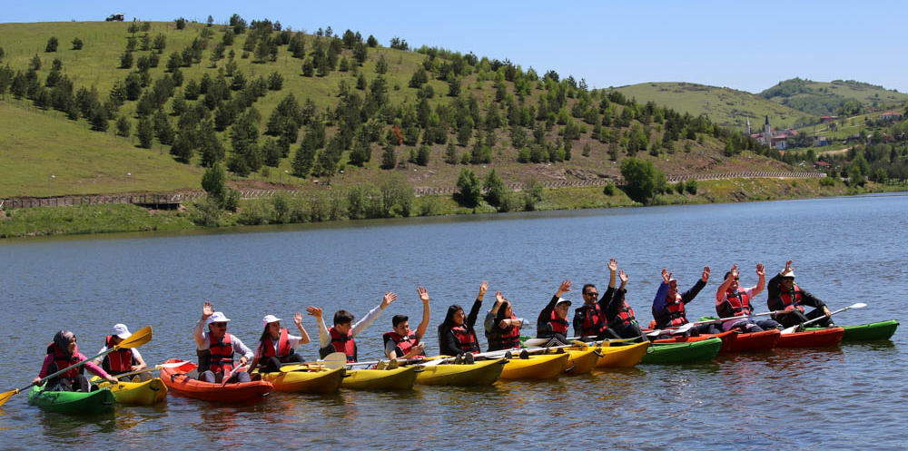
Water sports
In our country, water sports are mostly seen in touristic places such as the Mediterranean, Black Sea and the Aegean
Rafting
Dive
Kiteboard
Canoe
Sails
Fishing

Slide 5
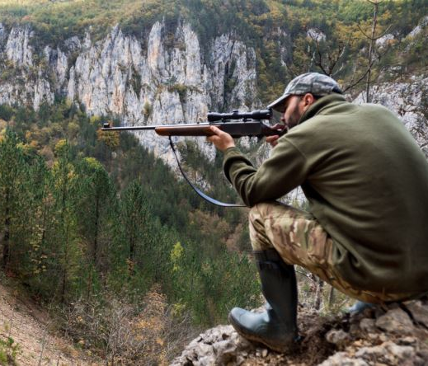
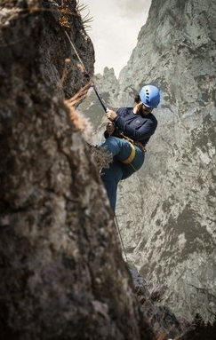
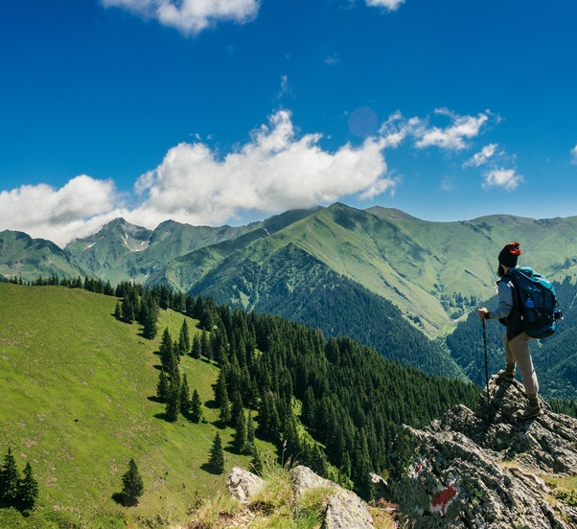
Mountain sports
Türkiye is one of the countries with high elevation in terms of the mountains it has and the area they cover
Some mountaineering activities in our country
Climbing
Hiking
Trekking
Hunting

Slide 6
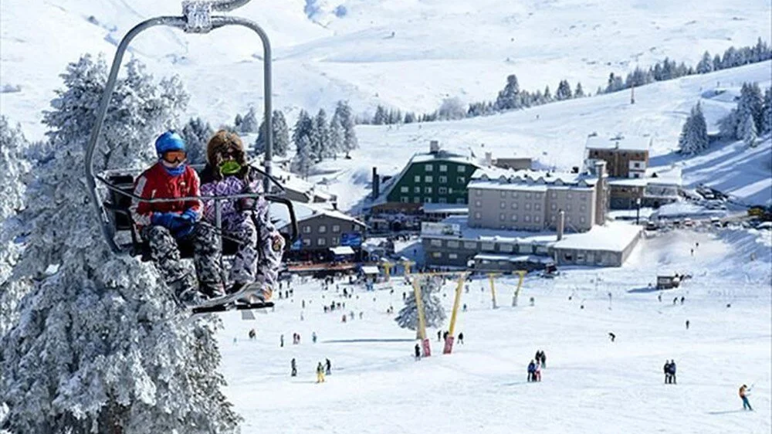
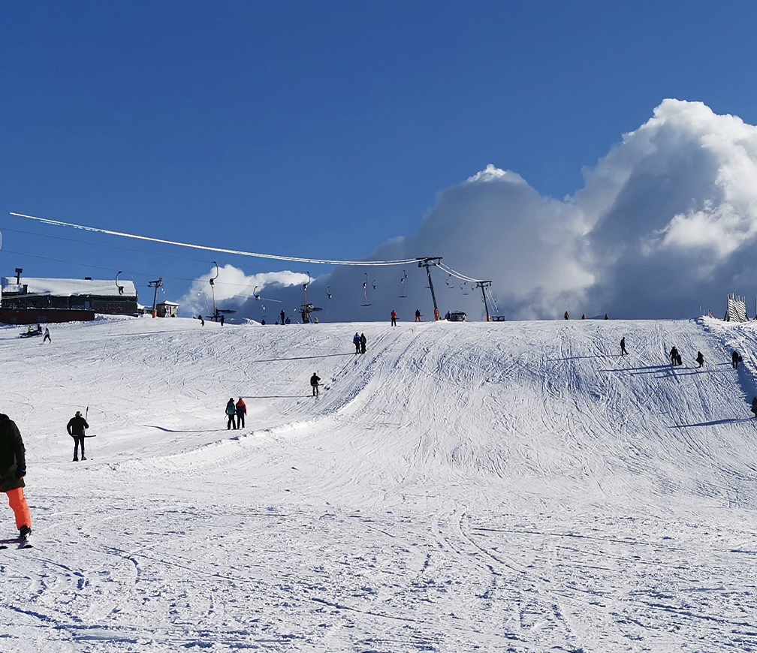
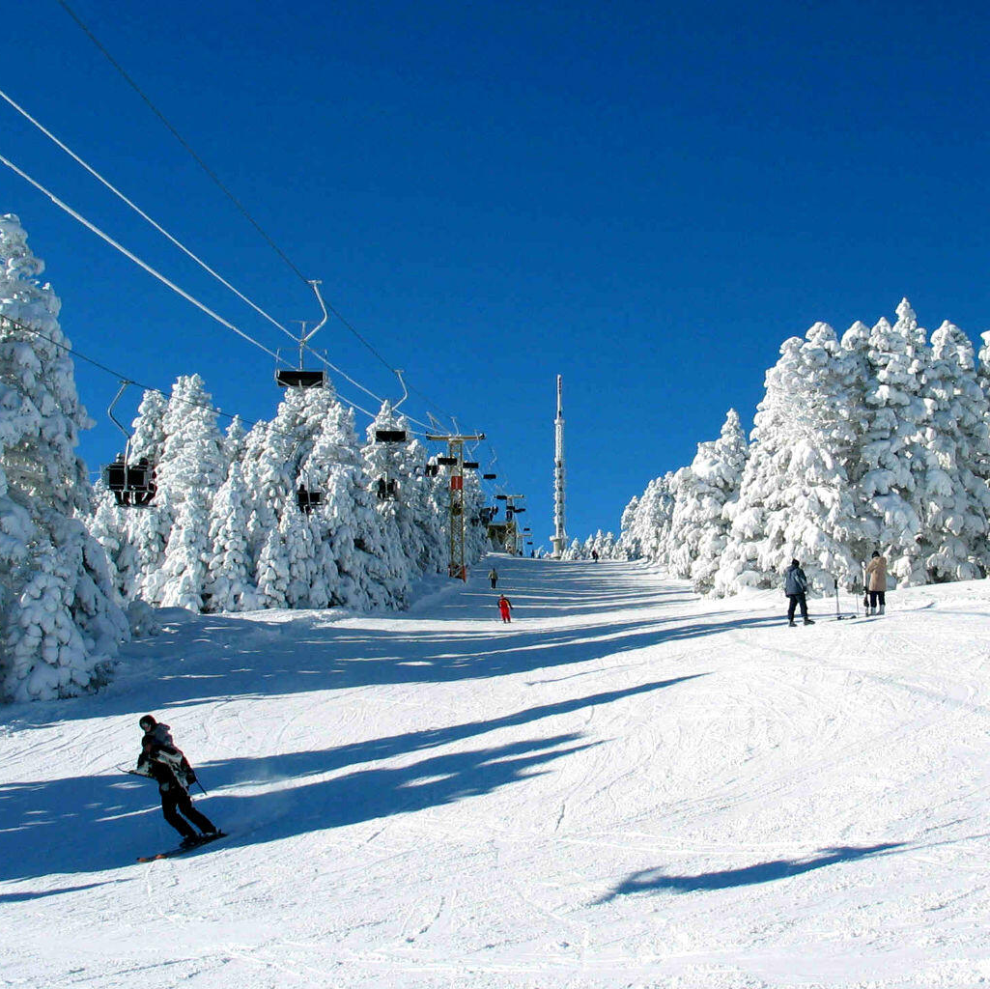
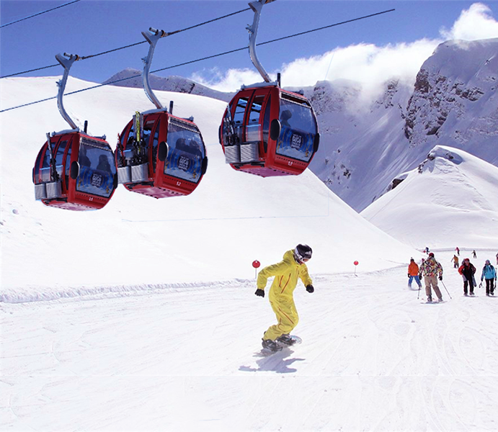
Among the mountain activities, skiing should not be forgotten. In our country, Uludağ hosts a lot of tourists

Slide 7

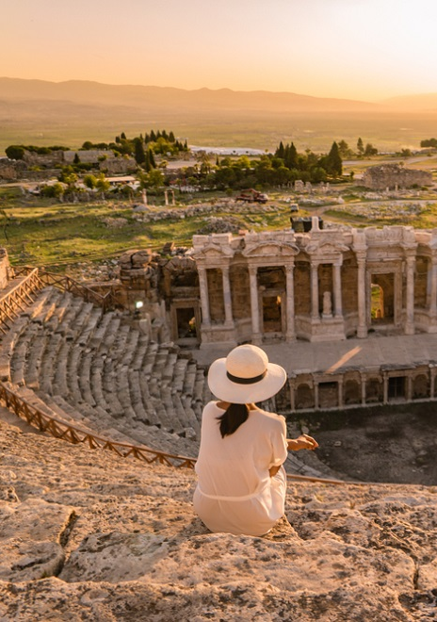

Trips
With its natural beauties, architectural structure, historical cities, Türkiye fascinates many tourists
Historical monument trips
Cave trips
Nature trips

Slide 8
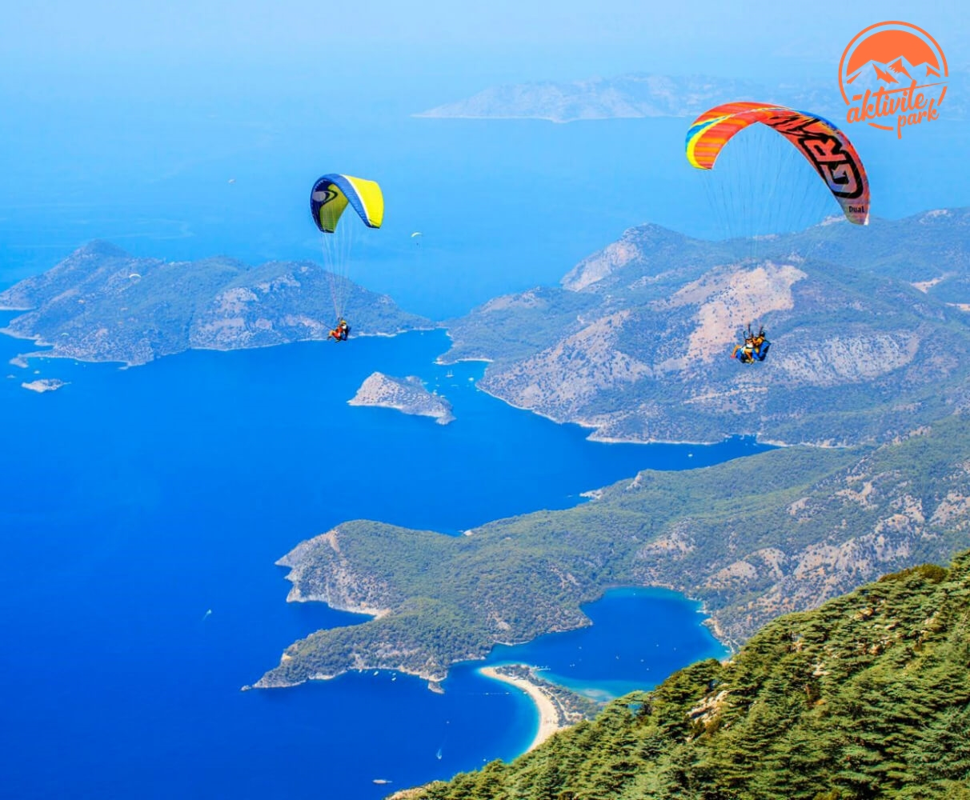
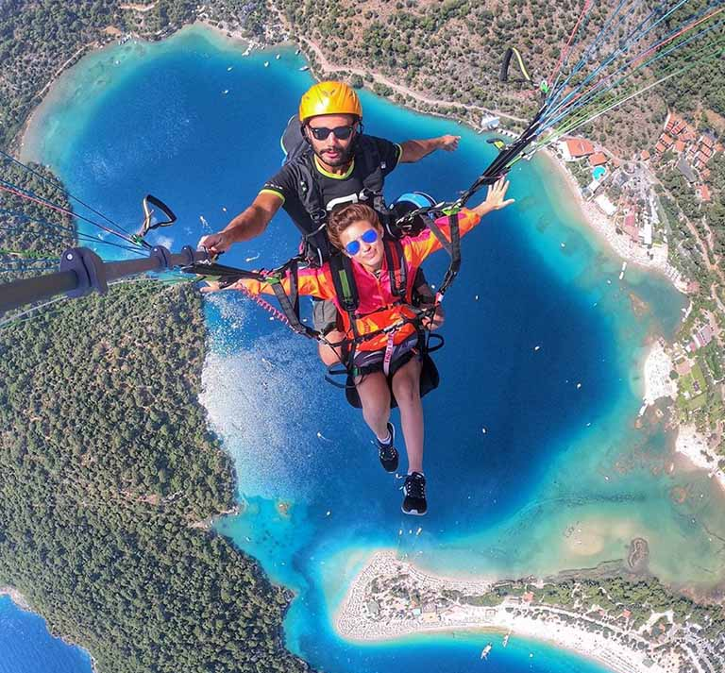
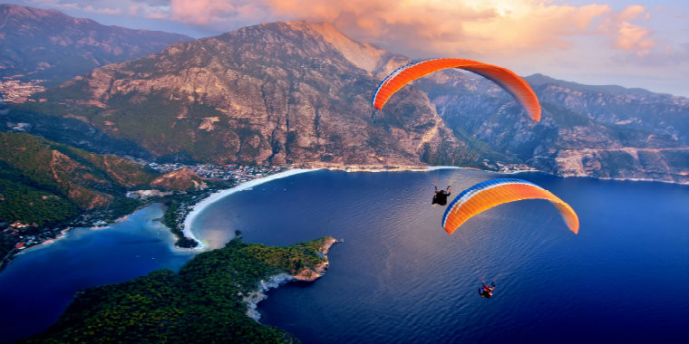
Sky Diving
In Türkiye, Fethiye is the center of sky diving in the Dead Sea. The city attracts tourists with both its natural beauties and extreme sports .

Slide 9
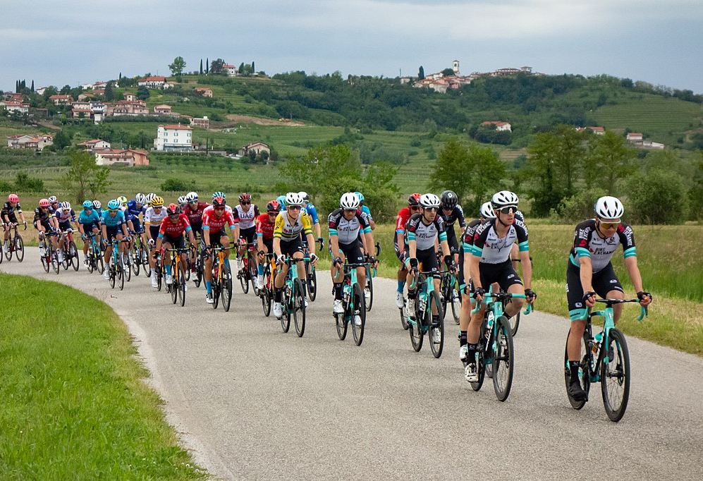

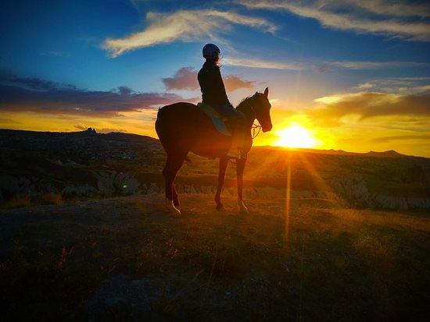
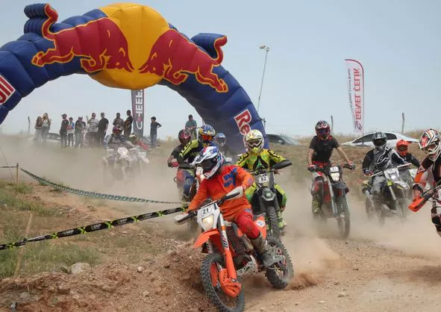
Other activities
W
Cycling
Ride a horse
Enduro Enduro
Photography
Camping
Walking

Slide 10
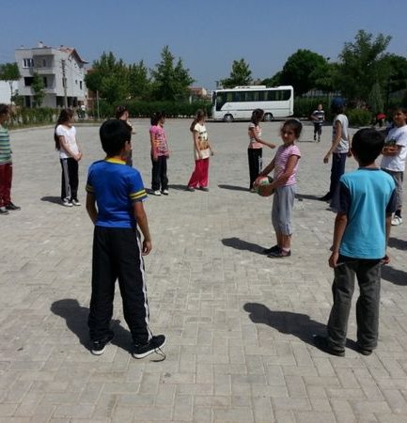
Street Games
İstop
Players form a circle . To start the game, one of the children becomes a midwife. The midwifes throws the ball into the air, saying the name of one of the players. As the ball falls to the ground, if the player whose name is said catches the ball in the air, he throws the ball back into the air, saying someone else's name. Unable to keep the ball in the air, the child shouts "istop" when he picks up the ball from the ground. Players who run away have to stand where they are at the moment of being called "istop". The midwifes tries to hit one of the players standing with the ball in her hand . If he can shoot someone, the person he hits becomes a midwife, and the game continues in the same way. If he can't it, the person with the ball in her hand continues to be a midwife.

Slide 11
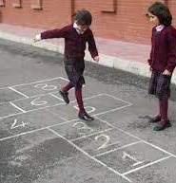
Hopscoth
Hopscoth is a game that can be played in many players as well as it can be played with a single player. The aim is to finish the round without missing your balance . For player hopscoth you need a piece of stone , or anything that you can throw. You need to draw squares to the ground , firs one should be alone. Then this should be connected to two squared that are lined side by side. The order should be one alone square followed by two side by side squares , then again one alone square. The length of this serie can be longer or shorter, it depends how you prefer. You need to throw the stone to the smallest number then the next should be consequative number. You have to jump through the squares with one foot. The person who successfully finishes the game wins.

Slide 12
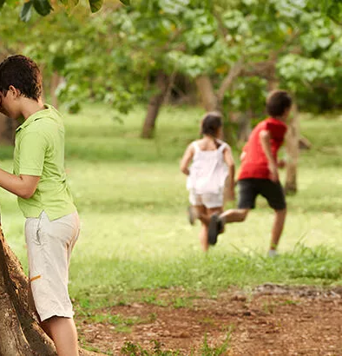
Hide and Seek
Firstly we should choose someone. He/she should close his/her eyes and he/she count 15second (The players can decide it). While he/she counting players should hide. Then 15 second later he/she stop counting and he/she try to find players. If he/she fond a player he/she should say his/her name and touch where he/she counted. If he/she say wrong name, game will stop.

Slide 13
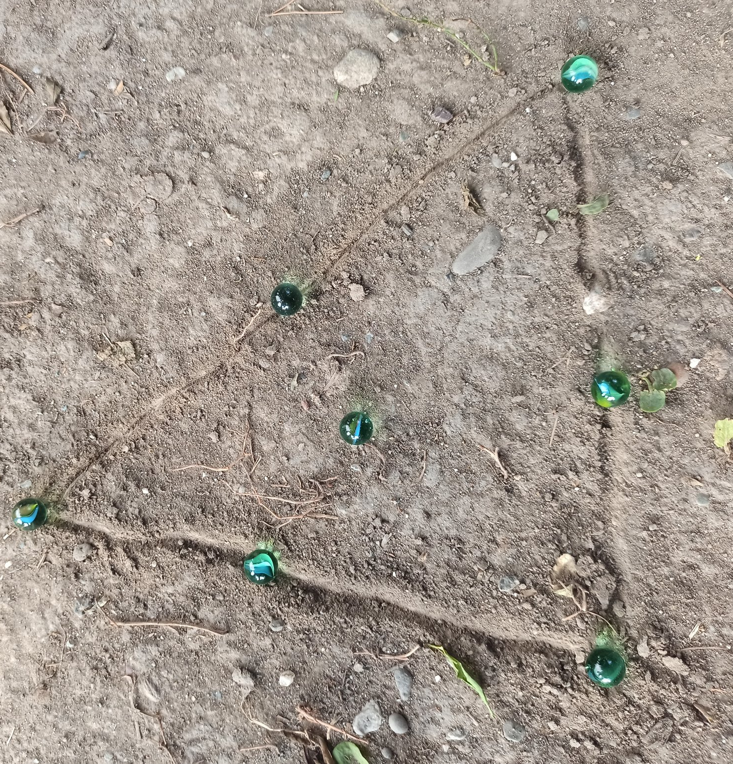
Marble
The games is of course played with marbles . A triangle is draw . Each player puts an equal number of marbles on and inside the lines of the triangle . A goal line is draw 3-4 meters from the triangle . Each players shoot at this line with the game ball. According to proximity of the balls to the line , the starting order of the players is determined . Shot are fired goal line to the balls in the triangle. The ball that is shot and taken out of the triangle becomes the player who makes the shot.

Slide 14
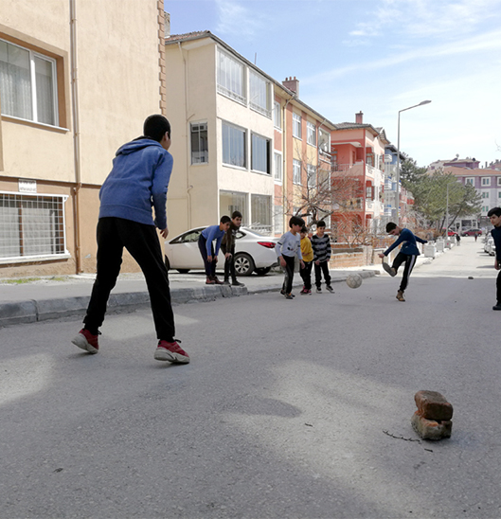
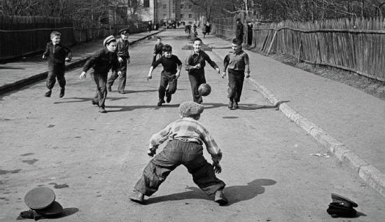
Street Football
Street football( in other words neighborhood matchs)game is a game of football played between children with different rules .

Slide 15
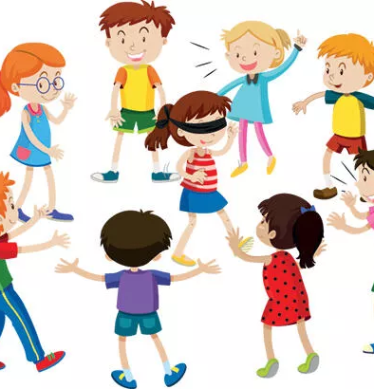
Blind Man's Buff
For the game of blind man's buff,an area drawn in the form a circle is determined. At least 4 players ar needed to play the game . One player is selected as blindman and his/her eyes tied with scarf. Blindman should not see anything. Then he/she tries to catch other players inside the room or determined area. When the blindman catches a player he/she should recognize this person and tell his/her name. If he/she can't recognize the person he/she catches, he/she continues to become blindman. If the recognize the person is right, that person becomes a blindman.

Slide 16
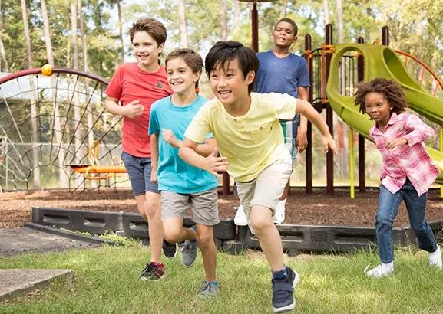
Ebelemece
After the midwife chooses one of the players, the other players start to run away. The player who is the midwife must catch one of the others and count to 11. In the meantime, if the player he caught does not escape, he becomes a midwife . İf he escapes , the same person continues to be a midwife

Slide 17
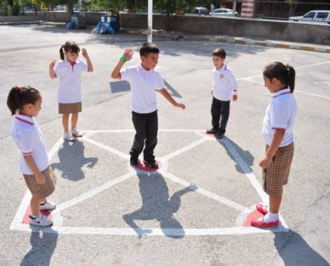
Puss in the Corner
It is played with at least 4 people . The midwife stands somewhere in the middle compared to the other players. Players constantly try to change corners with each other without being caught in the middle. Meanwhile, the player caught by the midwife loses his/her corner and becomes a midwife himself .

Slide 18
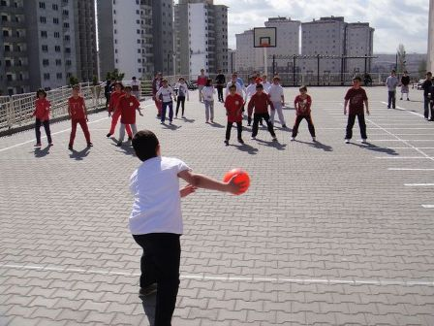
Dodge Ball
Dodgeball is a sport played by throwing soft balls , or hard rubber balls, at people in a square court. The goal is to be the last one to be hit with the ball. Players may only throw balls at people who are not on their own team. If a player is hit by the ball, he or she should go to the outside of the court to the other team. From the outside, players throw the ball at players still on the inside.

Slide 19
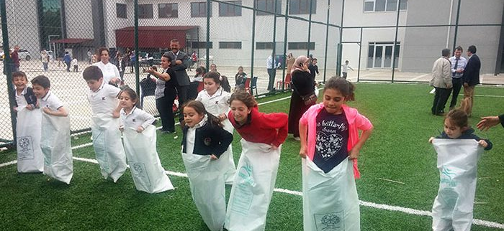
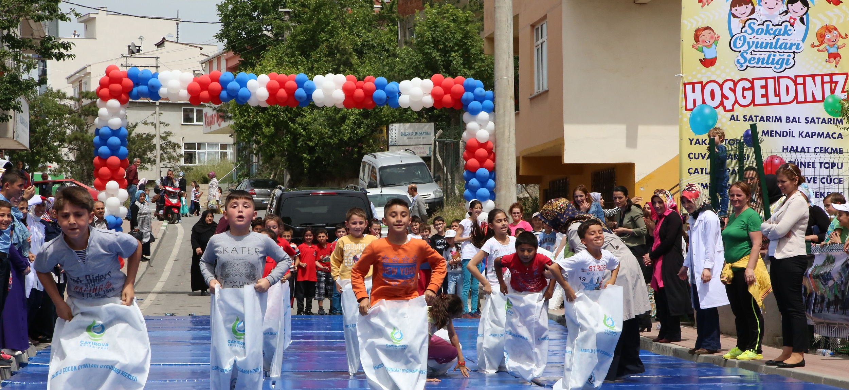
Sack Race
Sack racing is a game played with a sack, there is a line in the sack racing which is set as a certain line, this line is the winner of the first game, if the players stay together, the camera records are checked and then the races are continued and the game continues like this.

Slide 20
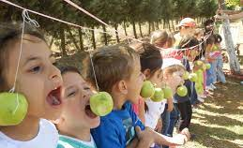
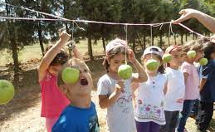
Apple Eating Contest
In this game, the contestants try to eat the apple hanging on the rope without using their hands. The contestant who eats the most apples when time runs out wins.

Slide 21
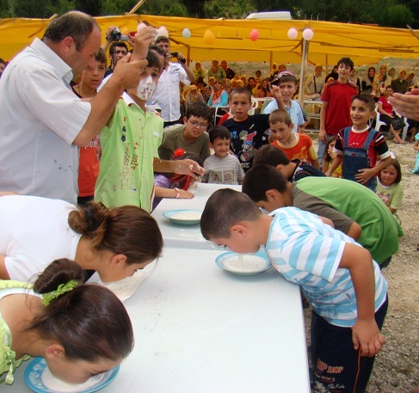
Yoghurt Eating Contest
Yoghurt Eating Contest: Students who will participate in the race bring a plate of yoghurt each. And they kneel before the audience. A coin is placed in the yogurt field. With the start signal, the contestants try to find the money in the yogurt on the ground with their mouths without touching their hands.

Slide 22
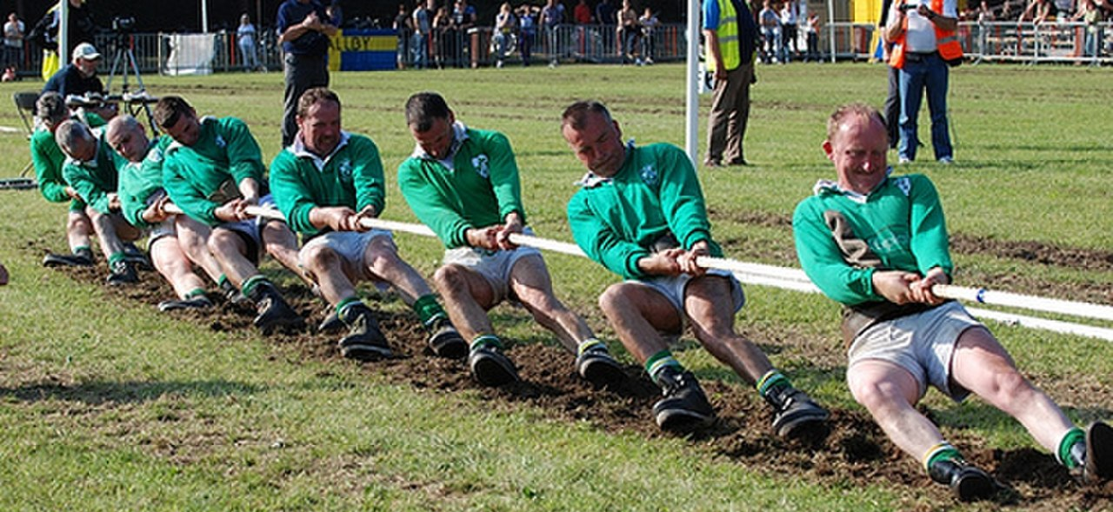
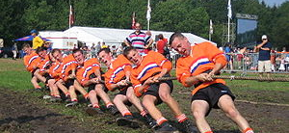
Tug of War
The team that can pull the opponent 4 meters and cross the middle line wins. All matches consist of three draws, the team that defeats the opponent in two of the three games wins. In some forms of the game, a total of three ribbons or handkerchiefs are tied or lines are drawn in the middle of the rope and two meters away from this point.

Slide 23
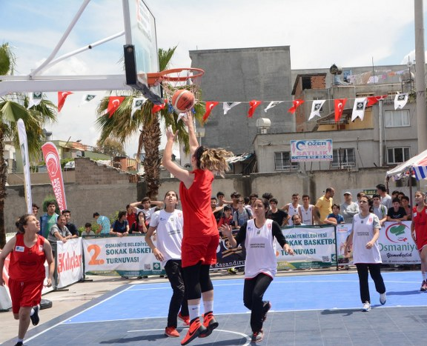
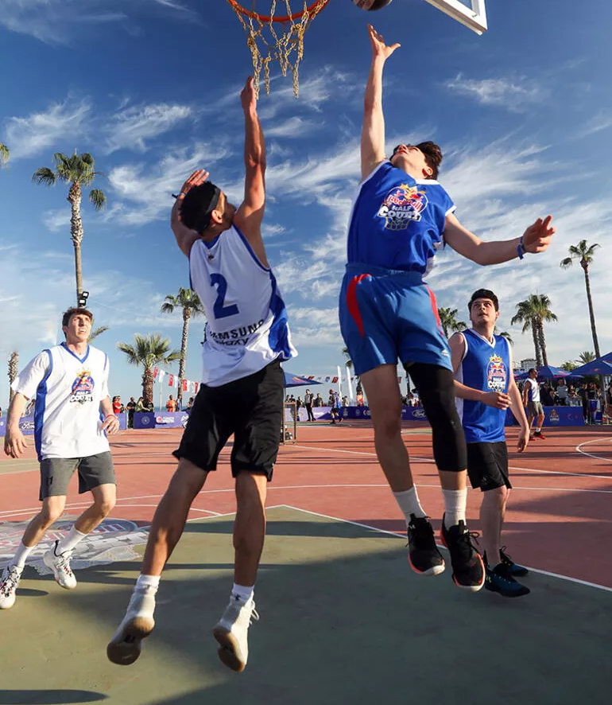
Street Tournaments
Every year there are street tournaments for young people.Young people form their own teams and compete.Street sports are held in public places. The winning teams are awarded by the municipality.

Slide 24
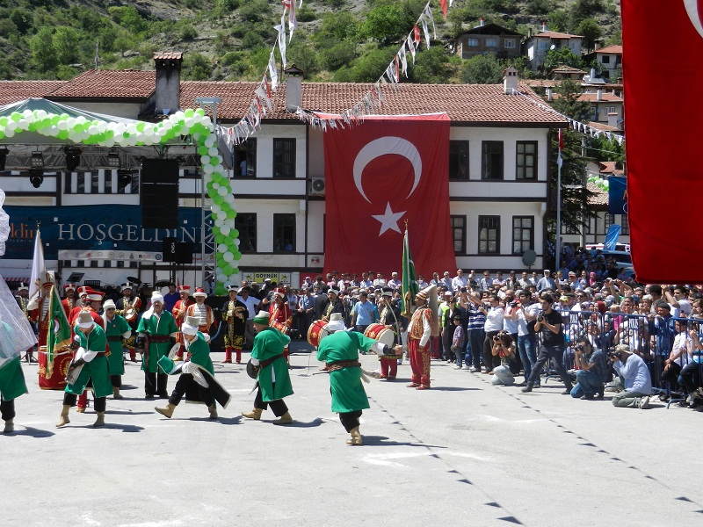
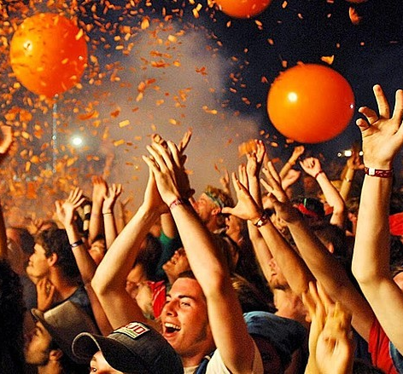
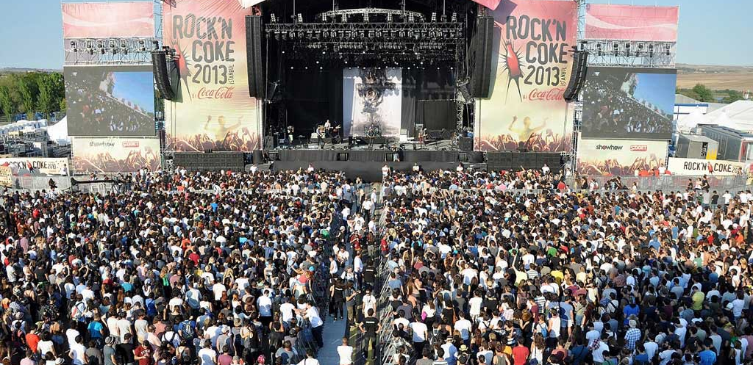
Festivals
Every year thousands of festivals are organized in Türkiye.People have fun in organizations that include many different activities such as music, film, food and theater.
These festivals can be organized not only for entertainment, but also for the continuation of traditions, the globalization of cultures and the commemoration of a particular person or event.

Slide 25
Prepared
Sıla Sueda GÖÇERİ
Thanks for listening

