Slide 1



Széchenyi István Roman Catholic Secondary School
2022-1-HU01-KA220-SCH-000087324
Funded by the European Union. Views and opinions expressed are however those of the author(s) only and do not necessarily reflect those of the European Union or the European Education and Culture Executive Agency (EACEA). Neither the European Union nor EACEA can be held responsible for them.

Slide 2
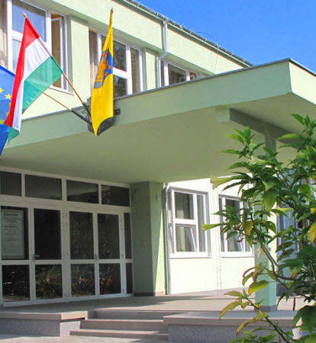
Introduction
located in Hatvan
more than 450 students
Several specializations

Slide 3




Specializations
Economics
Informatics
Management
High School
Health care

Slide 4
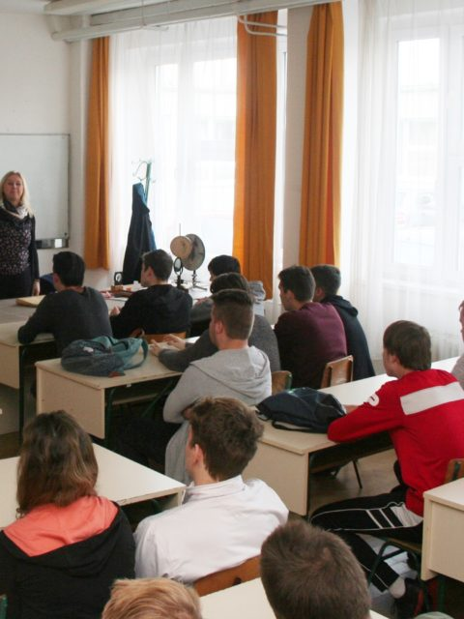


Foreign languages
English
German
Small groups
Pannon language
exam

Slide 5
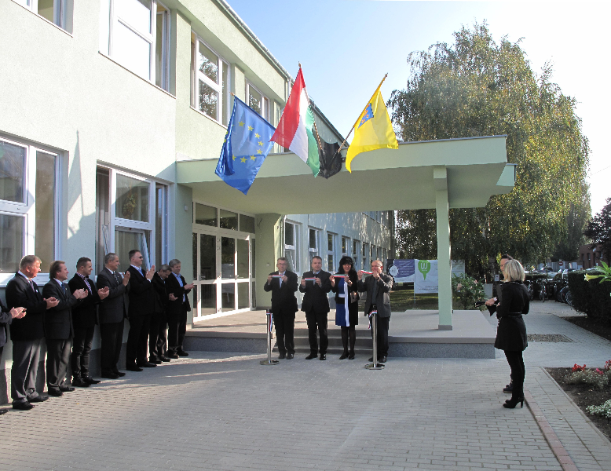
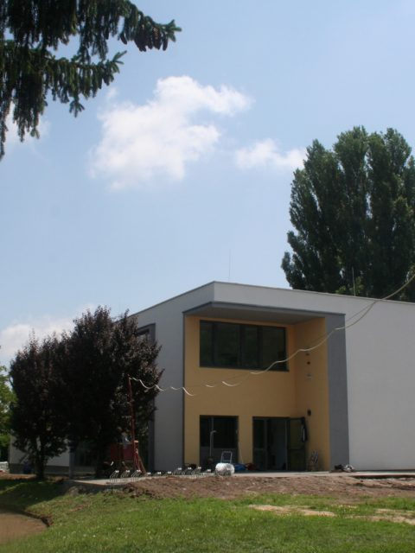
Our school today
2014-renovation
2018-new building

Slide 6
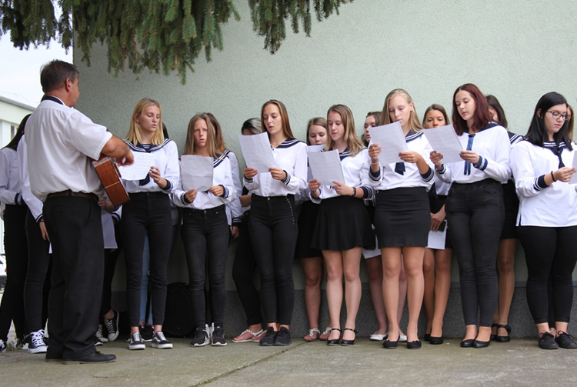
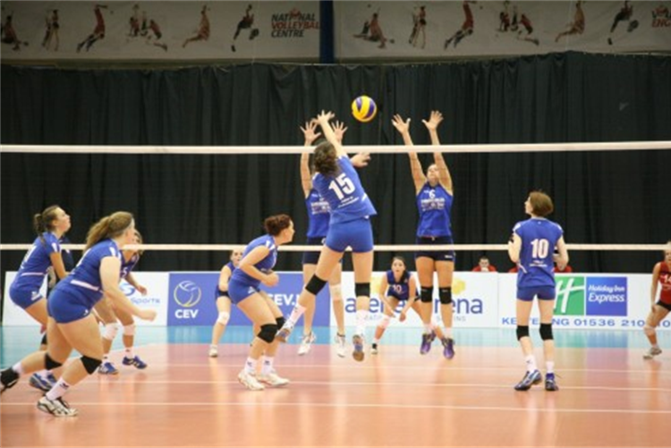
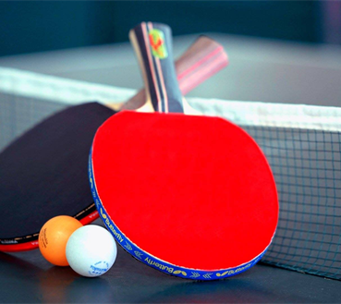


Community and sport activities
choir
volleyball
table tennis
basketball
football

Slide 7
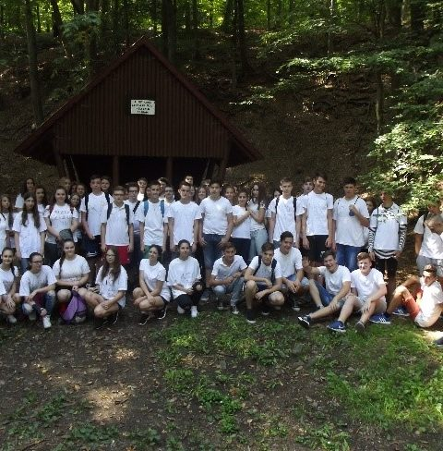
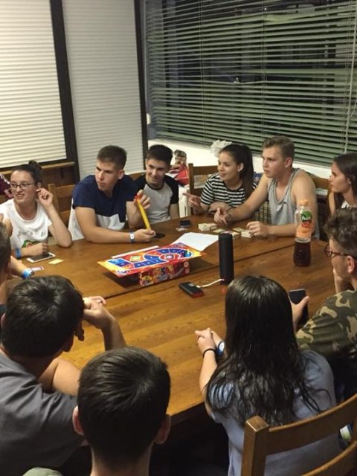
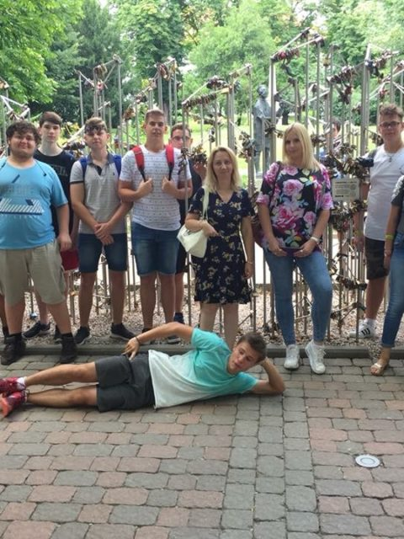
Camps
Freshers’ camp
English language camp

Slide 8
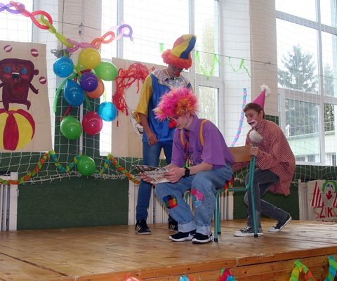
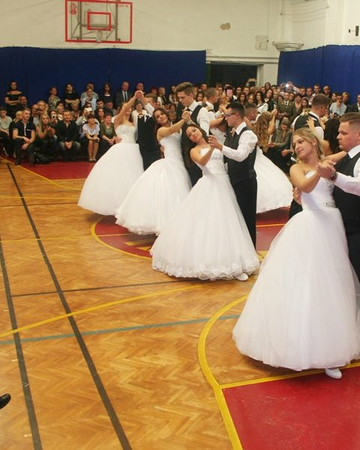
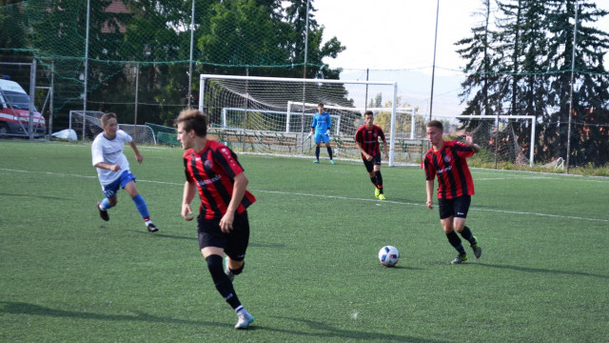
Annual events
Freshers’ day
School leavers’ ball
students’ day

Slide 9
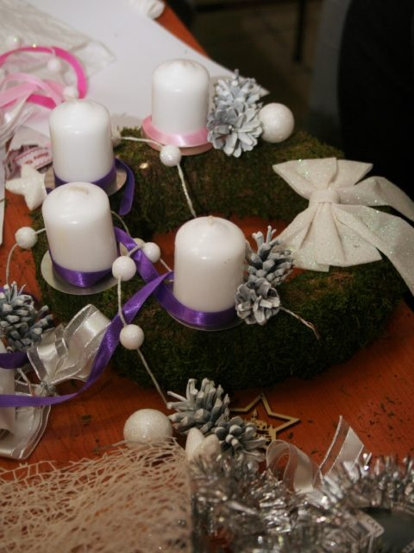
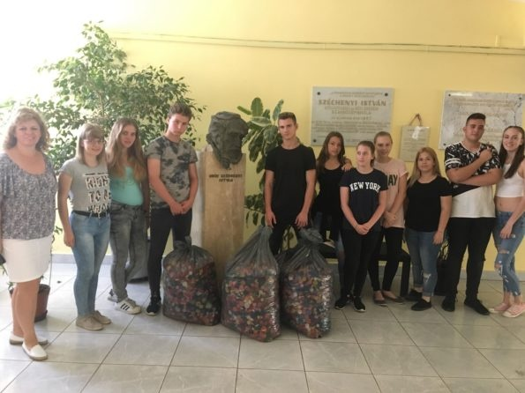
Competitions
wreath-making
Charity activities

Slide 10
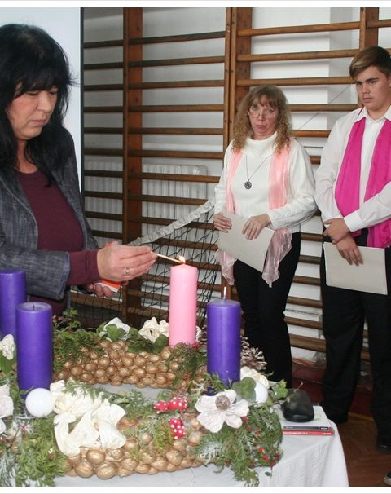
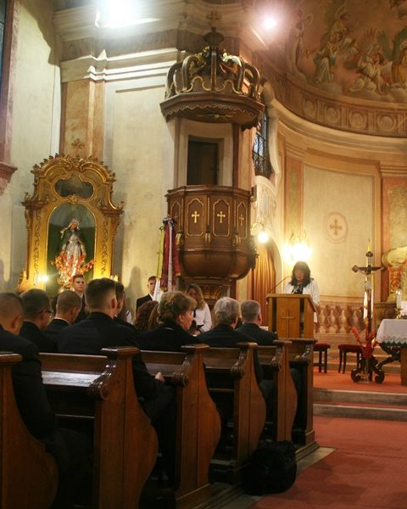
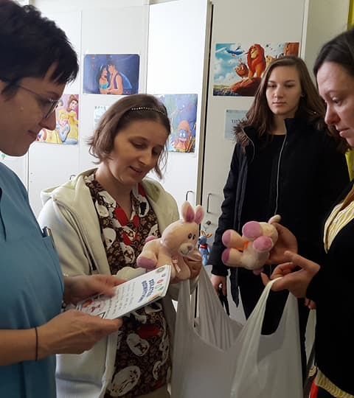
Religious life
Advent
attending a service
donations

Slide 11
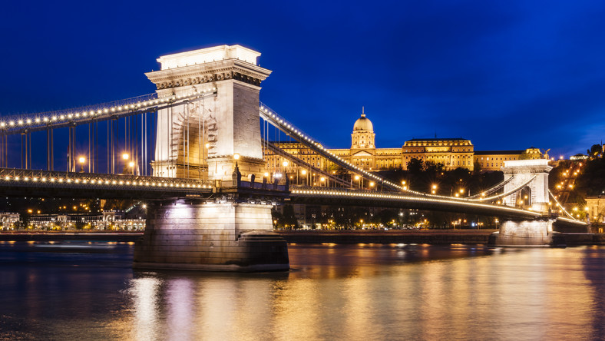
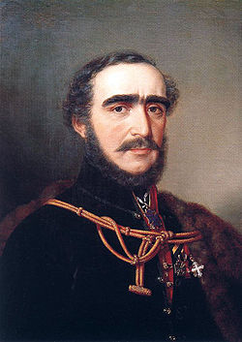
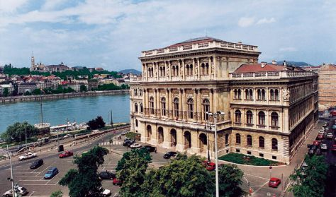
Széchenyi István
Chain Bridge
Hungarian Academy of Sciences

Slide 12
Thank you for your attention ☺

