Slide 1




PROJECT NAME: “LOG IN BACK THE REAL LIFE”
PROJECT NUMBER:
(2022-1-HU01-KA220-SCH-000087324)
PROJECT PARTNER:
ARDA BERATUNG & BILDUNG
https://www.ar-da.de/english-en/
E-Mail: info@ar-da.de
PROJECT COORDINATOR:
Dr. SUSAM DÜNDAR IŞIK
PROJECT ASSISTANT: Dr. KEMAL IŞIK
Funded by the European Union. Views and opinions expressed are however those of the author(s) only and do not necessarily reflect those of the European Union or the European Education and Culture Executive Agency (EACEA). Neither the European Union nor EACEA can be held responsible for them

Slide 2

Project name: Log in Back the Real Life
SOCIAL MEDIA LITERACY AND ITS APPLICATIONS IN EDUCATION

Slide 3


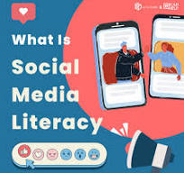


Project name: Log in Back the Real Life
SOCIAL MEDIA LITERACY AND ITS APPLICATIONS IN EDUCATION

Slide 4
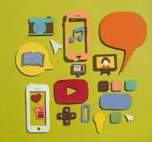
Table of Contents
General information about social media literature
Why do we need to learn social media literature?
How can we apply social media literature to education?
Case study

Slide 5
General Information on Social Media Literature
Social media literature
Definition:
Digital world:
We are in the twenty-first century. Our world is constantly changing
Social media: It includes all digital and online platforms, websites and applications that allow people to create, share and access content and information in the form of text, images, videos and picture
Today, social media is used by more than 4.62 billion people, and more and more join social media platforms every day (datareportal, 2023).
It is becoming particularly popular among children and adolescents who use social media to communicate, entertain themselves, educate and inform themselves, and stay politically active. Due to the widespread use of social media and how dangerous it can be, it is important to learn how to use social media in a healthy and safe way. This includes learning about social media literacy and acquiring social media literacy skills.
The impact of digital technology: It has changed the way we
live, work, communicate and receive information.

Slide 6
General Information on Social media Literature
Social media
Definition:
Different social media platforms can be divided into two types: 1. Social media used primarily for communication, such as WhatsApp or Signal
2. Social media used such as Instagram or Facebook, used primarily to disseminate content to a global audience. But all social media platforms can be used to spread information, opinions and other information.
Through social media platforms, people can interact and communicate with each other, and write messages to each other regardless of time and place. Today, social media is deeply embedded in our society and plays a role in healthcare, politics, activism, education and sports.

Slide 7
General Information on Social media Literature
Social media
Definition:
Social media is constantly accessible from all over the world and by anyone with access to the internet.
The wide variety of social media platforms means that social media can be used for many different purposes.
It means that people will communicate with each other; this can help maintain friendships, find jobs, raise awareness, access information and news from around the world, learn about cultural differences, and more.
On the other hand, this also means that people can constantly harass others, spread stereotypes and rumors, spread misinformation, use social media to promote their personal ideologies, deceive and defraud people, and much more.
Social media has certain known features and each has its advantages and disadvantages.

Slide 8
General Information on Social media Literature
Social media literacy
Definition:
Social media literacy is based on the concept of media literacy.
Media literacy is the ability to access and analyze media messages, create, reflect and take action using the information and communication tools created by the media.
Social media literacy centers the user as an individual and
users:
- Interactions with each other
- Their choices regarding the use of social media platforms,
- What they use social media platforms for and
- Values that affect other users.
In doing so, the evolving nature of social media and the ever-changing possibilities of social media are taken into account.
This can be applied to social media, including platforms such as WhatsApp, Instagram, Facebook and YouTube.

Slide 9
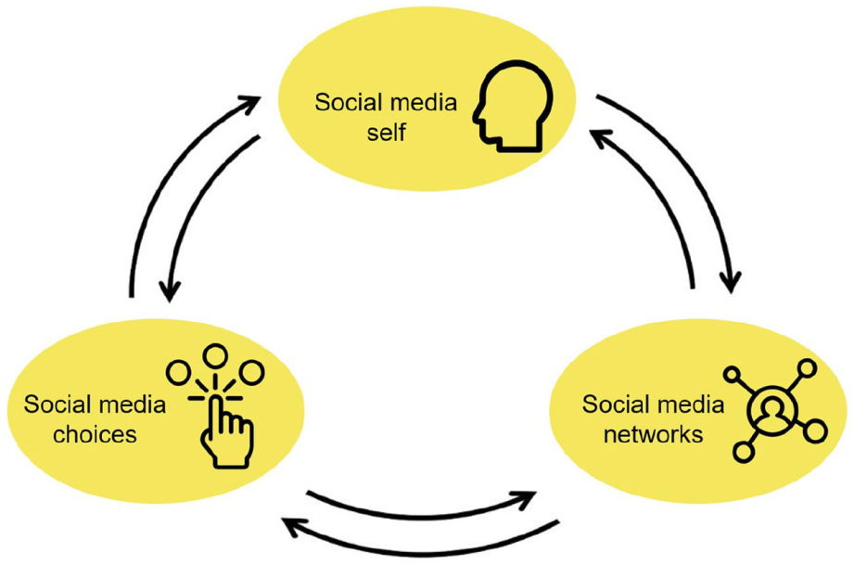
General Information on Social media Literature
Social Media Literacy Concepts
Social media user (Social media self):
Information about the person's motivations, choices, social media networks, and interactions.
Since social media is a platform where people can behave differently than in real life, the user's real
Generally, social media users are clear about their motivations and interests.
Areas of interest are recommended to them due to digital algorithms
Thus, users receive increasingly personalized media content

Slide 10

General Information on Social media Literature
Social Media Literacy Concepts
Social media bubble:
It also affects the user, causes certain ideas to settle in minds, and can sometimes even lead to radicalization. To avoid this, you can actively seek out content outside the bubble to expose yourself to different perspectives and opinions.
Different social media platforms; digital, online, web and application
Social media platforms are private property: Content available on the social media platform can be removed (hate, racist, sexist, exclusionary, hostile words).
Social media literacy: A real and very important issue. (to avoid distortion of reality on social media; learning to determine the reality behind the content that can be seen on social media platforms. This can be best done by comparing different sources and the perspectives and information they provide).

Slide 11
How can we apply social media Literacy to eduction?
1. Communication and Interaction: Teachers can communicate with students and engage with them through social media platforms. They can answer students' questions, share course materials, and encourage discussions.
2. Sharing Learning Resources: Teachers can share additional resources and materials related to the course through social media, allowing students to access more information and support their learning process.
3. Announcements and Reminders: Social media platforms can be used by teachers to make announcements related to the course or remind students of important dates. This can include deadlines for assignments, exam times, or changes in the schedule.
4. Engaging Content: Teachers can use social media to make course materials more engaging. For example, they can share educational videos, interactive infographics, or interesting articles to capture students' attention.

Slide 12
How can we apply social media Literacy to eduction?
5. Building a Community:
Social media can be a great tool for building a sense of community among students. Teachers can encourage collaboration and discussion within the class and facilitate communication between students.
However, it is important to consider some precautions when using social media.
Privacy concerns, security issues, and maintaining professional boundaries are important factors to consider. Therefore, teachers should be mindful of these issues and follow appropriate policies when using social media in their classes.

Slide 13
Effects of Social Media Literacy on Social Media Addiction
The findings of various studies show that social media literacy has a positive effect on social media addiction. (Eskandari and Baratzadeh Ghahramanloo, 2020).
In other words, increased social media literacy is linked to both decreased social media addiction and increased social support.
People who are media literate are better able to control how they interact with and use the media.
It is imperative to highlight the possible risks posed by social media and the internet to individuals, especially minors and students. A person's perceived level of anxiety, behavioral problems, depression, hyperactivity, and poor physical health are positively associated with time spent online, while quality of life is negatively associated (Machimbarrena et al., 2019; El Asam et al.; Twenge et al., 2016)

Slide 14
Social Media Literacy Competencies
The information age, where digital platforms have become an integral part of communication, education and social interaction, social media literacy has emerged as a critical skill set. Social media literacy has three core competencies: analysis, evaluation and contribution.
Analytics is the ability to observe and monitor the social media behavior of different people. This includes social media platforms used, social media content viewed, consumption patterns and interactions with other users.
Evaluation is the ability to, using what has been, a person's personal beliefs, values and experiences, which are the reasons behind internet use, and the ability to understand and interpret the content viewed.
Contribution includes content that one creates and shares across different social media platforms.

Slide 15
Social Media Literacy Competencies
The first important concept is the value of privacy. As individuals share various aspects of their lives on social media, understanding privacy settings and managing personal information becomes important.
The second vital competency is critical thinking. Students should be able to distinguish correct information from incorrect information. It is equally important for students to ask the following questions: For example, who benefits from such messages, who is harmful to them, who is most directly affected, who has the most expertise on this subject? counter arguments or other points of view?
Risk of sharing personal information online: Your digital footprint is the trail of information you create every time you use the internet. For example, when you buy something online, subscribe to a newsletter, post something on social media, or leave a review online, you leave a digital footprint.
Active digital footprint: Sharing the user's personal information on social media, all posts by a user accessing the website, subscribing to the newsletter, accepting cookies in the browser and filling out an online form are other actions that create an active digital footprint.
Passive digital footprint: Information collected about a user without their knowledge is called passive digital footprint. This happens, for example, when websites track a user's IP address, location, and frequency of page visits. The user may not always be aware of this process because it occurs secretly. Social media platforms and advertisers who create your profile using your likes, shares, and comments and target you with specific content are other examples of passive footprint.

Slide 16
What Should Teachers and Parents Keep in Mind
When Teaching Social Media Literacy to Children?
Online privacy
The importance of protecting personal information:
Create a strong password for yourself and your student
Even though it can be troublesome, avoid using the same password for multiple services!
Only if you have to, save the password somewhere safe, instead of on paper, on your computer, wallet or calendar if possible. The same goes for smartphones and PCs: do not create unencrypted, unprotected files that strangers can easily access.
Third, online security needs to be known to students. Students should be aware of common threats such as phishing, cyberbullying, and identity theft.
Finally, cultural competence and diversity are very important concepts to know. Social media literacy requires the ability to navigate this diversity in a respectful and inclusive way. Students, and to some extent users, must be aware of cultural nuances, avoid perpetuating stereotypes, and engage in constructive dialogue that promotes understanding and empathy between different backgrounds.

Slide 17
General Information on Social media Literature
Critical thinking: Critical evaluation of online content; children should ask themselves the following questions:
Critical thinking: Critical evaluation of online content; children should ask themselves the following questions:
- Who created this?
- Why did they create the content?
- Who is the content for?
- What techniques were used to make the content credible?
- Was something left out?
- How does the content make you feel

Slide 18
Everybody who is subjected to bullying eventually experiences physical or psychological complaints, such as difficulty sleeping, incessant headaches, nausea, or anxiety about leaving for work. Eventually, every victim of ongoing psychological violence becomes unbalanced. Bullying can cause long-term trauma and the development of post-traumatic stress disorder in its victims, much like it can in victims of major accidents, crimes, or natural disasters. This can show up as anxiety, depression, repressed or excessive anger, difficulty concentrating, sleep disturbances, or helplessness.
Cyberbullying awareness, examples and consequences the victims experiences

Slide 19
Cyberbullying can emerge in many forms:
- Cyberstalking, cyberthreat, social exclusion,
Posting offensive images
Online videos (happy slapping),
Flaming,
Bullying and harassment on a regular basis
Identity theft through impersonation, sending offensive or nasty messages via WhatsApp, SMS, or e-mail, posting unpleasant or hurtful images, videos, or comments in chat rooms, on websites, or on social media, making nasty or offensive phone calls and defamations.
Keep in mind that many small unpleasant details you or your students may not even be fully aware of can cause devastating feelings towards other people. Therefore, please raise awareness with regard to cyberbullying to prevent harm from your students and their pears and also other possible victims.

Slide 20
What Should Teachers and Parents Keep in Mind
Understanding Algorithms: What is an Algorithm?
Predefined, limited sequences of operations are called algorithms and are used to solve problems
Converting input values to output values
Steps are performed in a predetermined order
Algorithms are also used in mathematics and computer science, as well as in a variety of real-world applications such as elevator call functions and traffic lights, search engines or recommended content on social media. (Udupa and Samarasekera, 1996).

Slide 21
How algorithms on social media create a personal information bubble
Social media platforms want to keep their users online for as long as possible because the longer a user stays online, the more ads they watch, leading to greater revenue for the social media platform. Therefore, their algorithms determine what kind of content the user likes and dislikes. It uses the predicted emotional response to continue capturing the user's attention. All emotional responses, except sadness, with anger being the most effective, trigger a user to stay online longer. When a user feels sad, they are more likely to go offline.
Reading and sharing content: It is very important that you teach your students not to disclose private information by posting content on social media. This also includes posting photos of you and your friends without their permission. You should always ask for permission when publishing other people's personal information and avoid doing so whenever possible. Respecting the privacy of others is crucial to prevent possible identity theft or misuse of published content by malicious individuals, for example to bully victims..

Slide 22
Adult involvement
If students feel uncomfortable in any way or do not know what to do, they should contact a trusted adult. Since the psychological repercussions of cyberbullying are very severe, it is very important that you convey this message to your students in an appropriate but firm manner. It is vital that they seek help to stop bullying as quickly as possible. Both the social development and academic outcomes of the victim suffer from cyberbullying and their quality of life is significantly reduced. Please tell your students that they are not alone and need help. You should also tell them that there is no shame in seeking help; Because some may think that asking for help is a sign of weakness, when in fact it is a sign of courage and should be praised.

Slide 23

Questionnaire to Assess to what Extent Pathological Internet Addiction Is Exhibited
Why might cyberbullying occur frequently in schools?
The following questionnaire can be used by teachers as a tool to assess to what extent their students may suffer from pathological internet addiction. In this case, it is advised to seek professional medical and psychological help. The higher the accumulated points are with regard to the answers given, the more likely it is that the person taking the questionnaire exhibits some form of pathological internet addiction (Nazir et al., 2019).
Answer scale 1-5 (score 1 = never, 2 = rarely, 3 = sometimes, 4 = often, and 5 = always).
1. When I am not at school, I spend a lot of time using my device.
2. I feel the need to spend more time using my device.
3. feel upset when I am not able to use my device.
4. I lie to my parents about the amount of time I spend using my device.
5. Using my device helps me to forget my problems.
6. I do not spend time with my family members because I prefer using my device.

Slide 24
Questionnaire to Assess to what Extent Pathological Internet Addiction Is Exhibited
Why might cyberbullying occur frequently in schools?
7. I have spent more and more time on my device.
8. I feel upset when I am asked to stop using my device.
9. My parents try to stop or limit me using my device, but they fail.
10. I am sleeping less because I am using my device.
11. When I do not have my device, I think about what I do on it (video games, social media, and texting, etc.).
12. I feel frustrated when I cannot use my device.
13. I have problems with my parents about the amount of time I spend using my device.
14. Using my device is the most important thing in my life.
15. Using my device is more enjoyable than doing other things.
16. I lie to my parents about what I do on my device.

Slide 25
Questionnaire to Assess to what Extent Pathological Internet Addiction Is Exhibited
Why might cyberbullying occur frequently in schools?
17. I am not able to control using my device.
18. I have lost interest in hobbies or other activities because I prefer using my device.
19. When I stop using my device, it is not long before I start using it again.
20. check my device when I am doing homework or other important things.
21. I feel frustrated when I am asked to stop using my device.
22. I argue with my parents when they ask me to stop using my device.
23. I spend too much money on things for my device.
24. Using my device makes me feel better when I feel bad.
25. I continue using my device despite the fact that my grades at school are getting lower and lower.

Slide 26
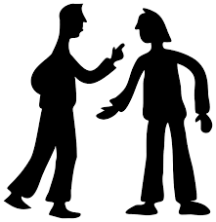
Safe Social Media Using Lessons Plans
Lesson Plan 1: "Safe Social Media Use and Digital Citizenship“
Lesson Plan 2: "Developing Critical Thinking in Social Media Literacy“
Lesson Plan 3: "Empathy or Navigating Empathy in a Digital World“
Lesson Plan 4: "Social Media Literacy "

Slide 27
Case Study - Sarah
Cyberbullying Response
Regulating the Conflict
Background: Sarah, a 14-year-old student, was being cyberbullied on a social media platform. Classmates would post hurtful comments about her appearance, causing emotional distress.
Discussion questions: Ask the class how they would feel in his situation. What should Shanna do next? What potential reasons might the person who wrote this message have for posting it?
Intervention: Learning about the situation, the teacher started a discussion in the classroom about cyberbullying. The teacher educated students on the consequences of their online actions and the importance of empathy. The teacher also reported the incident to the school administration and assigned a counselor to provide support to Sarah.
Solution: This intervention resulted in increased awareness of cyberbullying among students. The class collectively developed a commitment against cyberbullying, cultivating a more supportive online environment. Sarah received emotional support and ongoing discussions about digital citizenship and empathy took place at school.

Slide 28
Case Study - Sarah
Digital Footprint Awareness
Background: 16-year-old Alex was unaware of the permanence of digital footprints. Alex posted inappropriate content online and did not realize the potential impact this could have on college admissions and future opportunities.
Discussion questions: Ask the class if they have posted potentially dangerous content for future opportunities. What actions can Alex take to reduce the effects of his digital footprint? Are your students aware of their digital footprint? Is there a footprint that they are not aware of? Encourage constructive discussions among students and motivate them to question pre-existing beliefs to maximize the success of the course.
Intervention: The teacher taught a lesson on digital footprints, highlighting the long-term consequences of online behavior. Real-life examples were discussed in class, and students participated in activities to evaluate and organize their digital footprint. The teacher also contacted Alex privately to offer guidance on responsible online behavior.
Solution: Alex became more aware of the content shared online and actively worked to improve digital literacy. The school has implemented a digital citizenship curriculum that educates students on the importance of maintaining a positive digital presence.

Slide 29
THANK YOU FOR YOUR ATTENTION!

