Slide 1



„LOG IN BACK THE REAL LIFE”
Project ID: 2022-1-HU01-KA220-SCH-000087324
Funded by the European Union. Views and opinions expressed are however those of the author(s) only and do not necessarily reflect those of the European Union or the European Education and Culture Executive Agency (EACEA). Neither the European Union nor EACEA can be held responsible for them.

Slide 2
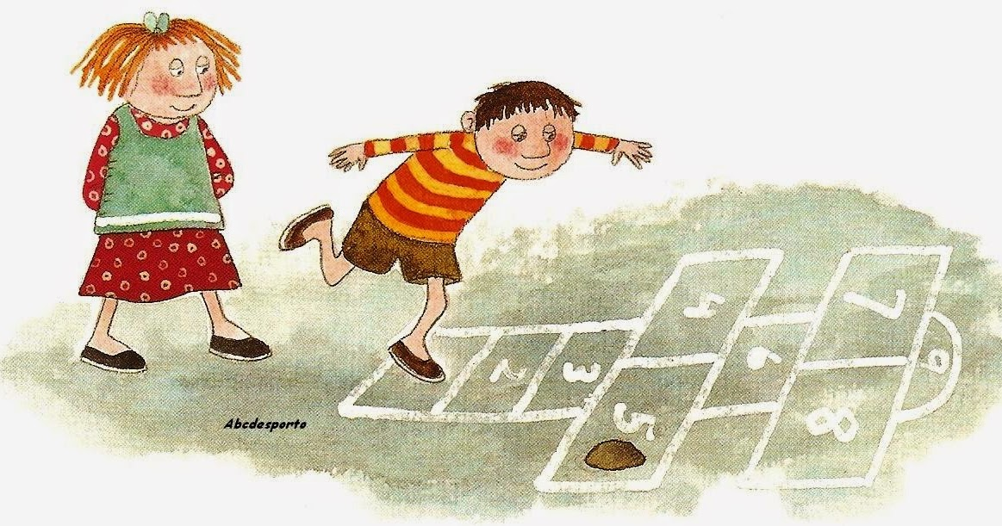
Rules
The route is done until the end and, on the way back, you have to pick up the stone in the station where it fell;
In the 4th and 5th stations, as well as in the 7th and 8th stations, you must step with one foot on each one simultaneously;
If the player becomes unbalanced, drops the stone or misses the intended station, he/she loses his turn.​

Slide 3
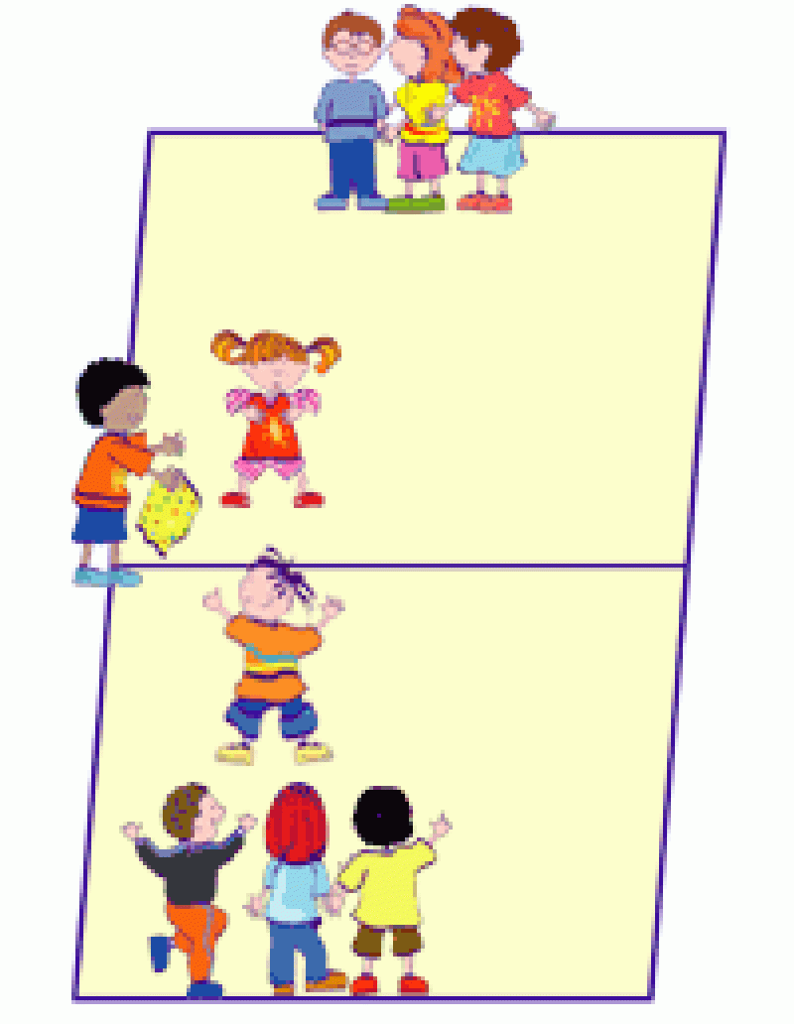
Rules
2
4
1
Divide the field into 2 equal parts;​
Choosing 1 player to carry the scarf. The player must be in the center of the field;​
Form 2 teams of 4 elements each;​
Each team must assign a number, from 1 to 4, to its players (in secret);
The bearer of the handkerchief calls for a number;​
The player, from each of the teams, with that number runs towards the handkerchief to try to grab it;​
Return with the scarf to your team;​
Cannot be touched by opposing players;
The game ends when all team members have participated, with the scarf holder shouting “Fire”.
3
3

