Slide 1



„LOG IN BACK THE REAL LIFE”
Project ID: 2022-1-HU01-KA220-SCH-000087324
Funded by the European Union. Views and opinions expressed are however those of the author(s) only and do not necessarily reflect those of the European Union or the European Education and Culture Executive Agency (EACEA). Neither the European Union nor EACEA can be held responsible for them.

Slide 2
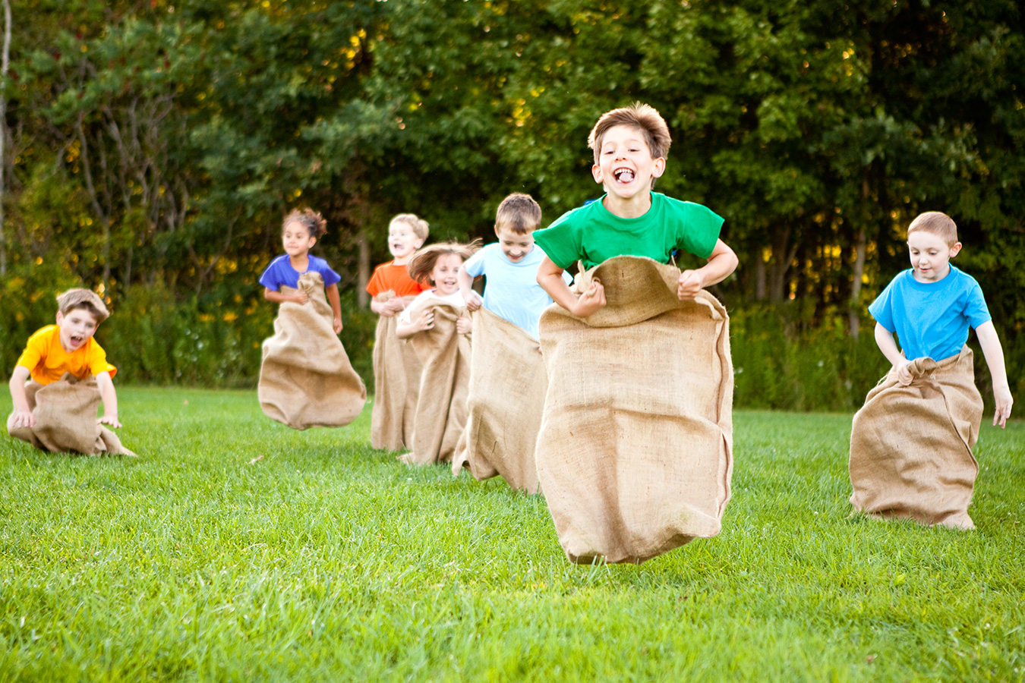


LOG IN BACK REAL LIFE

Slide 3
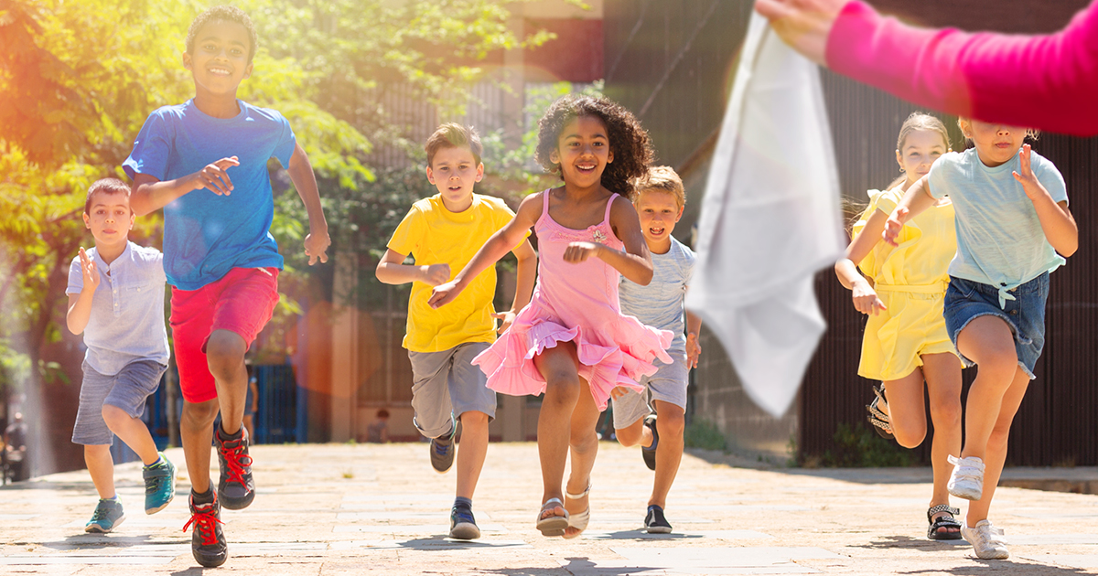
Scarf Bar Game

Slide 4
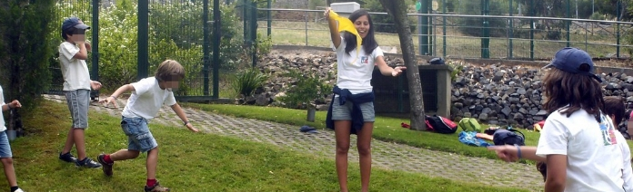
Scarf bar game
Very popular and traditional racing and chasing game.​
Objective:
Grab the handkerchief and return to the line marked at the bottom of the opponent's field or the team's own, without being touched by any opposing player.​
The team with the most points by the end of the game time wins.

Slide 5
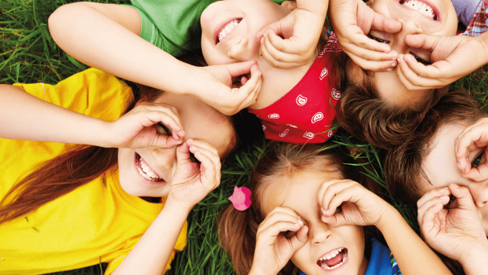




Benefits
Motor coordination;
Attention and memory capacity;​
Cooperation and opposition;​
Reaction speed in running and handling.

Slide 6
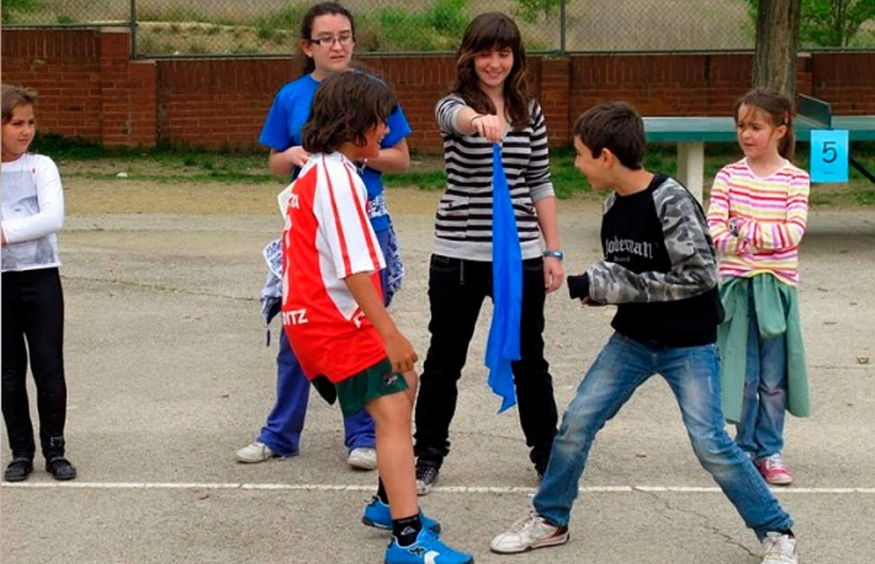
Description
Players: from 5 years on;
Material: handkerchief and chalk to mark the field;
Location: indoor or outdoors​.

Slide 7
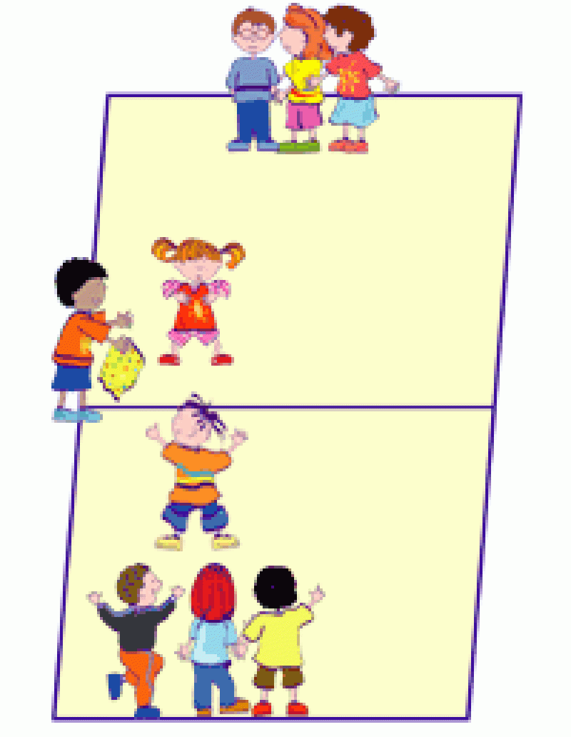
Rules
2
4
1
Divide the field into 2 equal parts;​
Choosing 1 player to carry the scarf. The player must be in the center of the field;​
Form 2 teams of 4 elements each;​
3
Each team must assign a number, from 1 to 4, to its players (in secret);
The bearer of the handkerchief calls for a number;​
The player, from each of the teams, with that number runs towards the handkerchief to try to grab it;​
3
Return with the scarf to your team;​
Cannot be touched by opposing players;
The game ends when all team members have participated, with the scarf holder shouting “Fire”.

Slide 8
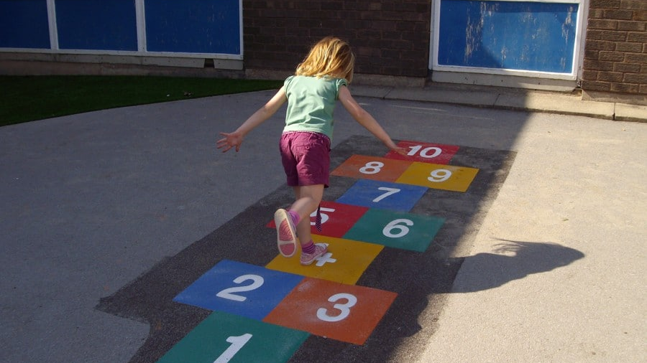
Hopscotch

Slide 9
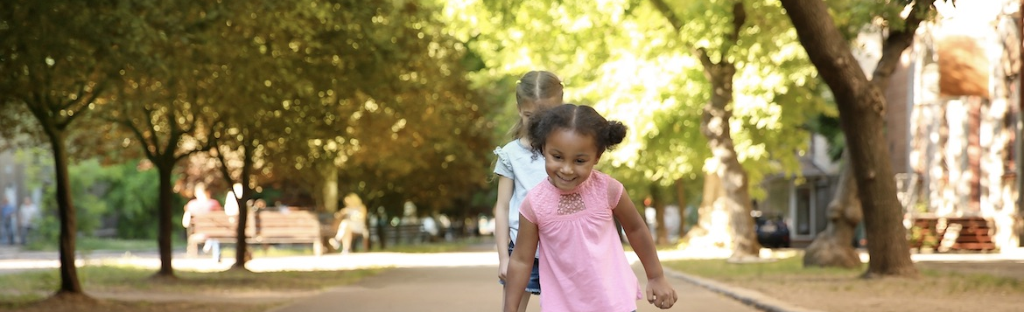



Hopscotch
Objective:
Jump with the foot over the stations;​
Pick up, without losing your balance, the stone that is on the ground.​

Slide 10
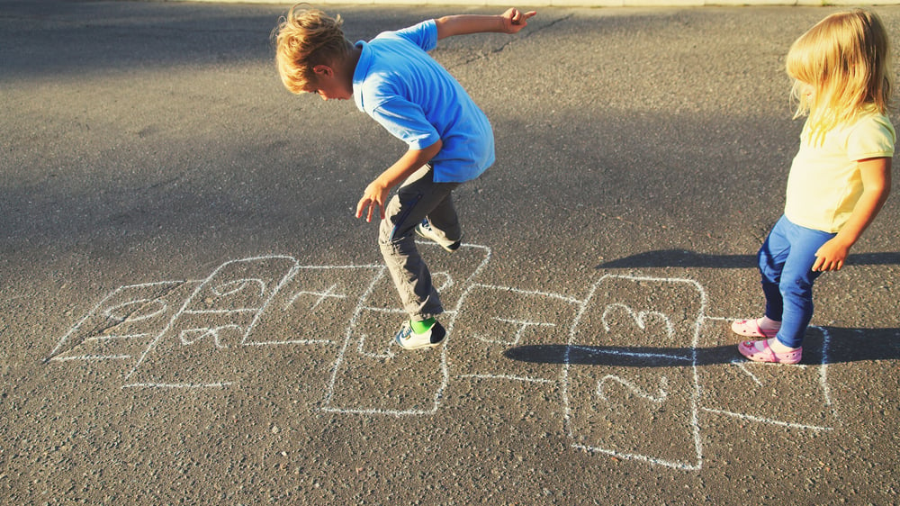
Benefits
Motor coordination;
Muscle strength
Interpersonal relationships

Slide 11
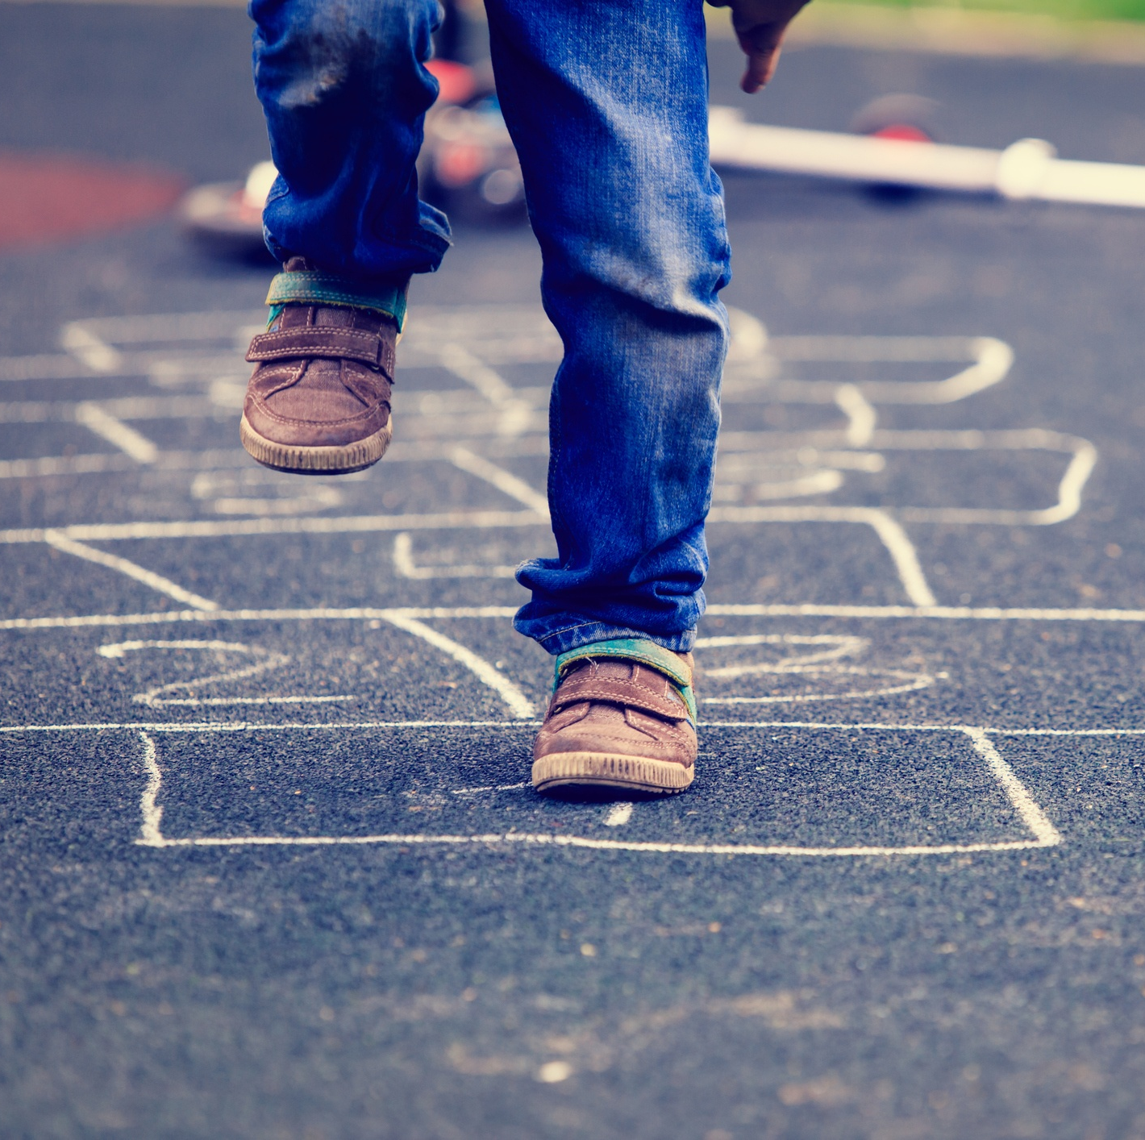
Description
Players: at least two, preferably over the age of 7;
Material: chalk stick to draw the station and a small stone;
Location: outdoor.

Slide 12
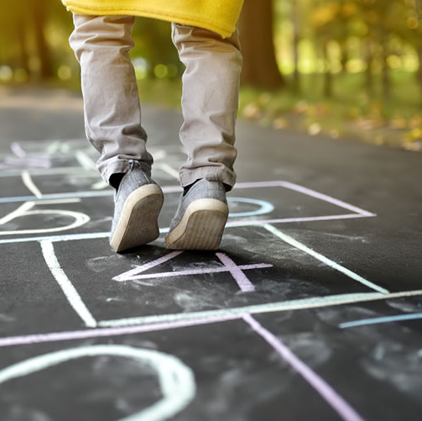
Rules
One of the players starts the game trying to hit the first station with the stone.
If they get it right, the player must jump from station to station, without stepping on the station with the stone.​
If the stone touches one of the lines of the station or goes out, the turn passes to the next player.​

Slide 13
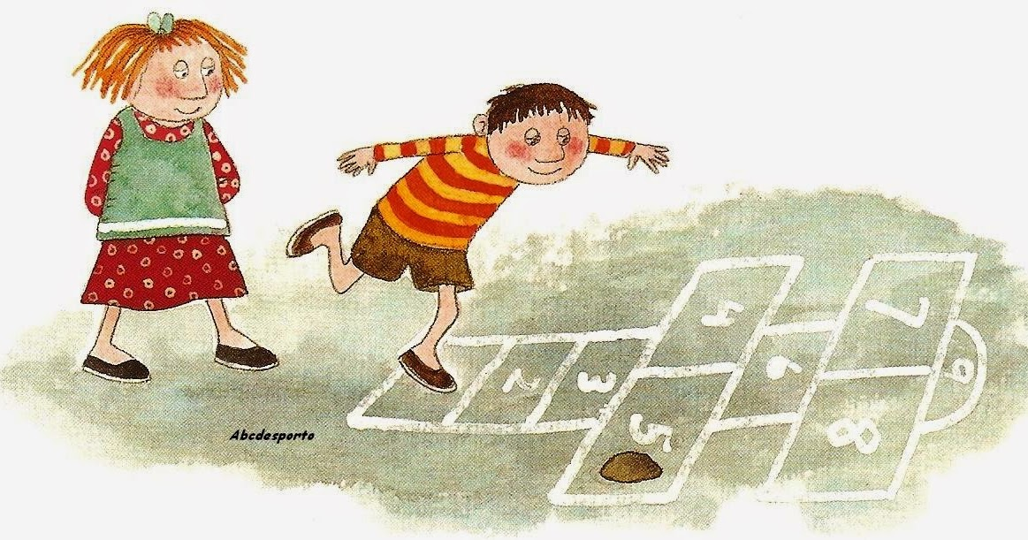
Rules
The route is done until the end and, on the way back, you have to pick up the stone in the station where it fell;
In the 4th and 5th stations, as well as in the 7th and 8th stations, you must step with one foot on each one simultaneously;
If the player becomes unbalanced, drops the stone or misses the intended station, he/she loses his turn.​

Slide 14
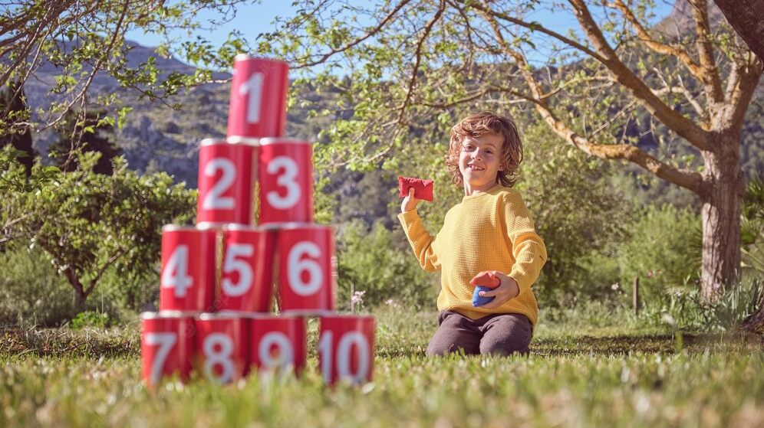
Can Knockdown

Slide 15
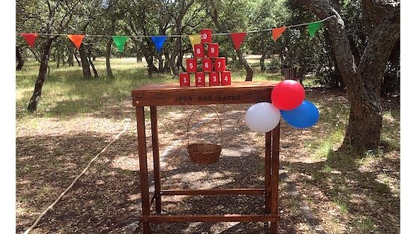
Description
Purpose: Is to place all the cans on the floor with the least possible throws.​
Age range: from 3 years on;
Material: A ball (plastic or fabric) and 10 cans;​
Number of participants: Minimum 2 players​

Slide 16
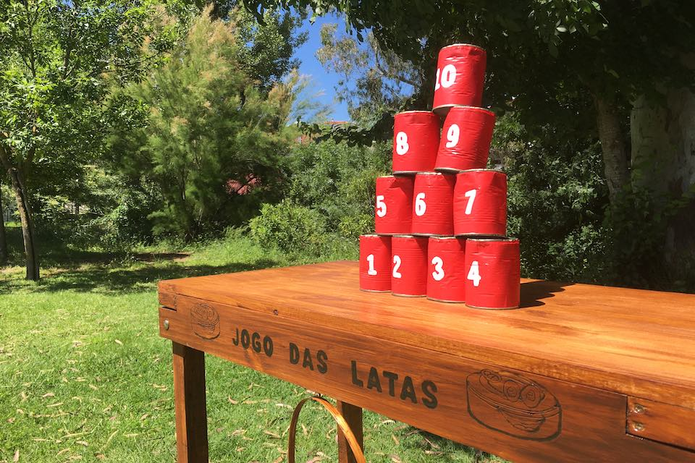
Benefits
Muscle strength;​
Spatial perception (distance, direction and precision);
Motor coordination.

Slide 17
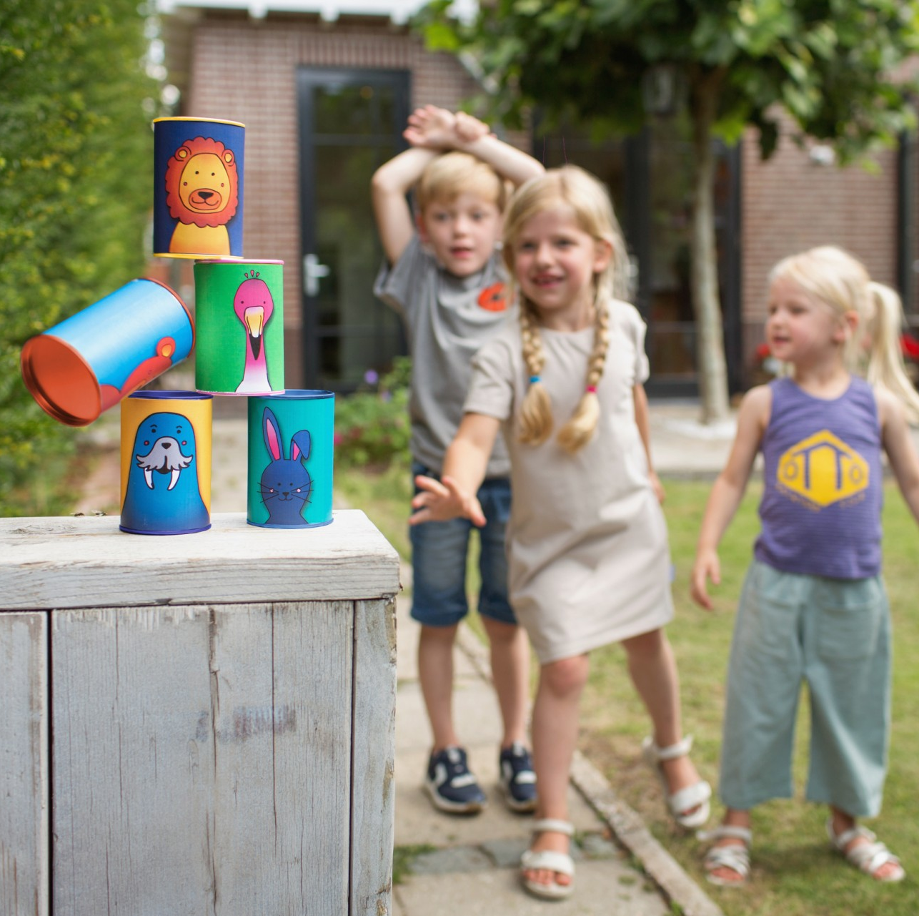
Rules
Arrange the cans in a pyramid shape; base should have four cans, on top three than two and last one
Make a line on the floor at least one meter away from the cans​;
Whoever manages to knock down the most cans wins.

Slide 18
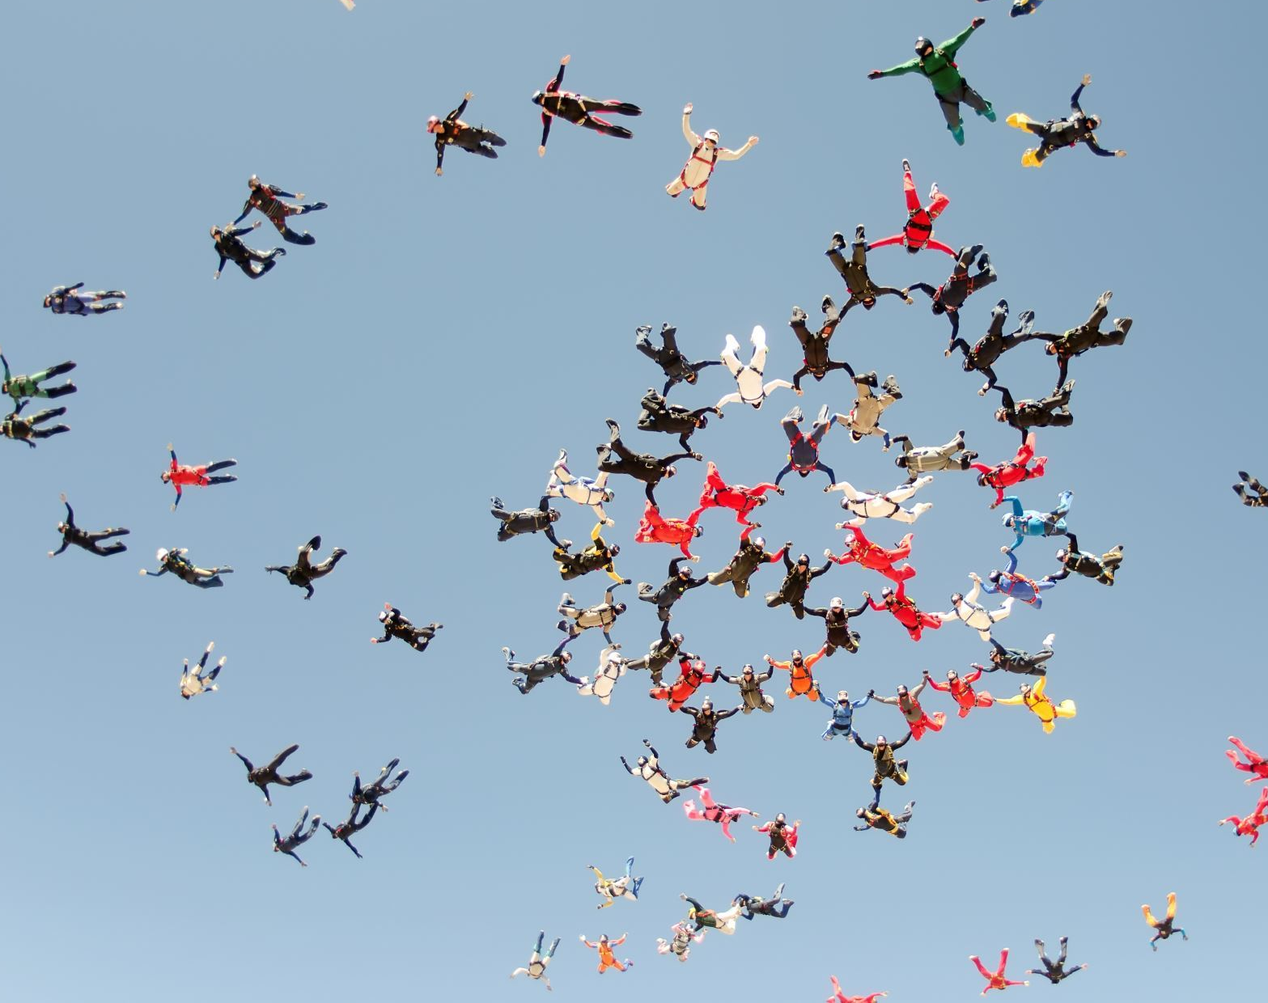
Conclusion
We hope you have understood a little more about the activities we talked about and that you will enjoy them as much as we do.
Now that we all know the roules let´s have some fun!!!
Thank you!

