Slide 1



„LOG IN BACK THE REAL LIFE”
Project ID: 2022-1-HU01-KA220-SCH-000087324
Funded by the European Union. Views and opinions expressed are however those of the author(s) only and do not necessarily reflect those of the European Union or the European Education and Culture Executive Agency (EACEA). Neither the European Union nor EACEA can be held responsible for them.

Slide 2

Outdoor activities in my country
Made by: Zsanett Gulyás and Antónia Varga

Slide 3


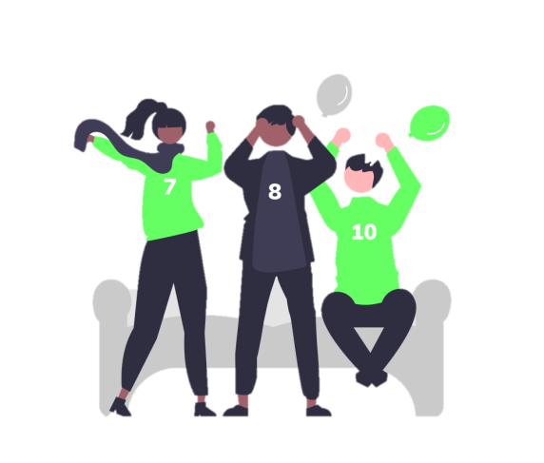

Hungary
Games
Activities
Sports
Programs

Slide 4






Sports in Hungary
Football/Soccer is the most popular among all genders and age groups.
One of the rarest sports to do is ice-hockey

Slide 5
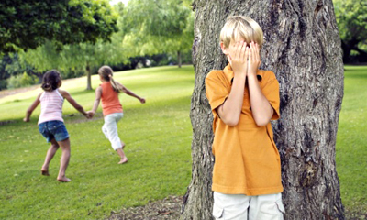
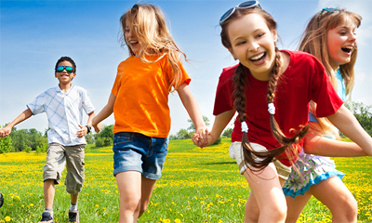
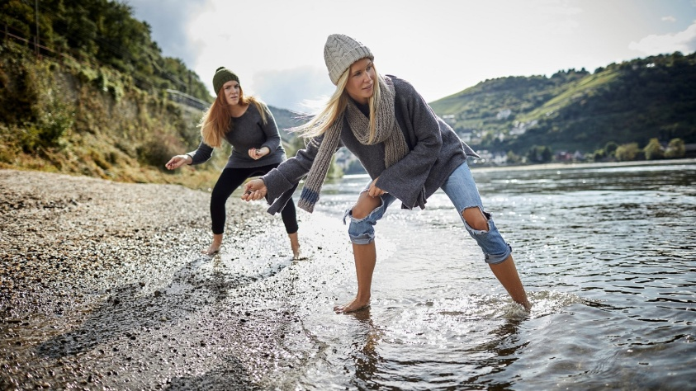
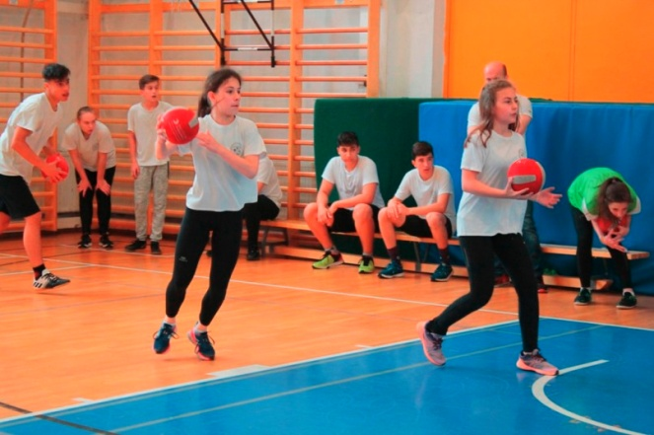
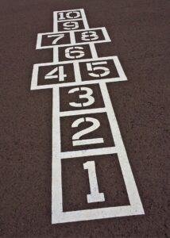
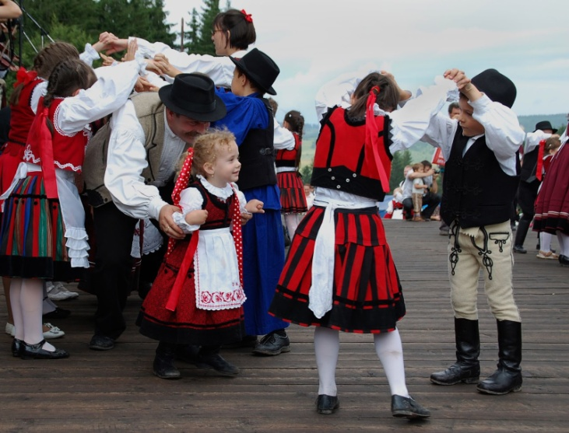
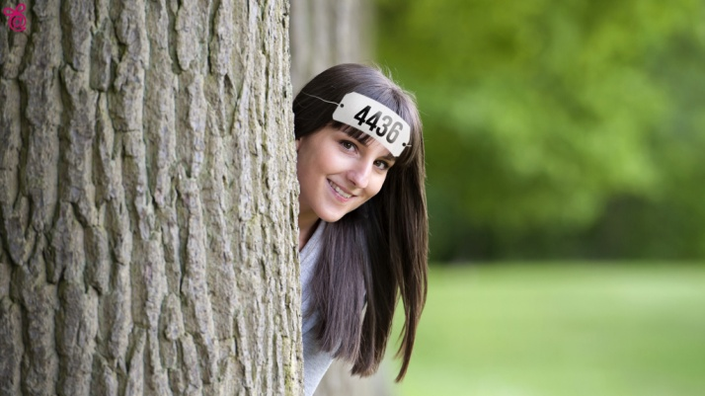
Popular games
Bújócska (Hide and Seek)
Fogócska (Tag)
Ipiapacs
Kacsázás
Kidobos (Dodgeball)
Ugróiskola (Hopscotch)
Számháború (War of Numbers)
Cicázás
Bújj Bújj Zöld ág

Slide 6
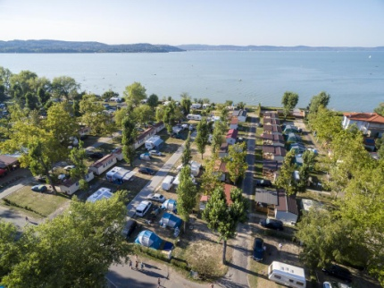
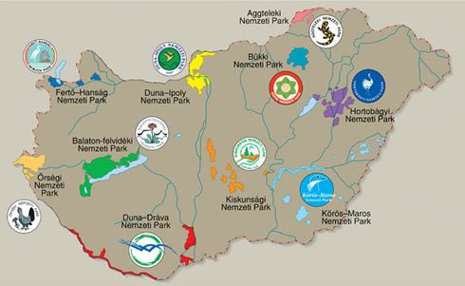
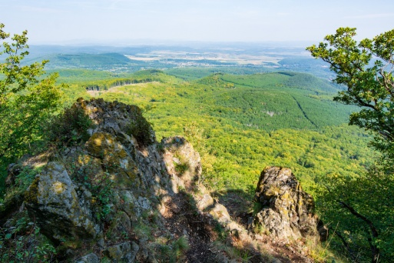
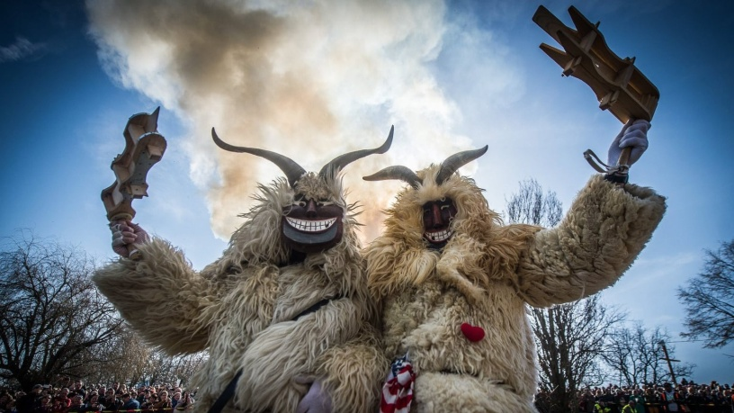
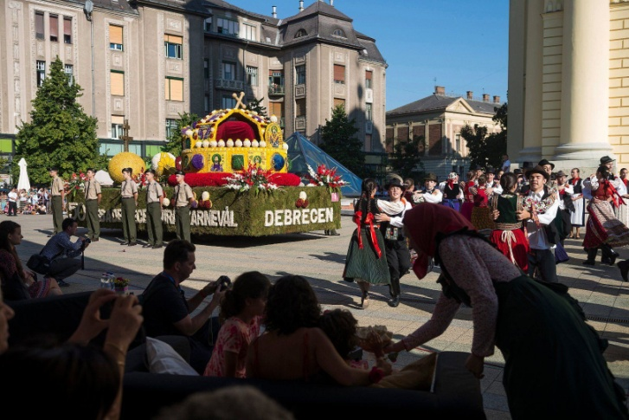
Activities you can do
Go camping:
Visit our national treasures:
In Mátra Mountains
Around the Lake Balaton
In holiday towns
National Parks
Cultural attractions
Go hiking in Mátra
Debrecen’s Flower Carnival
Sziget Festival
Busó Walking of Mohács
Take part in festivals:

Slide 7
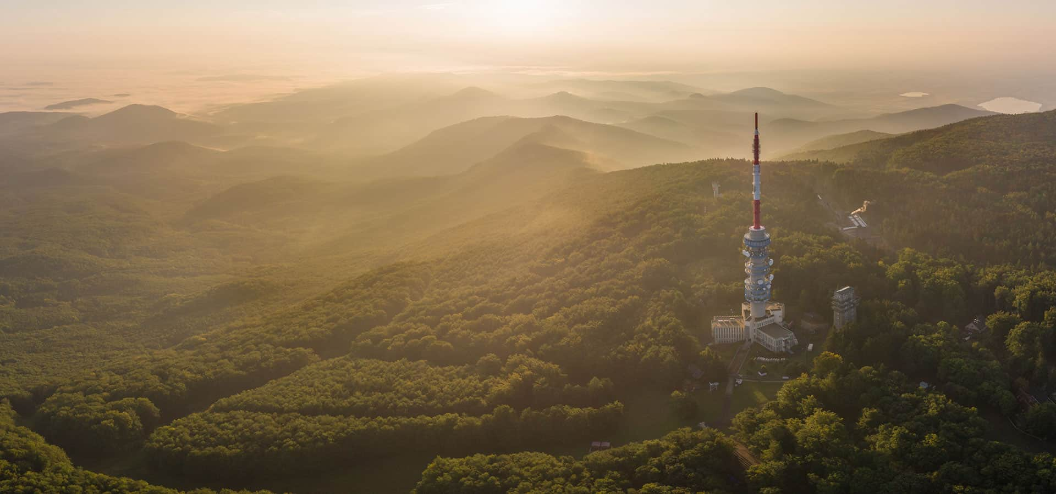
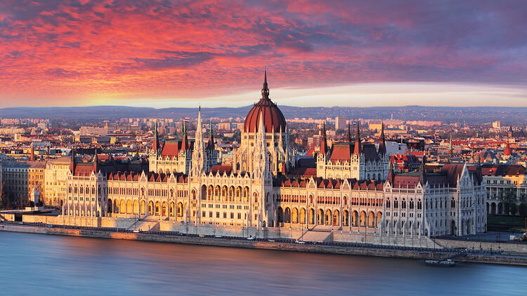
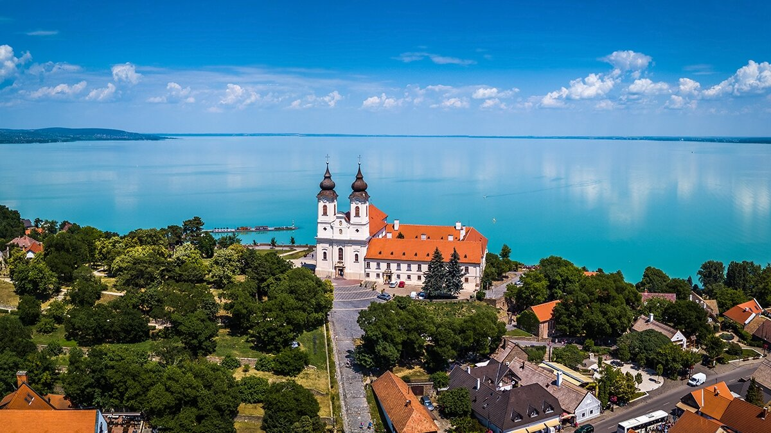
Programs to do in Hungary
Visit Budapest
Visit Lake Balaton
Parliament Building & Crown Jewels
Heroes' Square and the Millennium Monument
Buda Castle & Castle Hill
Fisherman's Bastion
Margaret Island
Budapest Zoo & Botanical Garden
Tihany Abbey
Badacsony
Sphere lookout
Hegyestű
Szentbékkálla Stone Field
Tagore Promenade in Balatonfüred
Visit Mátra
Oxygen Adrenalin Park
View Tower at Sástó
Kékes
Kisnána’s castle
Ski Park at Mátraszentimre

Slide 8
Thank you for your attention! ☺

