Slide 1



„LOG IN BACK THE REAL LIFE”
Project ID: 2022-1-HU01-KA220-SCH-000087324
Funded by the European Union. Views and opinions expressed are however those of the author(s) only and do not necessarily reflect those of the European Union or the European Education and Culture Executive Agency (EACEA). Neither the European Union nor EACEA can be held responsible for them.

Slide 2
NOSEDİVE
Is social media turning us into someone different?

Slide 3
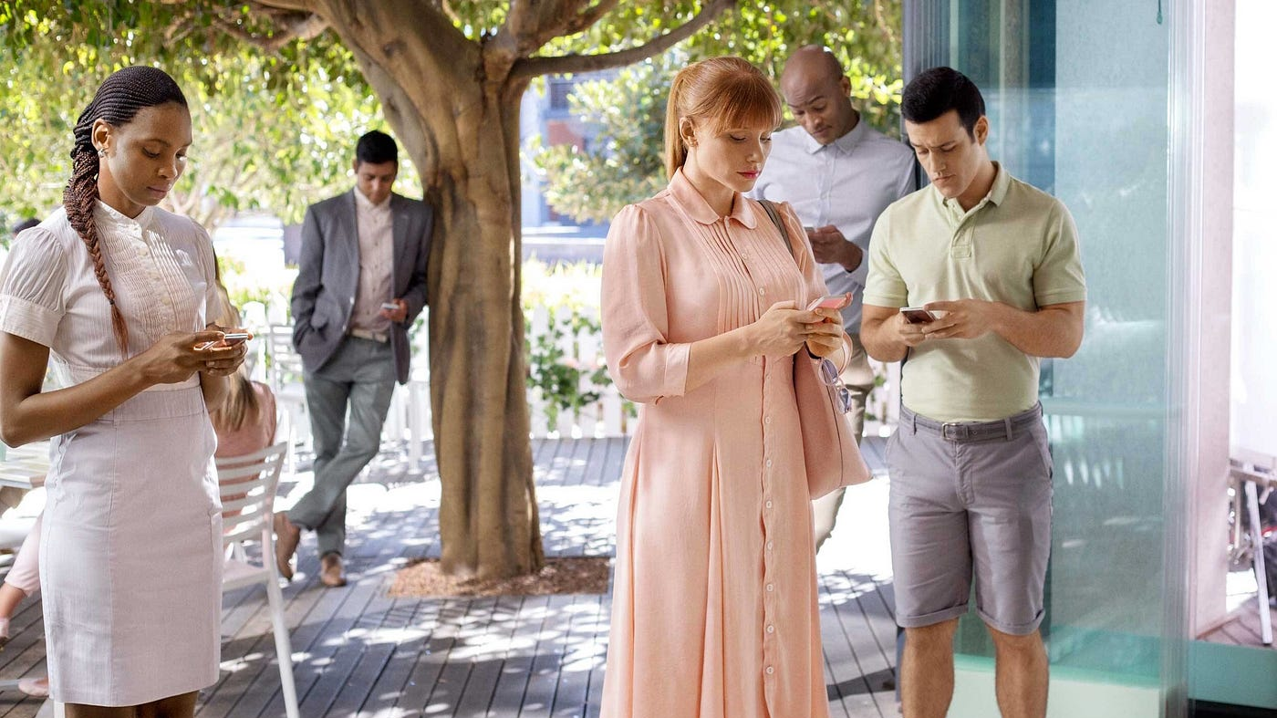
Nosedive is the name of the first episode of the third season of Black Mirror. Black mirror is a series that continued for five seasons about the harms of technology and how it affects our lives. Anthological, that is, each chapter has a structure that includes a different place, person and story.

Slide 4
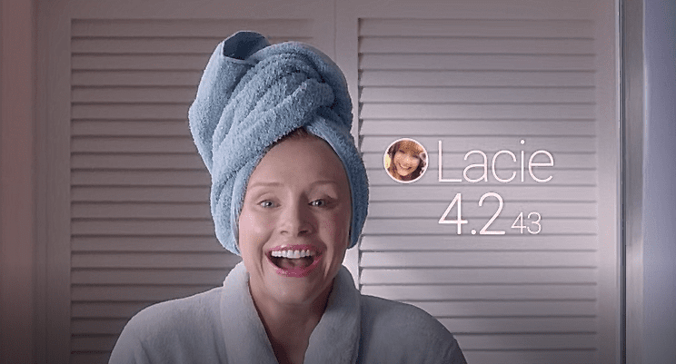
Our main character, Lacie, is a sweet and sympathetic young woman. In the world they live in, everyone has a technological lens and a phone-like device in their hands. With these devices, she sees how many points the person in front of him has on social media, between one and five. Our character Lacie has a score between 4.2 and 4.3, which makes him a normal person. Lacie's aim is to increase him score to 4.6 and move up to a higher status.

Slide 5
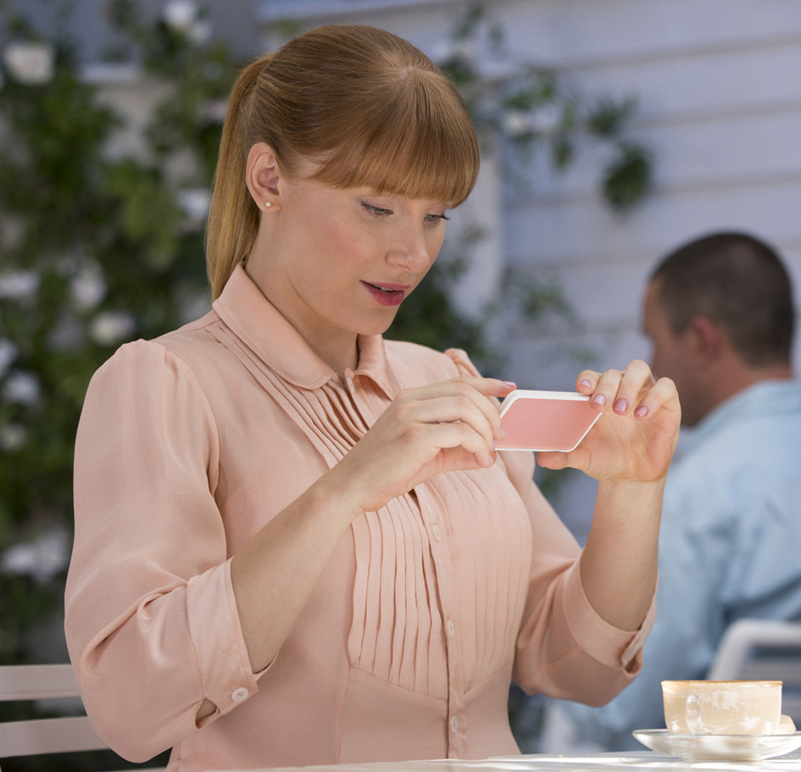
This purpose turns from want to need over time. Lacie becomes addicted to it.
She argues with her brother because her score is low, She does not help her friend in need, She buys coffee and cookies She doesn't like just to share on social media.

Slide 6
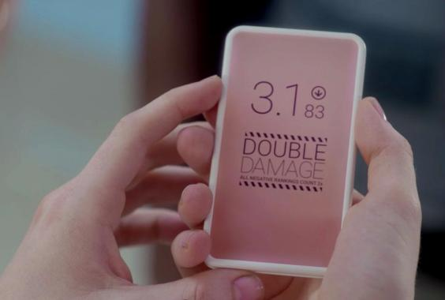
Lacie gets an opportunity to raise her score. She will give her old friend's wedding speech in front of people with high scores. Actually, the wedding is a long way from where Lacie lives, but she lies to her friend and tells her that she can come. Lacie wants to go by private plane, but her points are not enough by a small margin. Enraged by this incident, Lacie starts a fight and gets a penalty for deducting points. Her friend says that Lacie, whose score has decreased, should not come to the wedding, and the guests will be disgusted with her with this score.

Slide 7
Hearing this, Lacie has in mind to hit the wedding and make a good speech, get good points and return to her old score. Lacie is so addicted to the scores on social media that she committed dozens of crimes on her way to the wedding, pulled a knife on the security guards who tried to get herself out at the wedding, and lowered her score to 2.8
Lacie is imprisoned and the episode ends. She has fallen to the bottom because of her ambition to go up. Her friend used him for her score. People just judged him by her score, without thinking about what kind of person She was.

Slide 8
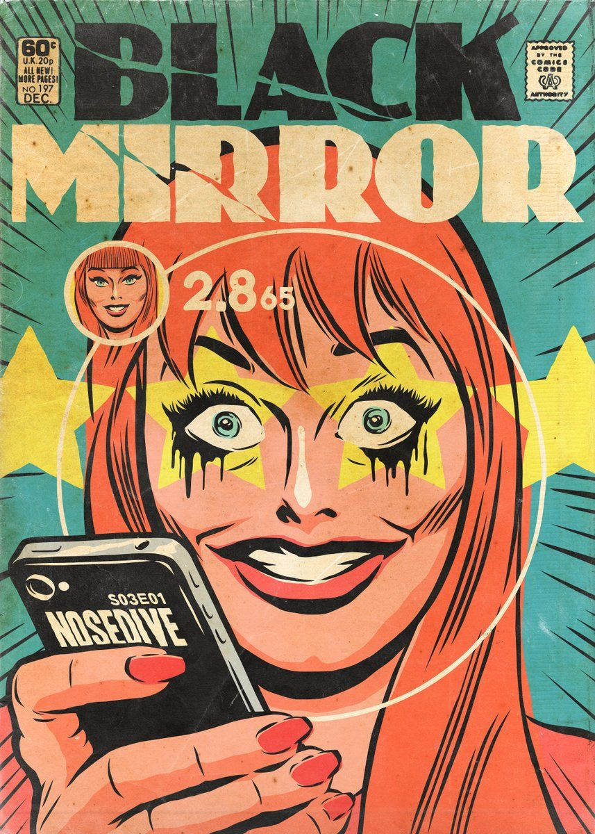
As for the question at the beginning of the presentation. At the beginning of the episode, a respectful happy person turned into someone who shouted and cursed at people because of her social media addiction. Yes, social media addiction turns us into a different person.

