Slide 1



„LOG IN BACK THE REAL LIFE”
Project ID: 2022-1-HU01-KA220-SCH-000087324
Funded by the European Union. Views and opinions expressed are however those of the author(s) only and do not necessarily reflect those of the European Union or the European Education and Culture Executive Agency (EACEA). Neither the European Union nor EACEA can be held responsible for them.

Slide 2

Made by: Julianna Horváth

Slide 3
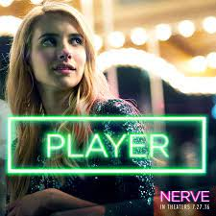
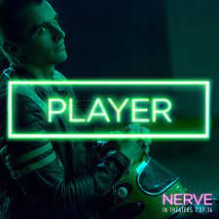
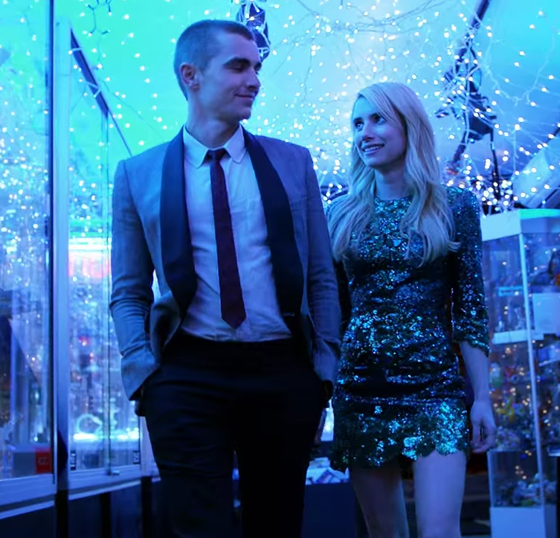


Characters

Slide 4
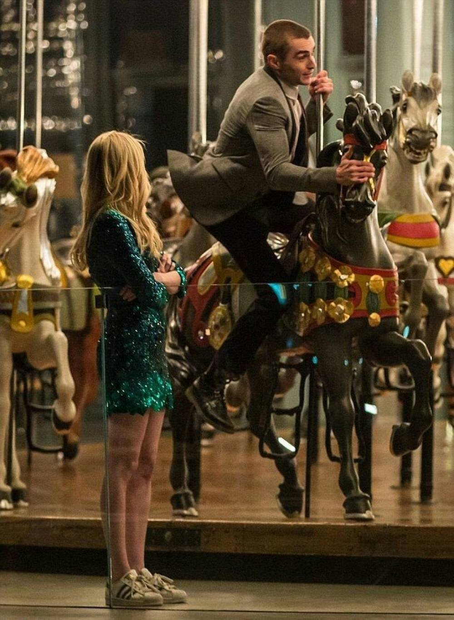
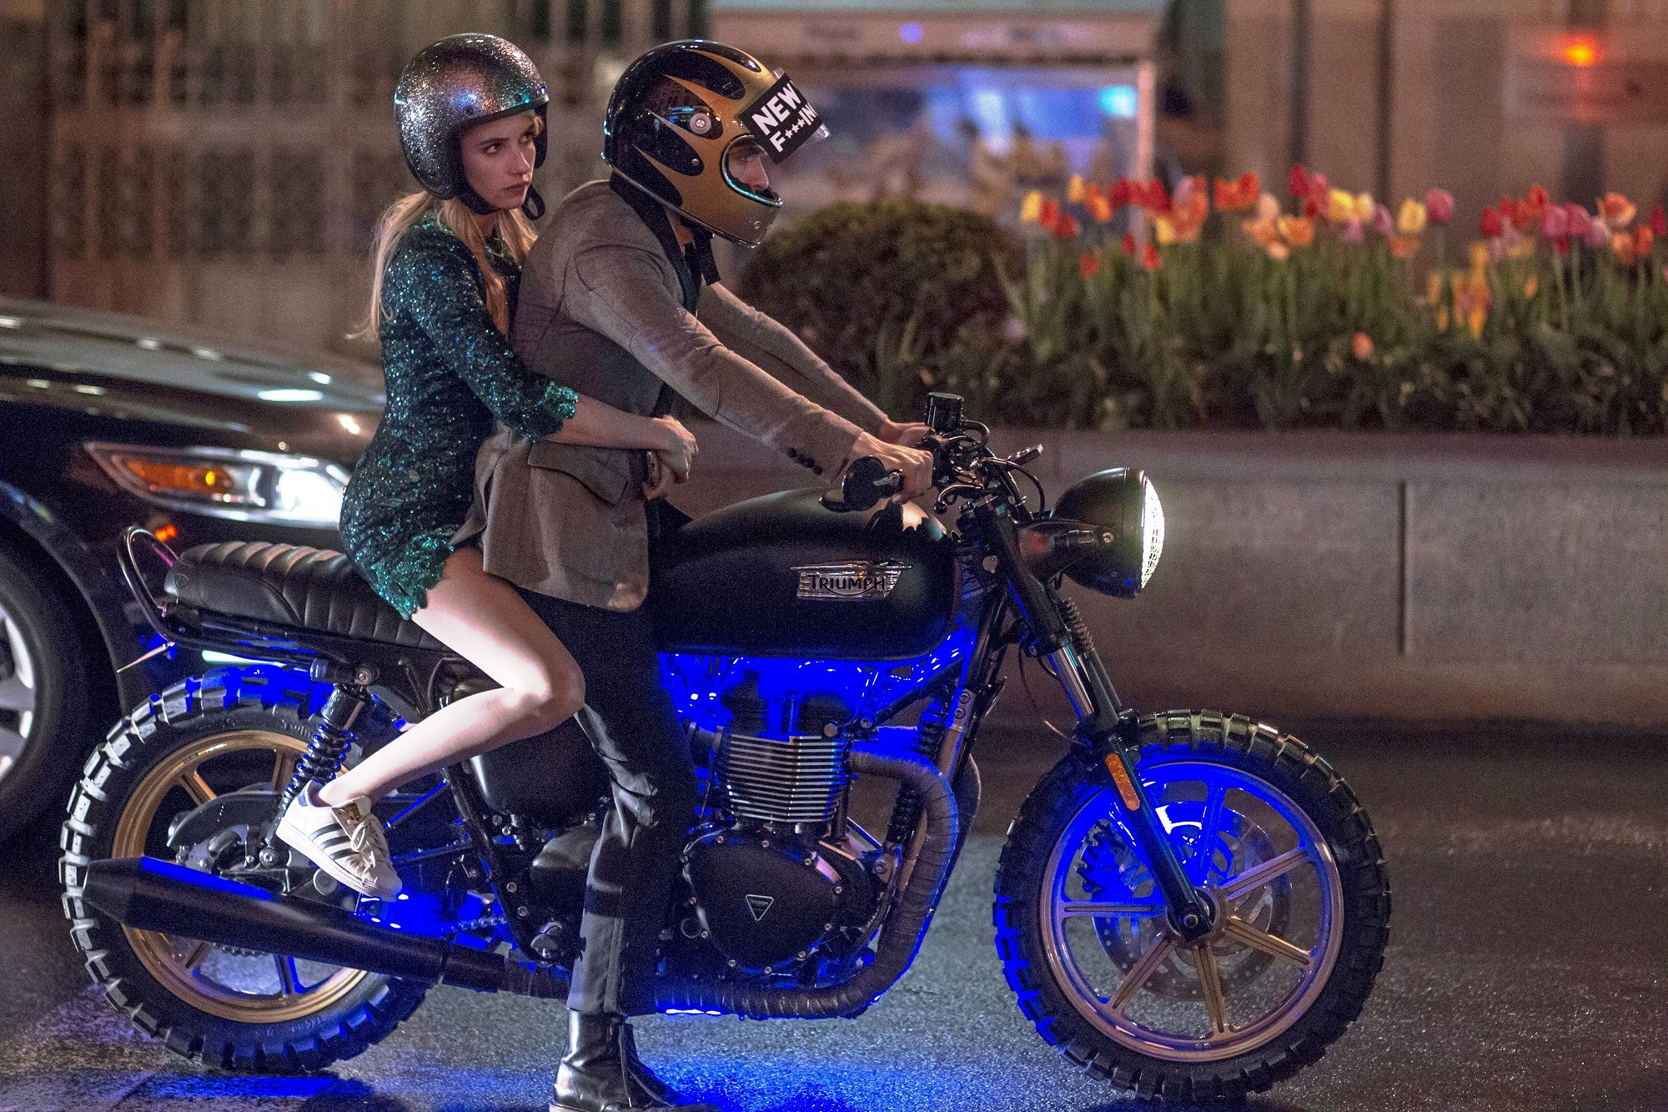
The story
an online game
a choice
lots of crazy ideas

Slide 5

Based on a book
Jeanne Ryan wrote it in 2012
Thriller and adventure novel

Slide 6


Slide 7
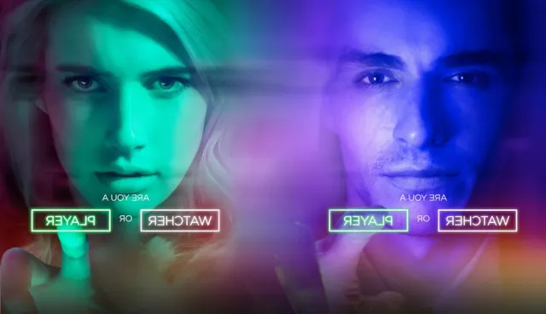

Slide 8
Trailer
https://www.youtube.com/watch?v=2PR9MOPTI7g

Slide 9

Thank you for your attention!

