Slide 1




PROJECT NAME:
“LOG IN BACK THE REAL LIFE”
PROJECT NUMBER:
(2022-1-HU01-KA220-SCH-000087324)
PROJECT PARTNER:
ARDA BERATUNG & BILDUNG GmbH
https://www.ar-da.de/english-en/
E-Mail: info@ar-da.de
Dr. SUSAM DÜNDAR-IŞIK
Funded by the European Union. Views and opinions expressed are however those of the author(s) only and do not necessarily reflect those of the European Union or the European Education and Culture Executive Agency (EACEA). Neither the European Union nor EACEA can be held responsible for them

Slide 2
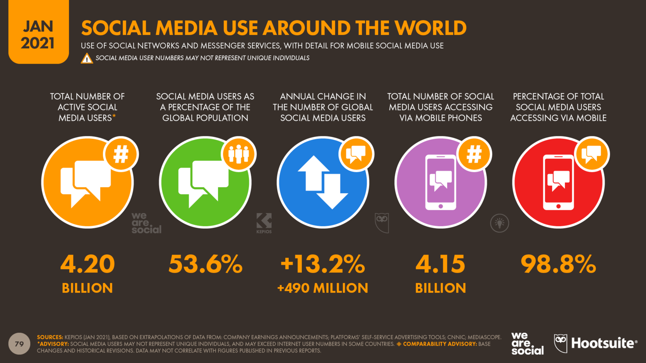
Social Media Use around the World
- 4.2 billion people use social media (roughly 54% of the world’s population).
- In 2021, social media usage increased 13% compared to 2020. It adds up to more than 0.5 billion users within just 12 months.
* Life satisfaction: A key to managing internet & social media addiction

Slide 3

Digital Addiction
- The average person spends 2-3 hours of their time on social media per day. This is equal to almost five years of a person’s whole life span.
- The latest social media addiction statistics indicate that more than 330 million people suffer from internet and social media addiction in 2021. This means that 7% of social media users suffer from social media addiction. This is up from 210 million social media addicts in 2019*.
- The average number of social media accounts per user is 8.4.
- Thus, digital addiction can be considered as a worldwide growing epidemic.
* Life satisfaction: A key to managing internet & social media addiction

Slide 4
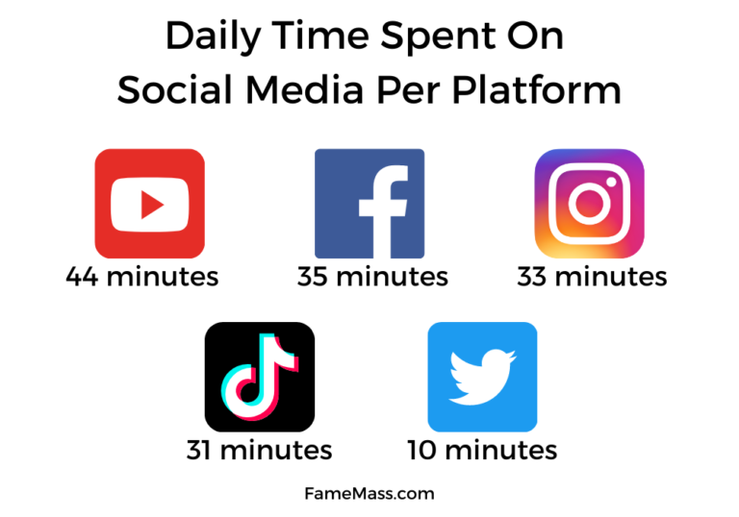
Which Social Media Application is Most Used?
- The wide acceptance of smartphones around the world expanded the social media coverage to more users.
- The latest stats of July 2021 show 2.8 billion Facebook users, 2.2 billion YouTube users, 2 billion WhatsApp users, 1.38 billion Instagram users, 1.3 billion Facebook Messenger users, and 0.73 billion Tiktok users are active today.
The most used social media app among the teenage group is YouTube, followed by Instagram, whereas TikTok is said to be the fastest growing influencing app for the age group of 16-24.

Slide 5
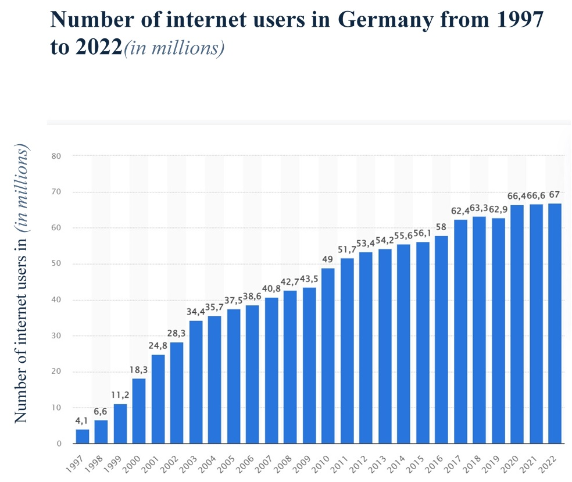

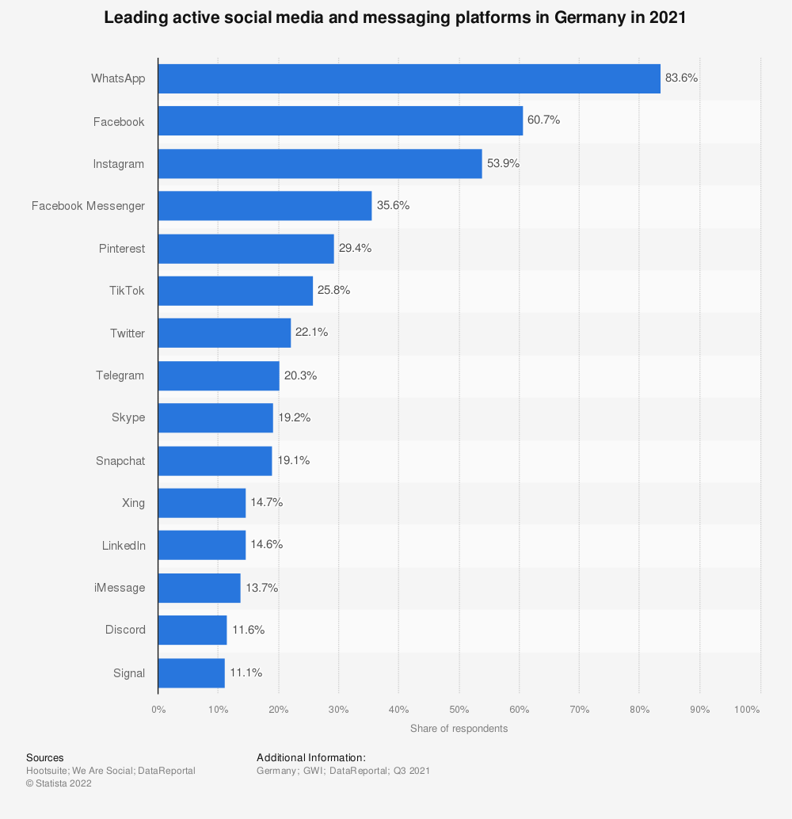
- Germany had a population of 83.84 million in January 2021.
- The number of internet users in Germany has been rising in the last decade. Up until 2022, around 67 million were counted compared to 49 million in 2010, this is a significant development.

Slide 6
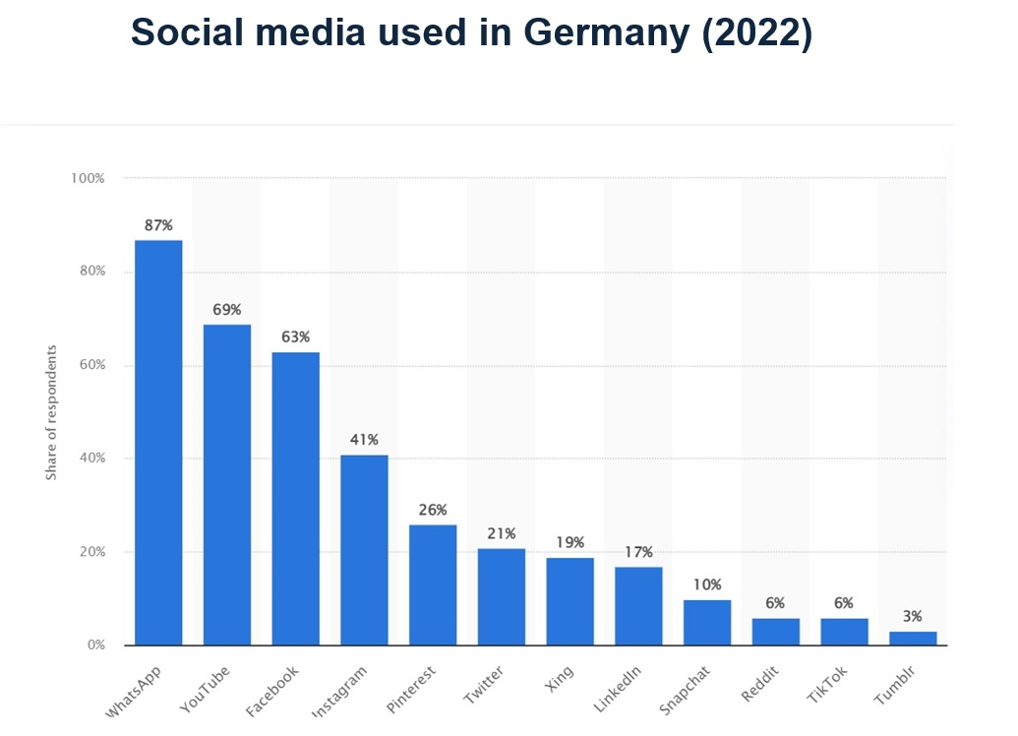
What Are the Most Used Social Media Platforms?
- In 2022, there were 60.88 million social media users in Germany, up from 57.45 in 2021. Since 2018, there has been an increase in social media users in the country of around 32 percent. By 2027, it is estimated there will be over 73 million social network users in Germany.
According to the statistic, the most used social media channel (including messaging apps) in Germany is WhatsApp, which reaches 87% of internet users. This is followed by YouTube which has a user percentage rate of 69%.
-

Slide 7

Definition of Digital Addiction
- A uniform definition of the term does not yet exist.
-There is talk of addiction, dependency or pathological, excessive or problematic use of the Social Media and Digital Platforms.
- The experts also disagree about the characteristics of these dependencies.
- There is disagreement about the number of people affected and bout when exactly a person is considered “dependent”.
- One of them best researched is the so-called Internet Gaming Disorder (IGD) or computer game addiction. It is recognized as an addiction by the World Health Organization (WHO), and is therefore an official disease.

Slide 8
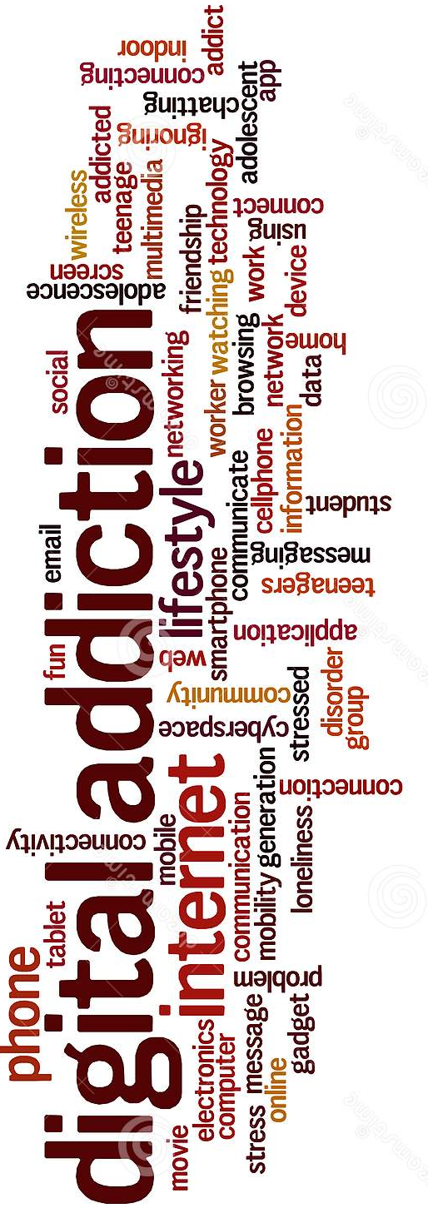
What is Internet Addiction?
-Internet addiction can be viewed as an impulse control disorder unrelated to the use of intoxicants and very similar to pathological gambling.
-Some Internet users can develop an emotional attachment to online friends and activities they create on their screens.
-Internet addiction is a potentially dangerous condition that affects people who spend a lot of time online to meet up with friends, play games, gamble, or just surf the web - despite the negative consequences.

Slide 9
Social Media Addiction Statistics about Teenagers
- According to their terms and conditions, most social media platforms allow users from the age of 13 or more. Teenagers spend more active time on social media compared to adults.
- Studies point out that teenagers who use social media for 2-5 hours or more are vulnerable to mental health issues compared to others.

Slide 10
Why Do Teenagers Spend More Time on Social Media?
- Social media is a virtual world where teenagers can create an identity that they fantasize about to be real in the physical world.
- They can create an account using their favourite movie character names and profile photos. They can express their ideas and views in discussion rooms without revealing their true identity.
- It gives the opportunity to escape from the real issue that they face at least for some amount of time every day.
- Social media can provide them with friends from different parts of the world and of different age, sex, and language.
- They can build their imaginary world with lies and deceptions to showcase themselves as the best version possible. Such pleasures slowly get into them asking for more of their real-world time.

Slide 11
Let us Check Out Some of Key Teenage Social Media Addiction Facts that Must Be Acknowledged
1. Gender Domination: Female teenagers who are single are more addicted to social media than any other groups
2. No Goodnight Sleep: The majority of them keep their phone right next to the bed, and it is the first thing they check waking up in the morning.

Slide 12
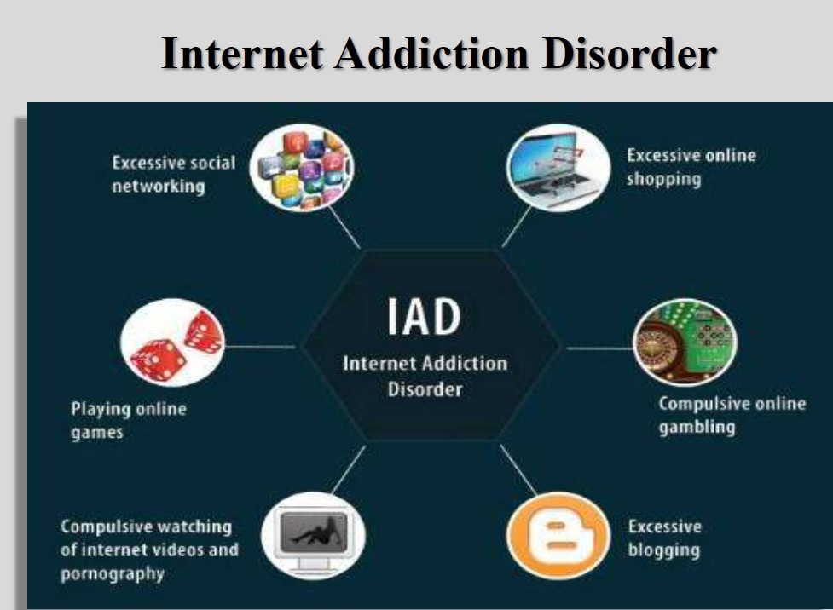
Internet Addiction Disorder
- When it comes to dependence on digital games, the role of playing online games are often in the foreground.
- Smartphone addiction often revolves around the excessive use of social networks and messenger services.
- But the excessive consumption of pornographic content can also become a problem.
But at what point does consumption become too much and problematic? When and how should parents intervene and what can they do to prevent it?

Slide 13
What Fascinates Children and Young People about Digital Worlds?
- Social networks and online games address the needs of children and young people in many ways. In addition to entertainment and exchange, they offer a variety of opportunities to get recognition and confirmation.
- Happy hormones are released through likes and friendly comments on social networks. This tempts you to look at your smartphone again and again to get emotional "replenishment".
- Digital games also give players recognition, success and rewards. In online role-playing games such as "World of Warcraft", communities and cohesion quickly develop.

Slide 14
Why Do Children and Adolescents Become Addicted? Who Is at Risk?
The question of why someone becomes addicted to smartphones or media is difficult to answer and has not yet been scientifically clarified.
Certain factors can promote addiction, for example:
- personal factors such as loneliness, shyness, or low self-esteem,
- depression, stress, fear of (failure), inability to cope with problems, or a lack of discipline,
- the social environment, e.g., lack of attention within the family or lack of acceptance from peers in the real world,
- failures or lack of sense of achievement in the real world and
- boredom and critical life situations (e.g., breakups or school problems).

Slide 15
Why Do Children and Adolescents Become Addicted? Who Is at Risk?
But the Internet and its possibilities also play their part.
Online games and social networks in particular work with reward incentives to trigger feelings of happiness in the users. This includes, for example, small profits, but also the number of likes or friendly comments.
- The phenomenon FOMO - "Fear of Missing Out" describes the pressure of having to be there all the time and the fear of not noticing something. Social networks such as Instagram and TikTok in particular, but also messenger services such as WhatsApp, tempt people to keep checking their smartphones.

Slide 16
When Does Addiction Start?
Is it still "normal", if a child sits in front of a smartphone, computer, tablet or games console for several hours a day? When it comes to screen time, many parents are understandably insecure. Simple and reliable answers are desired; but it is hardly possible to give them.
First of all, not every person who sits in front of the screen for a long time is equally dependent. The time spent in front of the screen is only an indication and not meaningful by itself.
Excessive media or smartphone use can also be a temporary phase. It is normal when children and young people are temporarily spellbound by the digital world. Especially new offers are often used intensively. As soon as the excitement of new games, apps, etc. wears off, other interests come back into focus.

Slide 17
Recognizing Dependency — a Checklist for Parents
The following questions can help with an initial assessment of whether any child has characteristics of a possible addiction to digital media (e.g. smartphone, computer, console, internet).
The checklist can only represent a rough guideline and does not replace medical diagnostics. Still, take every answer you answer “yes” seriously. If your child has five or more characteristics over a period of time, or you are unsure, seek professional help.

Slide 18
Recognizing Dependency — a Checklist for Parents
Is your Child at Risk of a Possible Digital Addiction?
- Do you have the impression that your child's thoughts are always revolving around the smartphone, computer, console or Internet - even during other activities?
- Does your child seem nervous, irritable or depressed when they have to go without their smartphone, computer, console or internet?
- Do you have the feeling that your child is increasingly withdrawing from friends?
- Are digital offerings crowding out your child’s earlier interests or hobbies?
- Does your child skip meals to play, surf the web or use their smartphone?
- Does it appear that your child has become worse in school due to media use?
- Has your child gained or lost a lot of weight?
- Is your child often overtired?

Slide 19
Recognizing Dependency — a Checklist for Parents
Is your Child at Risk of a Possible Digital Addiction?
- Does your child spend more and more time in front of the screen despite recognizable negative consequences?
- Do you suspect that your child plays, chats or surfs late into the night?
- Does your child increasingly use smartphones, computers, consoles or the Internet to reduce feelings such as anger or rage or to suppress problems?
Even if you answered "yes" to many of the questions, this is not yet a sign of pathological or dependent use of digital media. Stay in touch with your child and be curious about the apps and games he or she uses.

Slide 20
Prevent your Child from Becoming Addicted to Media
- Digital games, social networks and messenger services are extremely popular with children and young people. The following tips will help to make your child "media fit" and prevent addiction.
– General bans are not very helpful in the long run and tend to lead to people playing or surfing in secret. Instead, agree on fixed usage times together. Show your child that you trust him to keep these agreements.
– Be interested in the digital world that inspires your child. Get involved and play or surf with us. This makes the fascination more understandable and your child feels taken seriously.
– Question what fascinates your child so much. What do they like to do with their smartphone, computer or tablet and why? How do these offers succeed in satisfying the wishes and needs of your child?
– Talk to your child about games, content and media experiences. If you know what your child is doing on the screen, you can provide meaningful support and set boundaries.
– Even young people who are familiar with computers, smartphones and the like cannot necessarily assess the associated risks correctly and need support.

Slide 21
Prevent your Child from Becoming Addicted to Media
– As parents, you have a role model function. Check your own media behaviour and lead by example.
– Create a respectful family environment in which your child feels valued. This strengthens self-confidence and encourages your child to confide in you, if there is a problem.
– Provide suggestions and alternatives to smartphones & Co., for example in the form of joint ventures or leisure activities.

Slide 22
Agree Times and Rules
Agree early on in the family, which rules apply to digital devices and the Internet, what is permitted and what is not. When determining the times of use, consider your child's level of development and experience.
– Since smartphones and portable game consoles can also be used on the go, fixed usage times should be agreed here in particular.
– At bedtime, mobile devices can be placed in a “media garage” (e.g. a box in the hallway). For older children, devices should be on airplane mode or turned off at night.
– Do not shy away from “fair” conflicts. Parents have the right to limit media consumption in a reasonable way, even if this results in a dispute. Justify limitations so your child feels they are being taken seriously and understands why you are setting limitations.
– Agreements made should be kept. If this is not the case, act accordingly! Even if it is often difficult, a temporary ban on the internet, smartphones and digital games can be the right step.
– The more trust and experience you ascribe to your child, the more he can be granted. Instead of a daily limit, agree on a weekly workload together. The child divides the agreed time freely. This is how your child learns to take responsibility.

Slide 23
Is It Possible to Fall Back on Technical Control Options?
In principle, technical aids also offer the possibility of limiting usage times and content on digital devices. However, such settings do not offer 100%-protection and can be circumvented by older children if necessary. Technical assistance can therefore only support media education, not replace it. In addition, they do not prevent friends from playing and surfing, for example.

Slide 24
Is My Child Already Lost in the Media World?
If your child withdraws more and more into digital worlds, it is important to start talking to each other again. It is of little use to ban media consumption or the use of smartphones across the board.
– Approach your child openly. In the conversation, make your child aware of your perception and speak without reproaches about the media offerings, without which your child can no longer get along.
– Look for the reasons for the excessive consumption. What is your child missing in real life? What unsatisfied wants and needs does it have? Where are the worries and problems?
– Change something in the environment, offer alternatives. Encourage and design leisure and employment opportunities in the family.
– Encourage your child to resume hobbies previously pursued. Especially activities and experiences in a group form a useful counterweight to virtual experiences.

Slide 25
Resort to Professional Help
If you realize that the problem cannot be overcome alone, do not hesitate to resort to professional help. Seek support to get your child out of smartphone or media addiction. Contact points are, for example, addiction and family counselling centers or psychologists.

Slide 26
When Does Addiction Start?
Dependence is a process: the boundaries between "normal use", "problematic use" and a dependency are fluid.
Always look at the overall situation and look at the motivation behind the use. The following checklist will help you with the assessment.

Slide 27
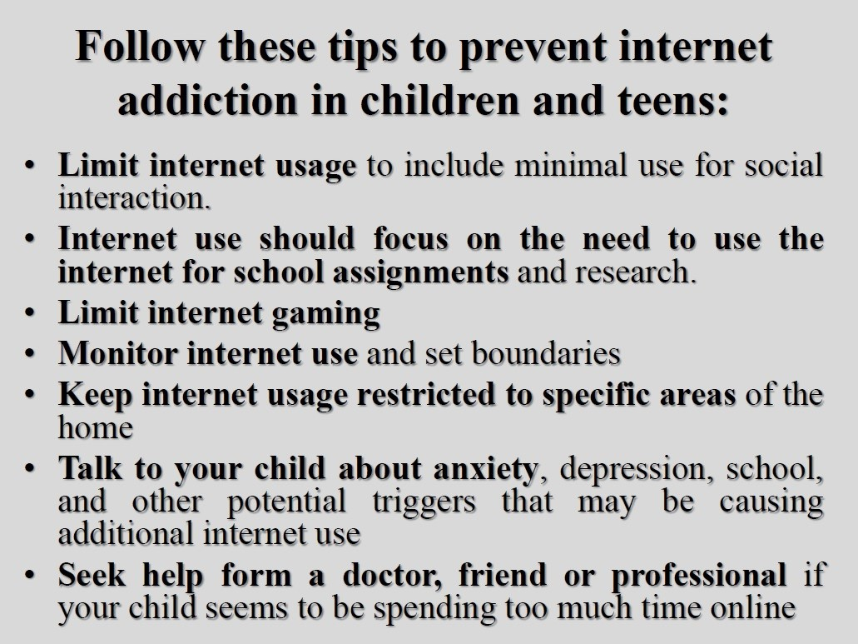

Slide 28
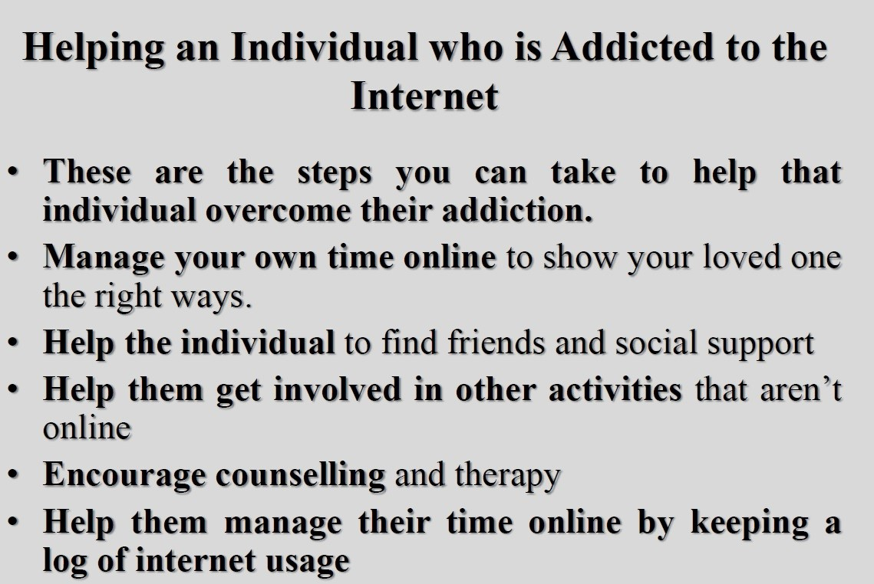

Slide 29
Internet Addiction
Treatment for Children
and Adolescents
• Individual, group, or family therapy
• Behaviour modification
• Dialectical Behavioural Therapy (DBT)
• Cognitive Behavioural Therapy (CBT)
• Equine Therapy
• Art Therapy
• Recreation Therapy
• Reality Therapy

Slide 30
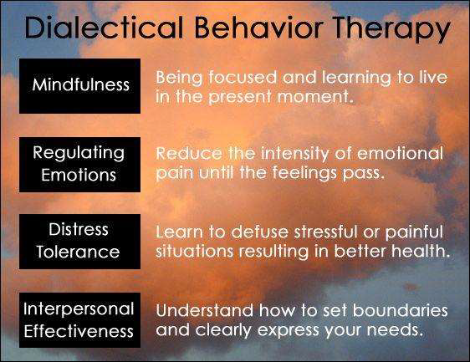
Dialectical Behavioural Therapy (DBT)

Slide 31
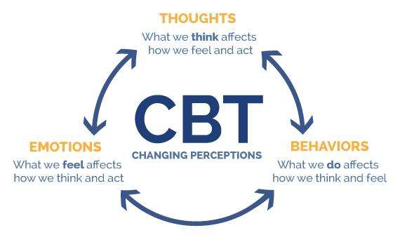
Cognitive Behavioural Therapy (CBT)

Slide 32
Teachers as Supporters of Internet Safety
• Teachers should first realise the importance of their role.
• Teachers will be aware of the problem.
• Teacher will need to develop a student strategy to wean their students from internet addiction.
• Teachers need to know social networks and internet programmes for conscious internet use.
• Teachers, students and families should work together.

Slide 33
Teachers as Supporters of Internet Safety
• Teachers should be able to suggest other activities that might be of interest to students.
• Teachers should be able to manage student groups effectively.
• Teachers should have clear and strict rules for their students.
• Teachers should be able to guide their students.

Slide 34
Teachers and Counselling
• Topic: overcoming relationship problems between students
• Definition of the problem: verbal and emotional abuse in the student group
• Purpose of the study: to ensure group tolerance and to establish an atmosphere of trust

Slide 35
Teachers and Counselling
• The teacher can ask the following questions to his/her students:
• What do I adore the most?
• What kind of career do I want to pursue in the future?
• Here the teacher identifies the interests and values of the students.

Slide 36
Teachers and Counselling
Conclusion: the students become more aware of their values, understands the importance of efficient time management and organises their personal life in an efficient way.
Implementation: the learner can ask the students to answer all these questions in writing or have the students talk about them in the classroom environment.

Slide 37
Teachers and Counselling
Assessment:
Cohesion: the level of trust in the class is low, but there is a definite improvement in cohesion. The sense of "WE" is only beginning to develop.
Disagreement: high level of self-confidence in contrast to low group-confidence.
Agreement: relationships within the group are based on mutual trust and harmony.

Slide 38
Teachers and Counselling
Example Case Study (1):
Hans (student): nervous, does not see friends, always at home, tired, has attention disorder.
Hans' teacher calls his mother Hanna on the phone. She tells her mother about the above symptoms. Hans' school results have dropped significantly, and he wants his mother to come to school.
Hanna is helpless, she does not know how to help her child.

Slide 39
Teachers and Counselling
Example Case Study (2):
The mother of a child addicted to excessive internet usage: “He spends 20 out of 24 hours a day on the internet, both on the computer and on his mobile phone. Now his grades are mediocre.”
(How does he react when you forbid him to use the internet?) “His reactions are horrible, agitated and angry.” The mother has been worried ever since she read a study, claiming that children who spend a large part of their lives on the internet tend to isolate themselves from their peers and become depressed. There are also physical consequences.

Slide 40
Teachers and Counselling
( Solution Case Study):
- Not doing homework
- Does not go to school
- Brief description of the situation (what happened):
- Intervention strategy
- Medium and long-term strategy goals
- How do students feel when they are online?
- The goal here is to be aware of the emotional causes of internet addiction in students and to make suggestions to close this emotional gap.

Slide 41
“LOG IN BACK REAL LIFE”
PROJECT NUMBER:
(2022-1-HU01-KA220-SCH-000087324)
THANK YOU VERY MUCH FOR YOUR
ATTENTION!

