Slide 1


Hungary
Funded by the European Union. Views and opinions expressed are however those of the author(s) only and do not necessarily reflect those of the European Union or the European Education and Culture Executive Agency (EACEA). Neither the European Union nor EACEA can be held responsible for them.
2022-1-HU01-KA220-SCH-000087324

Slide 2
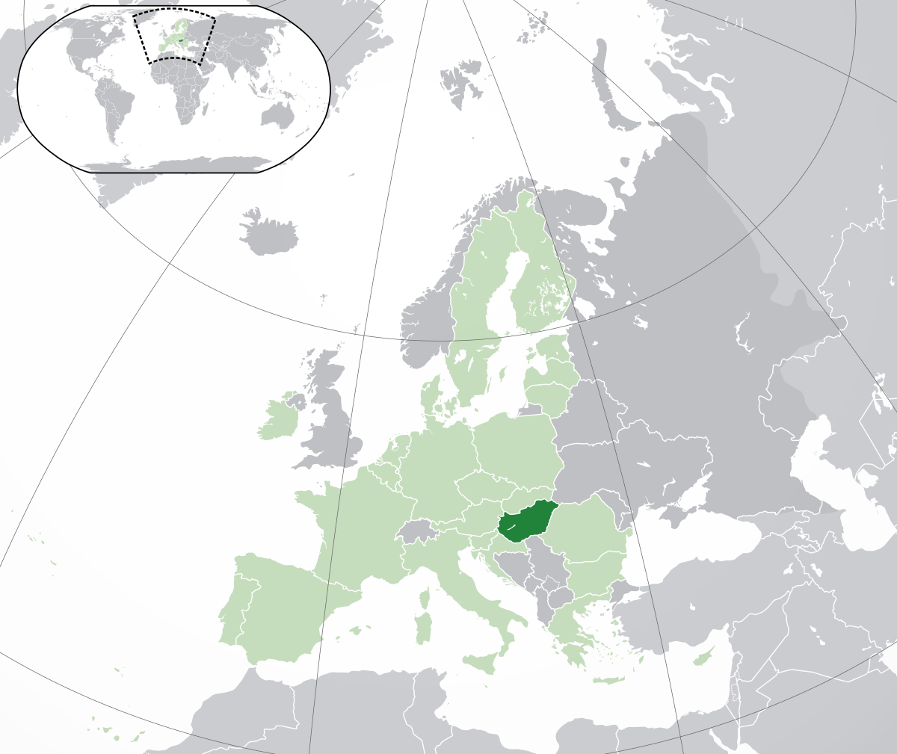
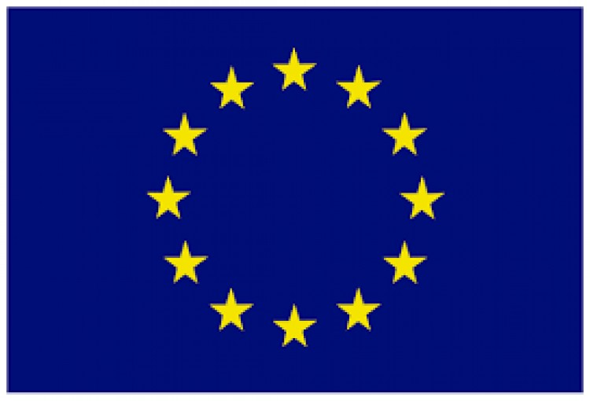
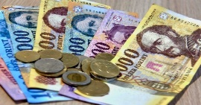
Let’s get to know Hungary!
Democratic Republic in Cenral Europe, Carpathian Basin.
Bordered to: Slovakia, Romania, Serbia, Slovenia, Croatia, Austria and Ukraine
Member of European Union
Hungary’s population 10 000 million people.
It’s territory : 93 036 km
It’s currency is the Forint

Slide 3
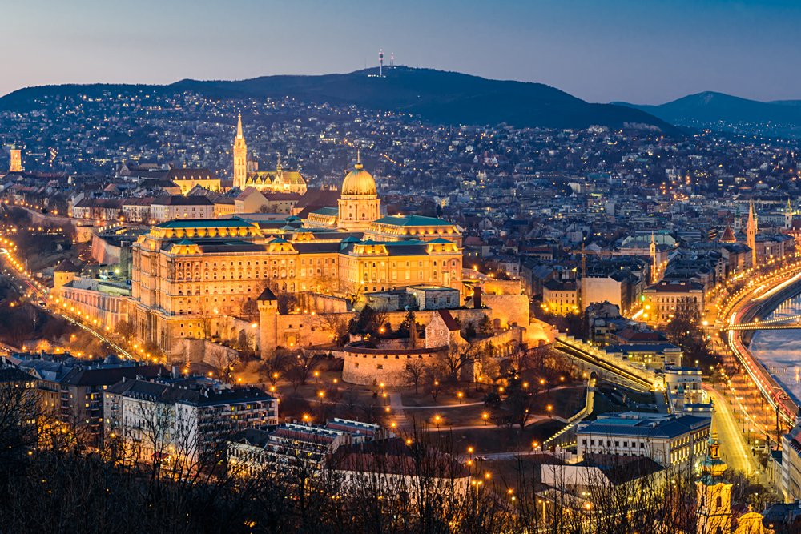
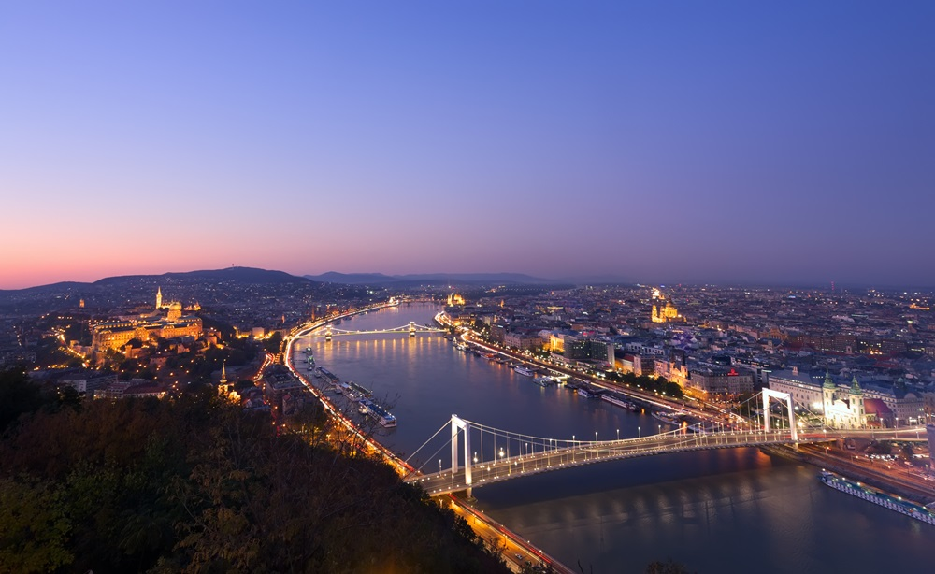
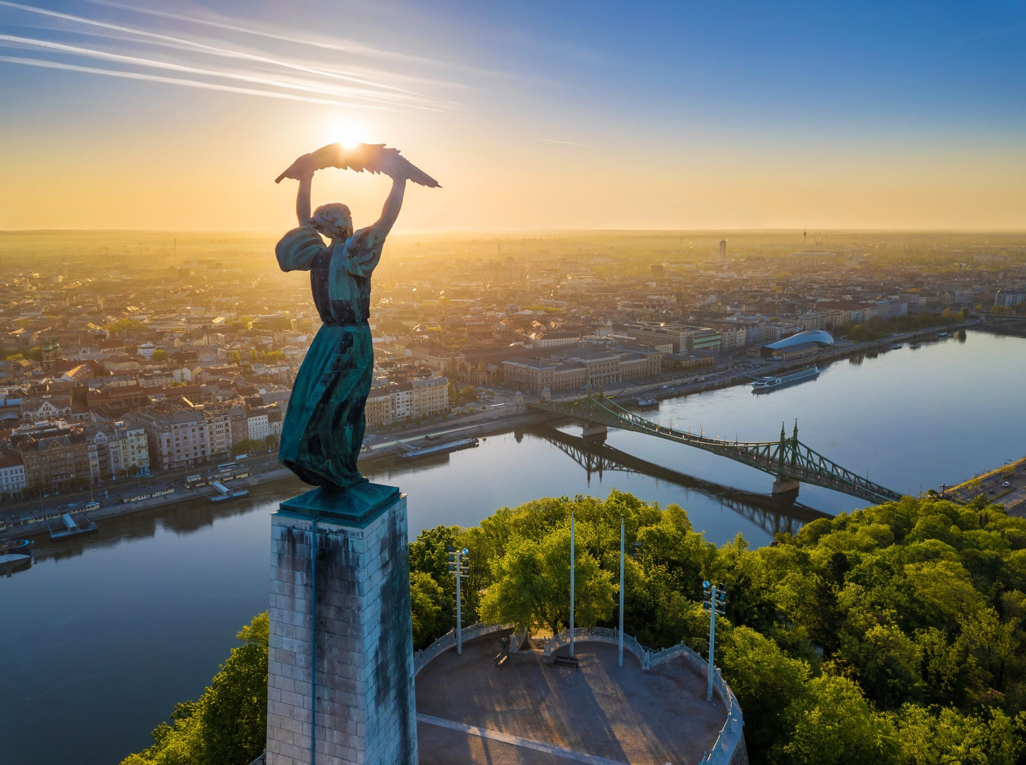
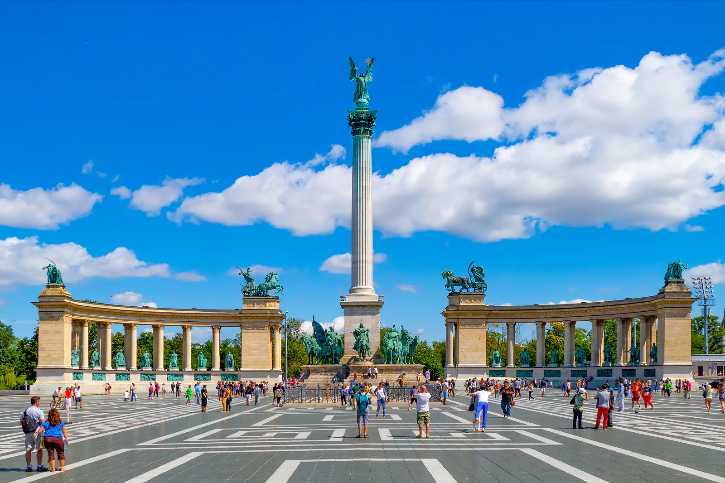
Europe’s heart: Budapest
Budapest is the capital city of Hungary
population 1,7 million people
Politics, cultural, induatrial, commericial,
and transport center, famous Spa town
It is rich in world heritage sites

Slide 4
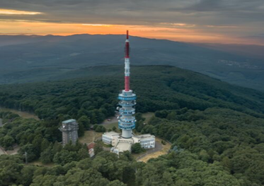
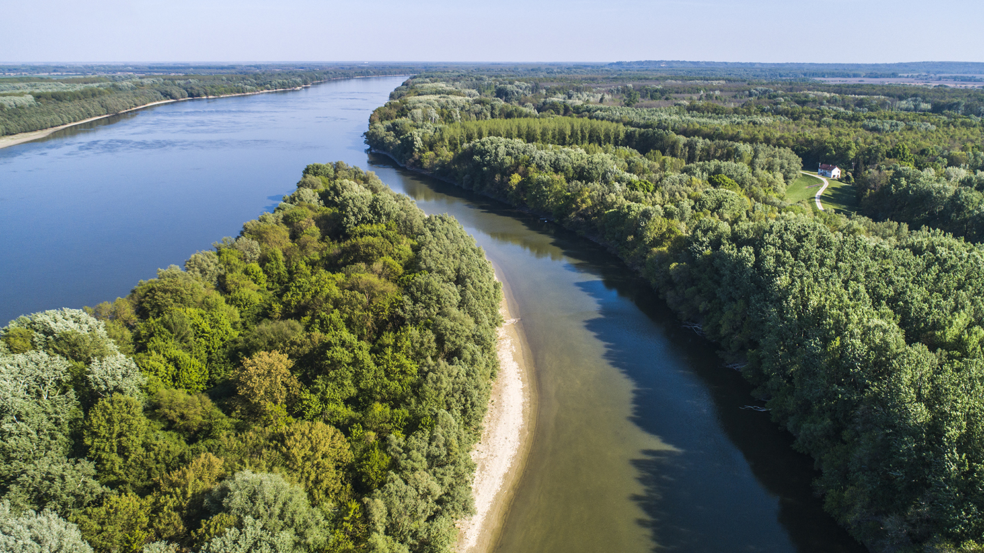
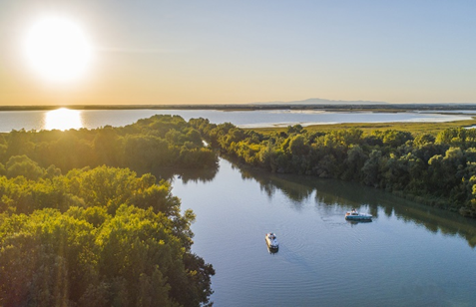
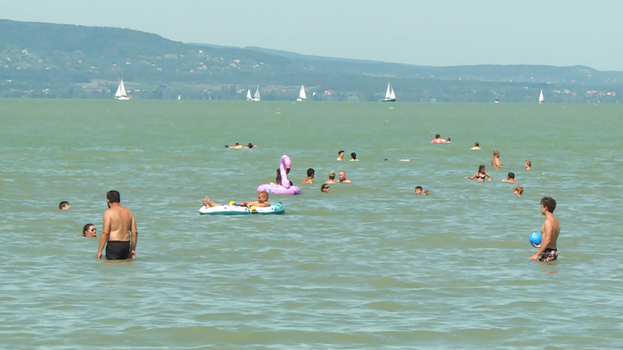
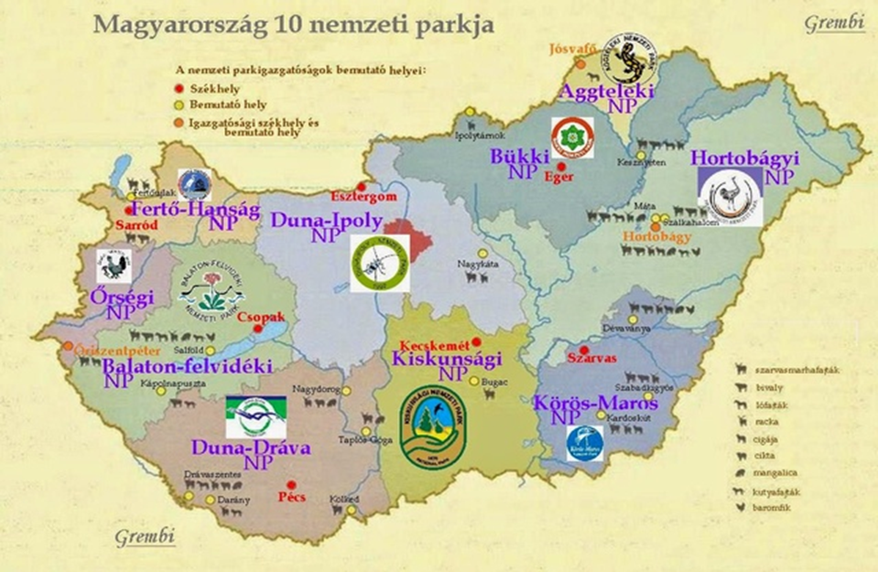
Nature
The heighest point is the Kékes (1014 metres)
Largest rivers are the Duna and Tisza
Lake Balaton is the largest lake in Central Europe (592 km)
10 National Park

Slide 5
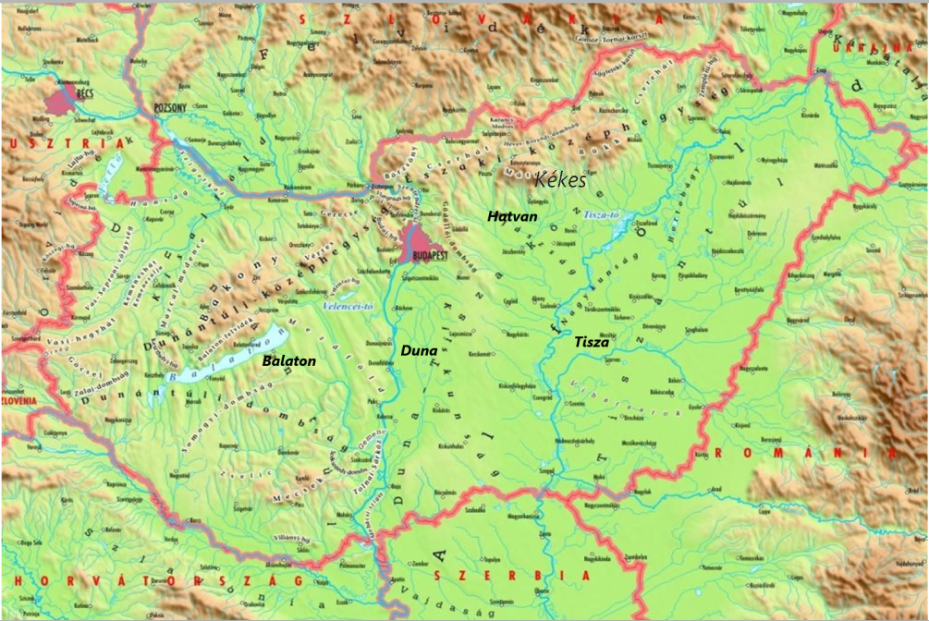

Slide 6
Hungarycums

Slide 7

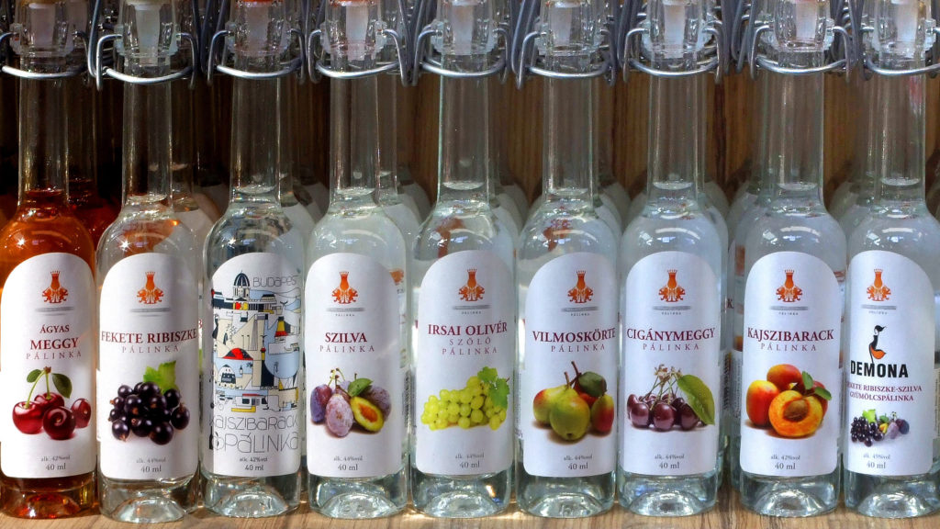
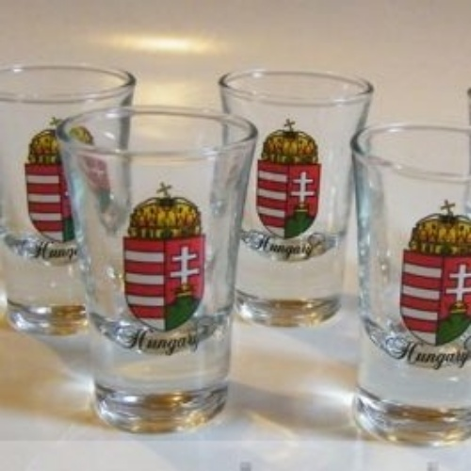
Pálinka In English: brandy

Slide 8
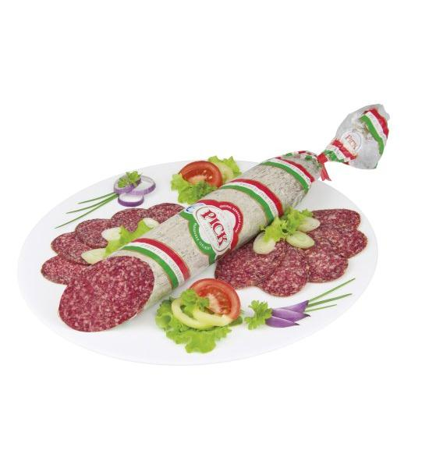
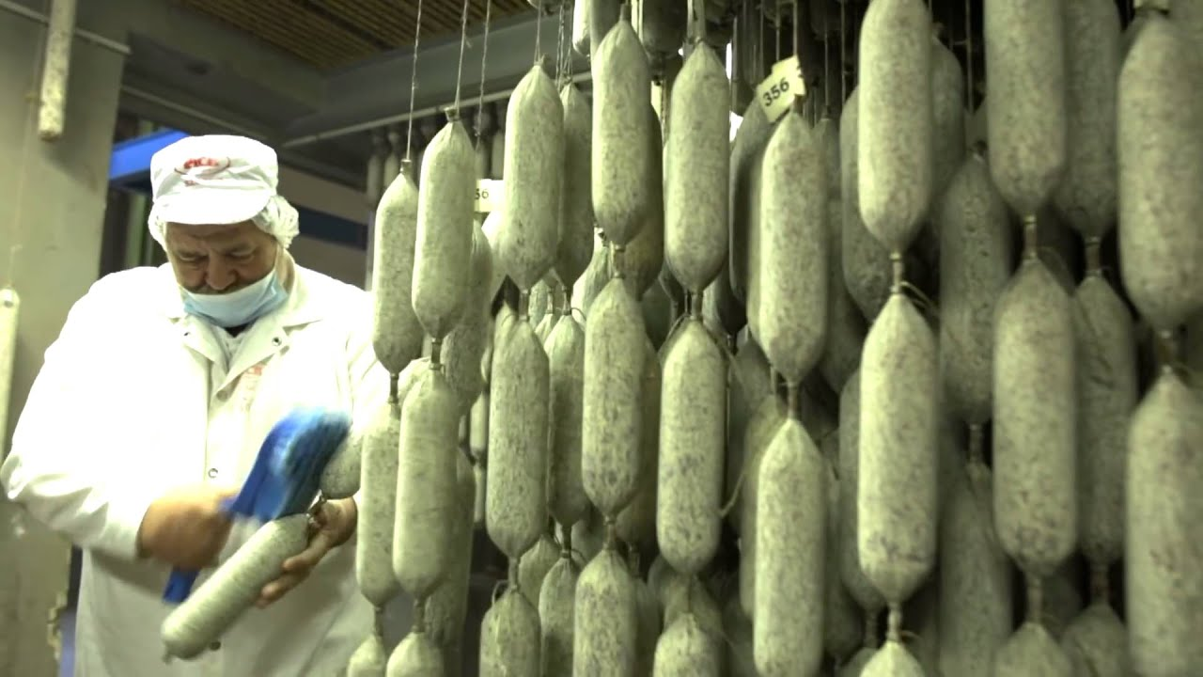
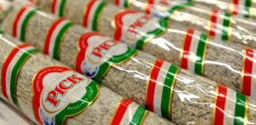
Téliszalámi In English: winter salami

Slide 9

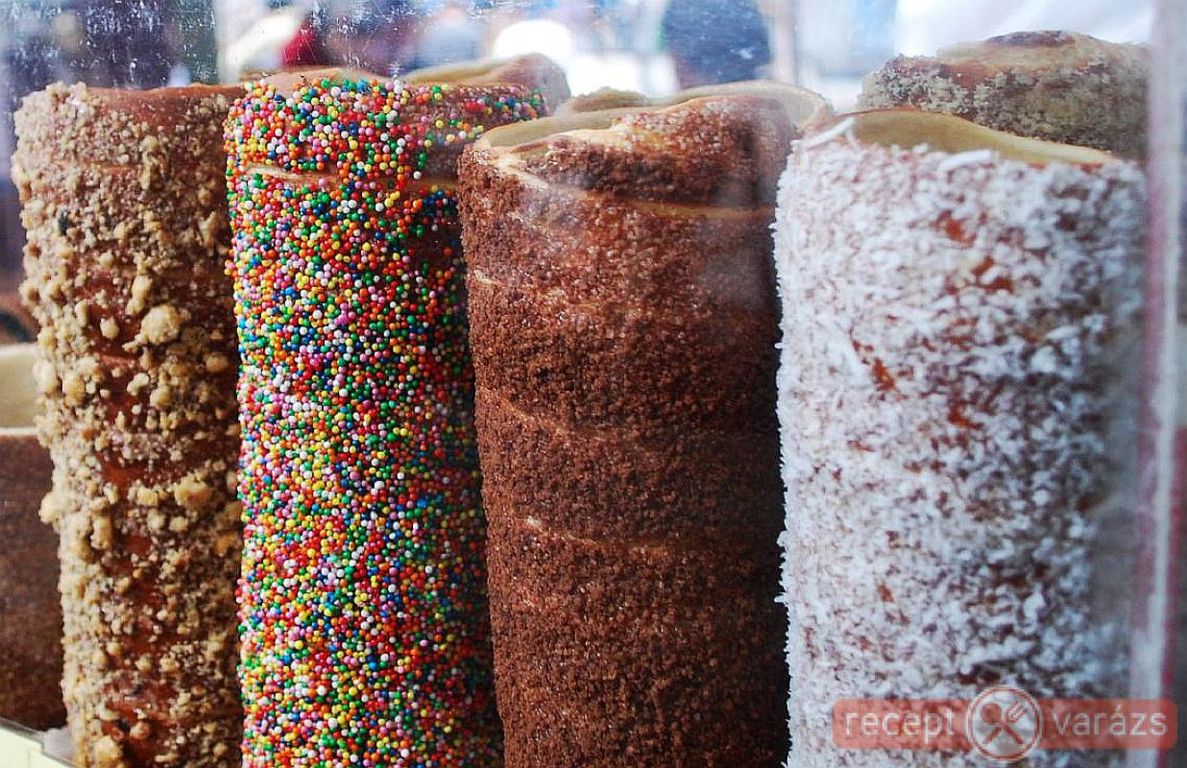
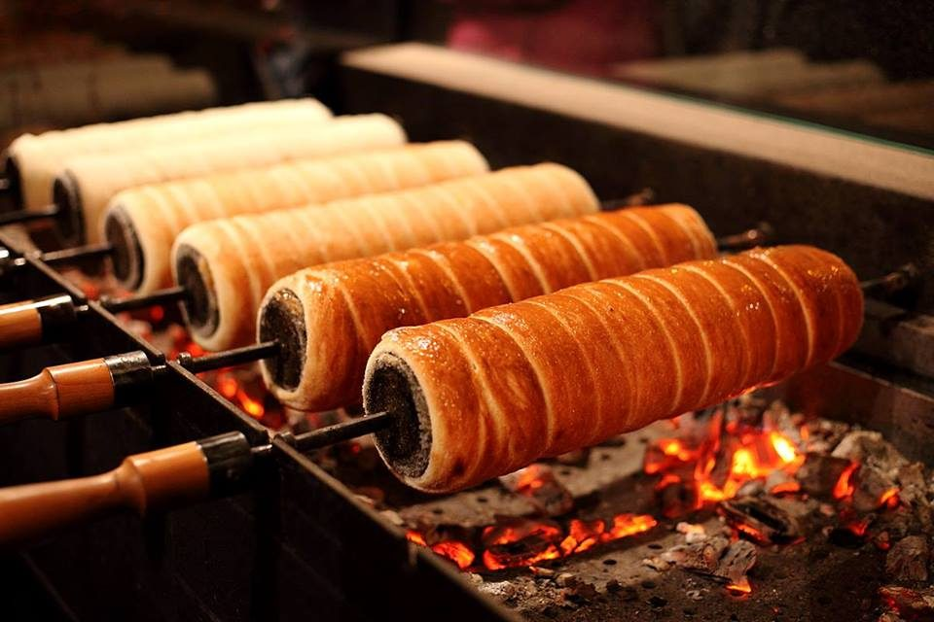
Kürtöskalács In English: Chimney cake

Slide 10
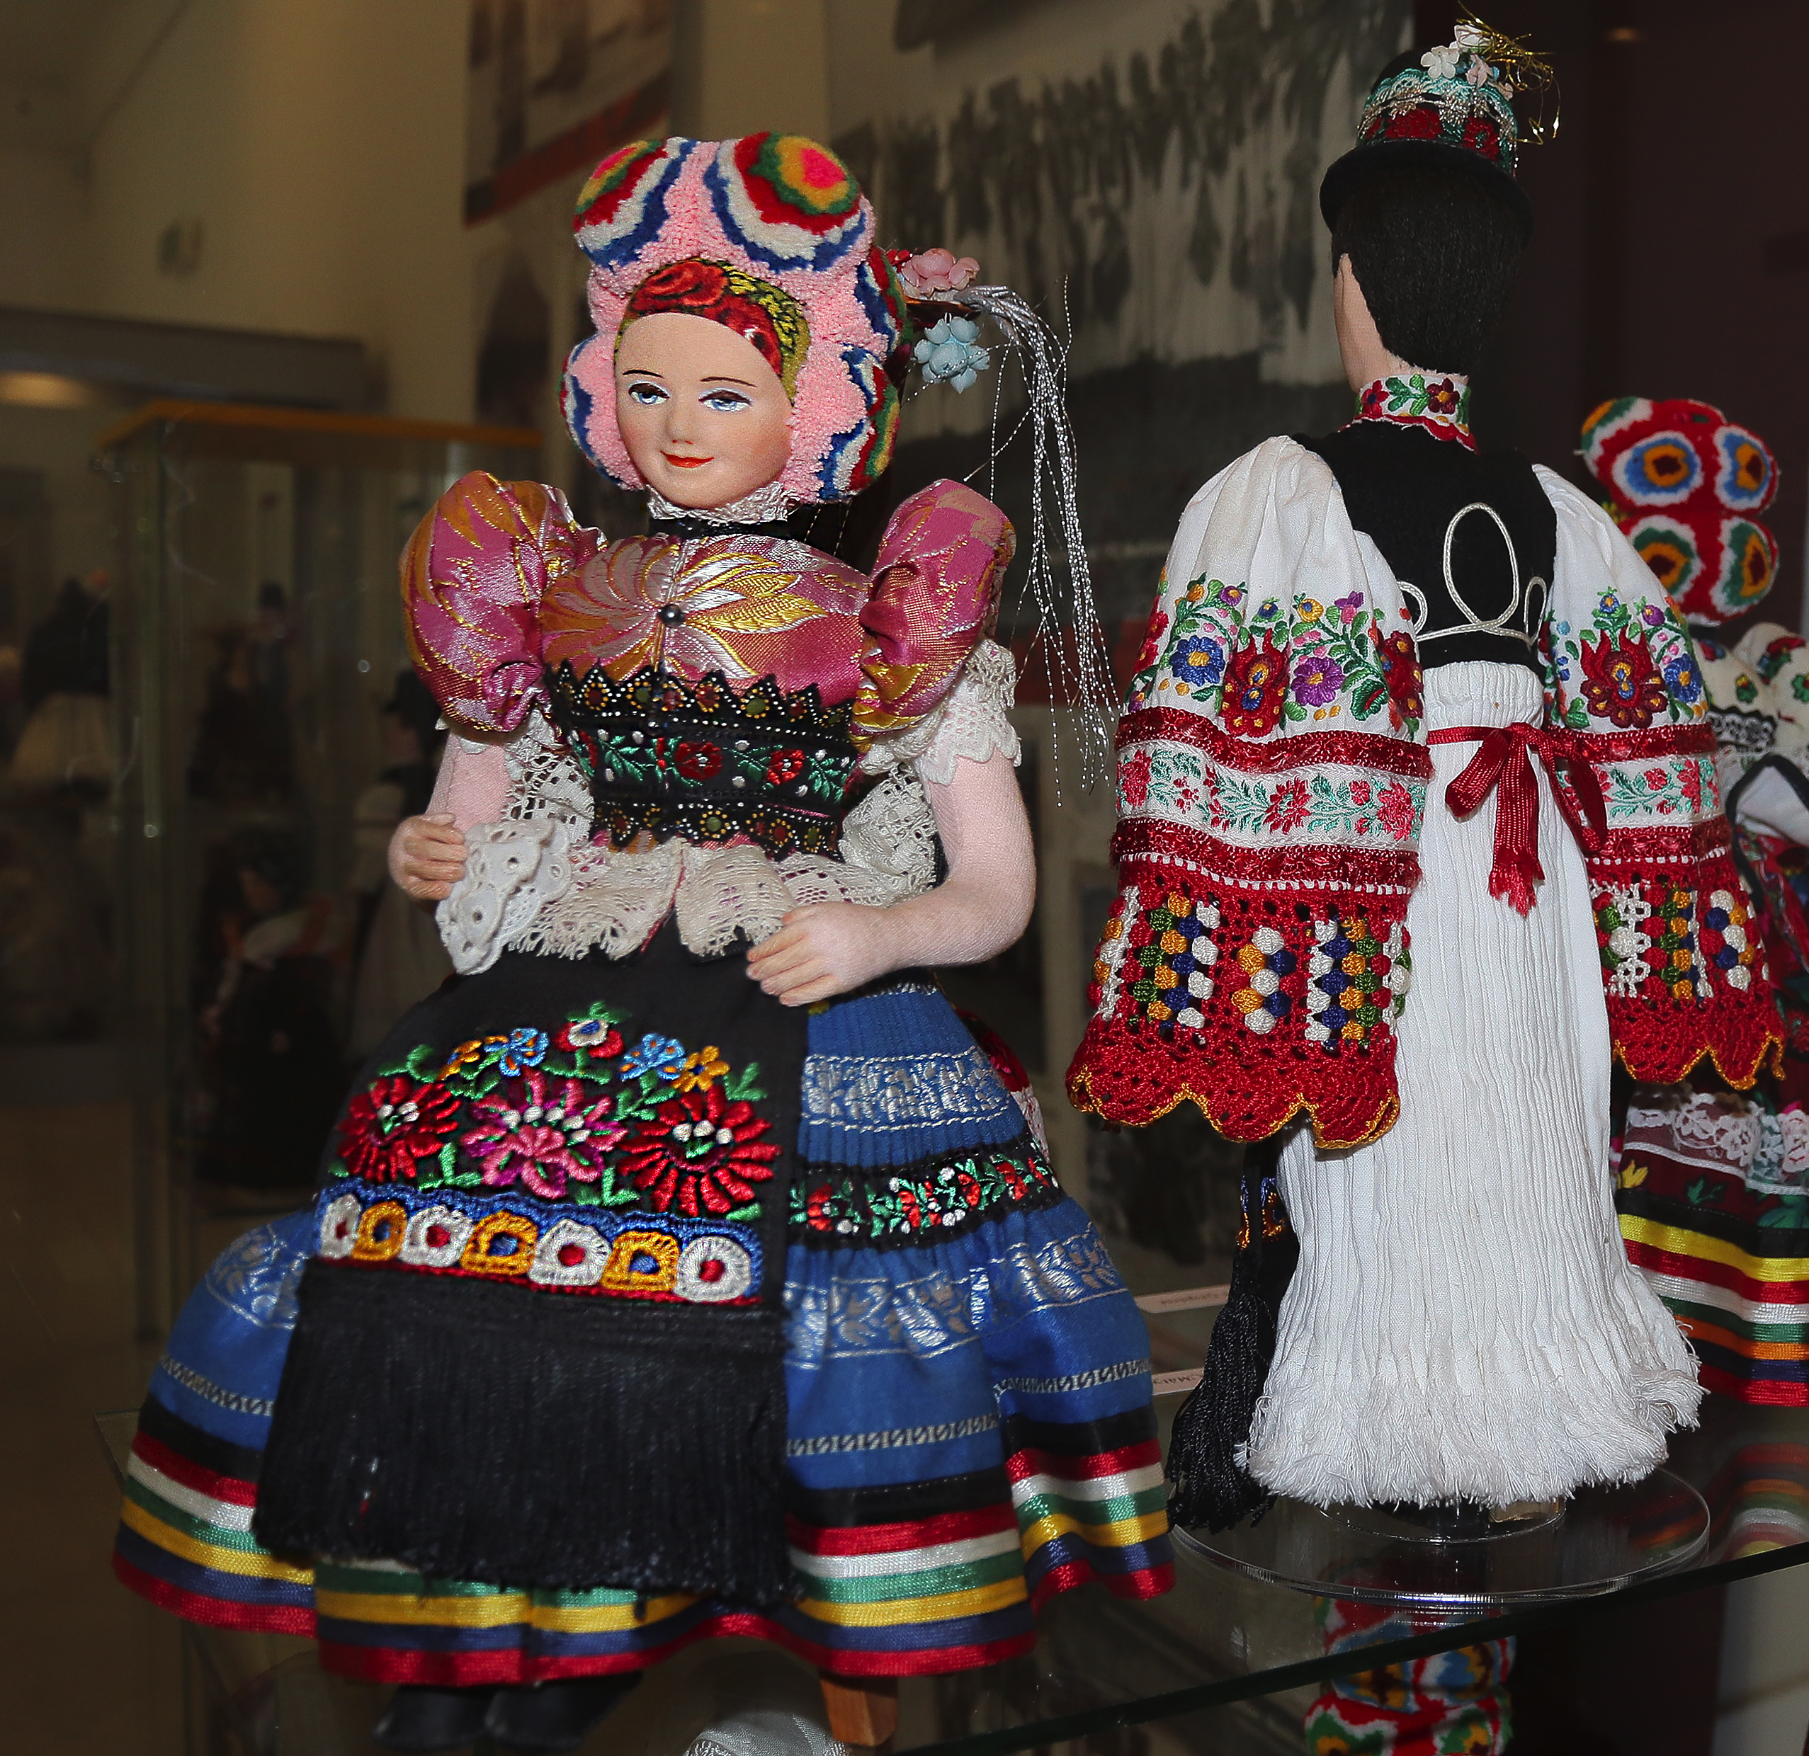
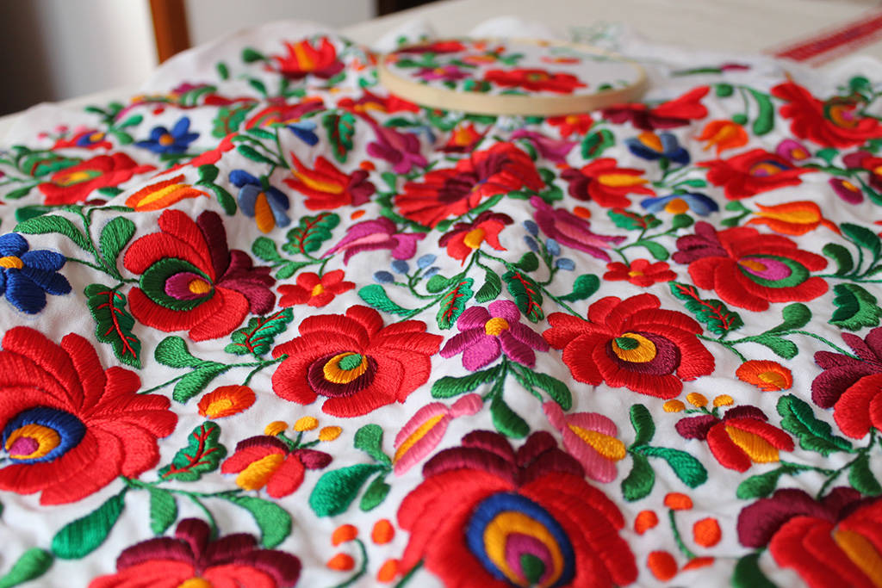
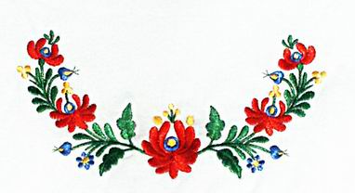
Matyó embriodery

Slide 11
Thank you for your attention!

