Slide 1



„LOG IN BACK THE REAL LIFE”
Project ID: 2022-1-HU01-KA220-SCH-000087324
Funded by the European Union. Views and opinions expressed are however those of the author(s) only and do not necessarily reflect those of the European Union or the European Education and Culture Executive Agency (EACEA). Neither the European Union nor EACEA can be held responsible for them.

Slide 2


Hungarian Indoor Games
Traditional Pastimes for Fun and Socializing
Made by: Máté Tóth, N’Koli Forestier

Slide 3
Introduction to Hungarian Indoor Games
Sakk (Chess)
Társasjátékok (Board Games)
Darts
Asztali foci (Table Football)
Ping-pong (Table Tennis)
Gombfoci (Button Football)

Slide 4
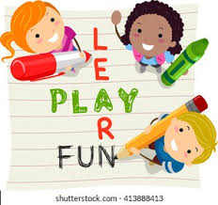
Introduction to Hungarian Indoor Games
In Hungarian culture, indoor games hold significant importance as they serve various purposes beyond mere entertainment. Here's a brief overview of their importance:
Social Bonding:
Indoor games provide opportunities for social interaction, allowing friends and family members to come together, bond, and strengthen their relationships.
2. Cultural Heritage:
any indoor games in Hungary have deep-rooted cultural significance, reflecting traditions passed down through generations.
3. Mental Stimulation:
Games like chess, puzzles, and strategic board games stimulate mental faculties such as critical thinking, problem-solving, and strategic planning.
4. Relaxation and Recreation:
Indoor games provide a means of relaxation and recreation, offering a break from the stresses of daily life.
5. Education and Learning:
Many indoor games involve elements of learning and skill development. For example, playing board games can enhance literacy, numeracy, and decision-making skills, especially in children.
6. Community Engagement:
Indoor games often serve as focal points for community engagement, bringing people together from diverse backgrounds and fostering a sense of community spirit.

Slide 5
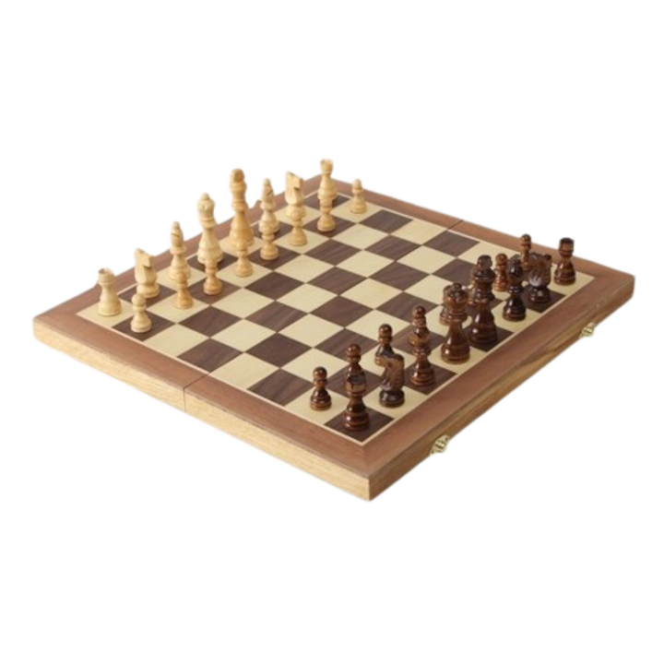
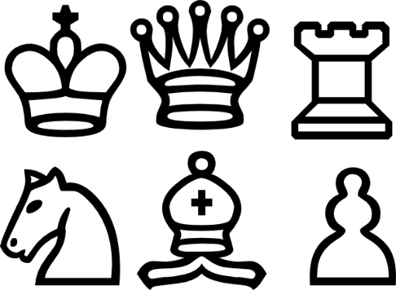
1. Sakk (Chess)
In Hungary, chess is not just a game but a cherished cultural tradition deeply ingrained in the fabric of society
Hungary's Strong Chess Tradition:
Hungary boasts a rich and storied tradition in the world of chess, marked by a legacy of excellence and achievement.
The country has produced numerous grandmasters, chess champions, and influential figures who have left an indelible mark on the global chess community.

Slide 6
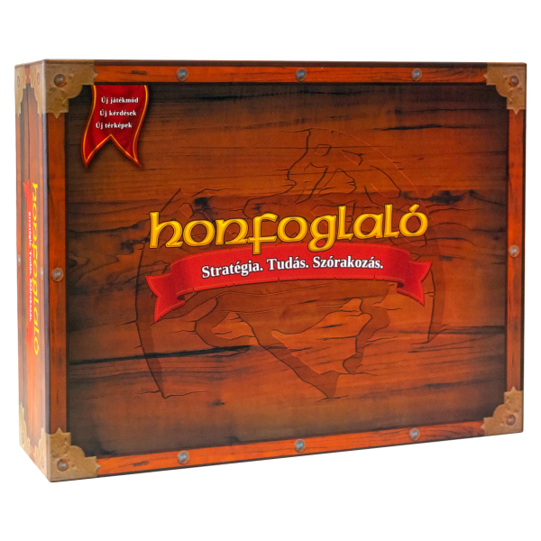
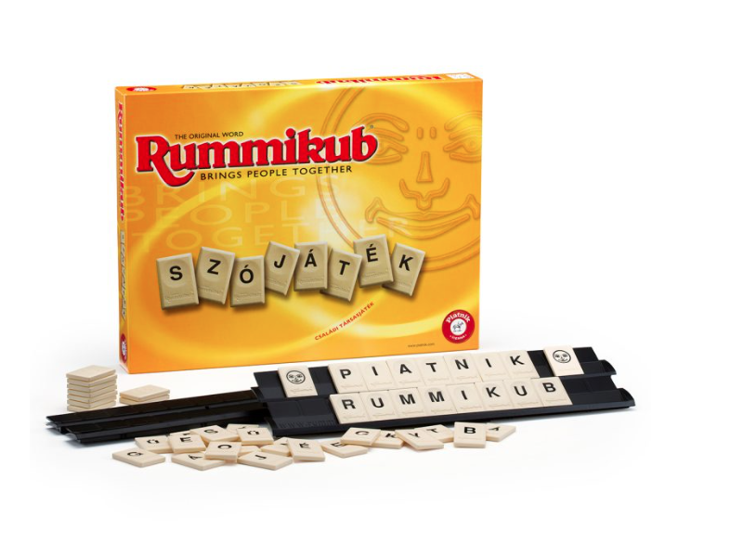
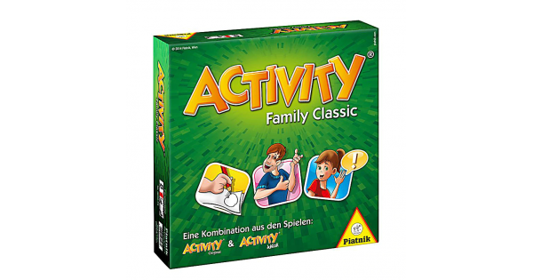
2. Társasjátékok (Board Games)
In Hungary, board games hold a special place in the hearts of many, offering a blend of entertainment, strategy, and social interaction. Here are some popular board games in Hungary, including unique ones like "Rummikub" and "Activity„
Rummikub
Activity
Carcassonne

Slide 7
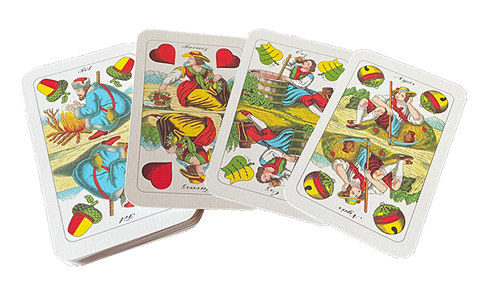
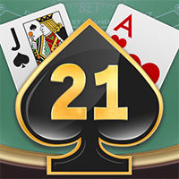
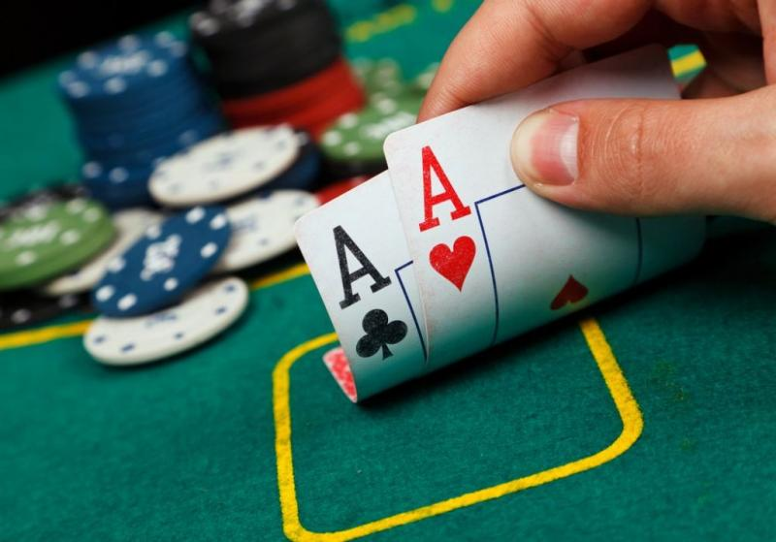
3. Kártyajátékok (Card Games)
Card games like Kártyapóker and Makaó play an integral role in Hungarian culture, serving as a means of bonding and strengthening social connections
For example:
Makaó:
Kártyapóker (Card Poker)
21:The 21 card game, also known as Blackjack, is a thrilling classic that has captivated players for centuries. It's a game of strategy, skill, and a touch of luck, where players aim to reach a total card value of 21 or closest to it without exceeding it.

Slide 8
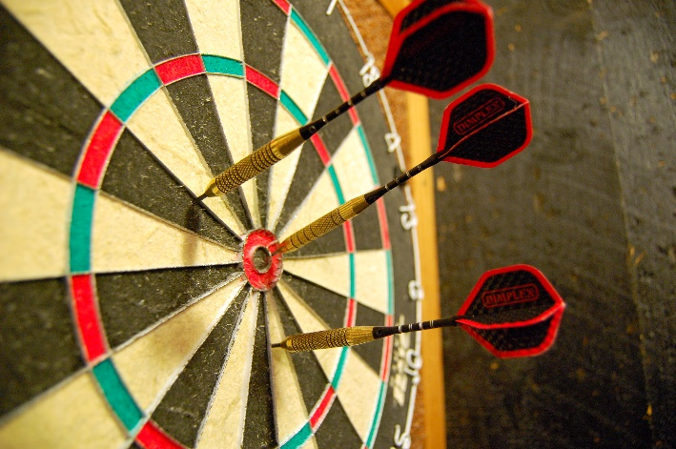
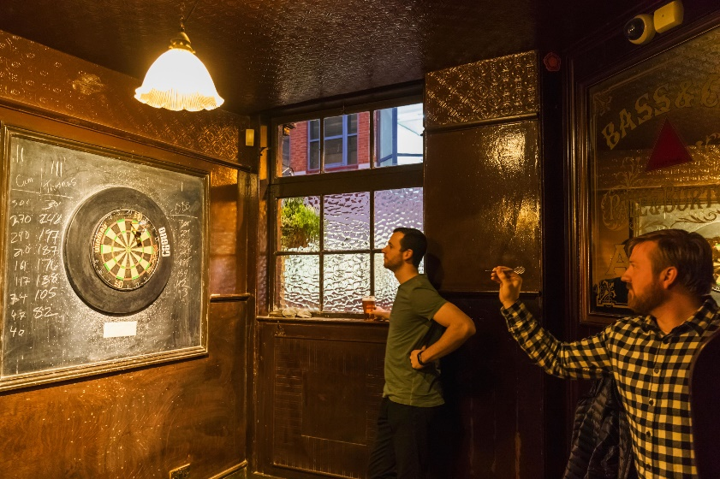
4. Darts
Darts is not just a game in Hungary; it's a social activity that brings people together, fostering friendly rivalries and creating memorable moments. Whether you're aiming for the bullseye or simply enjoying the company of friends, darts offers a rewarding and enjoyable experience for all who partake in it.
Typical Settings for Playing:
Pubs
Social Clubs
Dart Halls

Slide 9
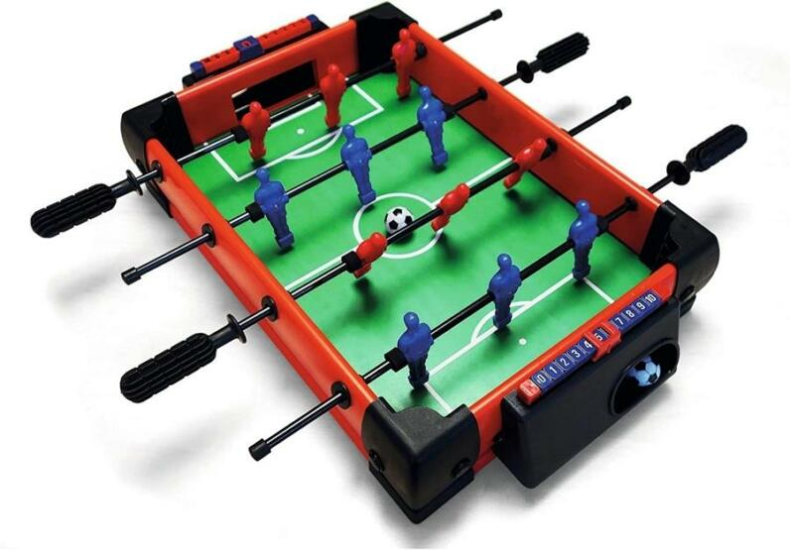
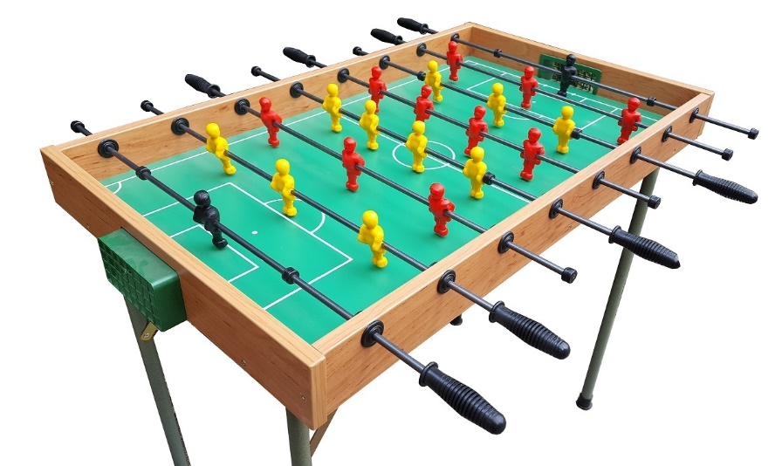
5. Asztali foci (Table Football)
Table football is a tabletop game that simulates soccer (football) by using miniature player figures mounted on rotating rods. The objective is to maneuver the figures to kick the ball into the opponent's goal while defending your own
Typical Settings for Playing
Pubs and Bars
Recreational Centers
Youth Centers and Schools

Slide 10
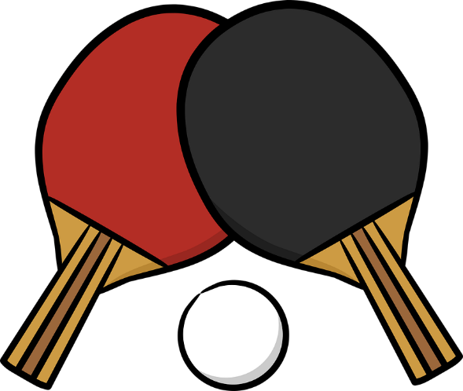
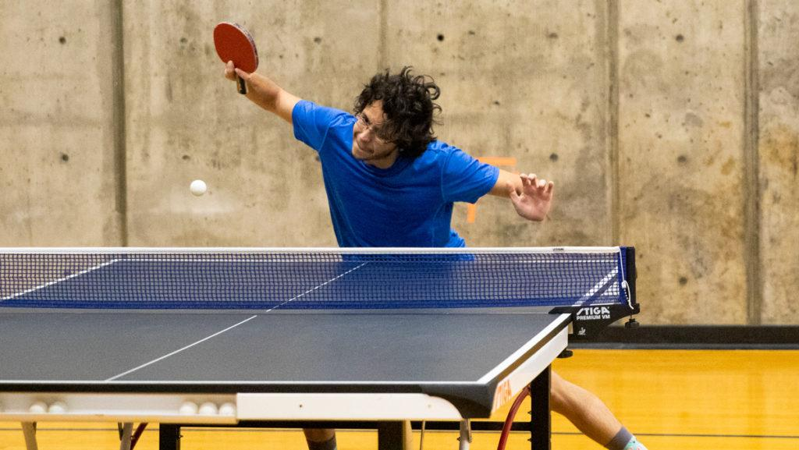
6. Ping-pong (Table Tennis)
Ping-pong is a thrilling racket sport played on a table divided by a net, with players using small paddles to hit a lightweight ball back and forth across the table. The objective is to score points by striking the ball in such a way that your opponent is unable to return it successfully
Typical Settings for Playing:
Recreational Centers
Schools and Universities
Community Centers and Public Spaces

Slide 11
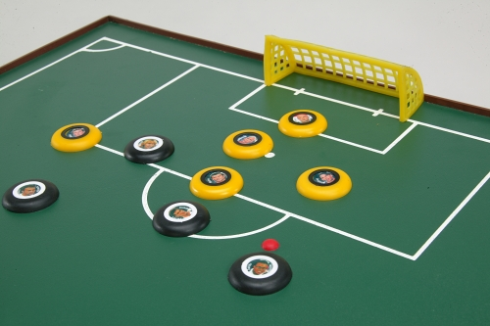
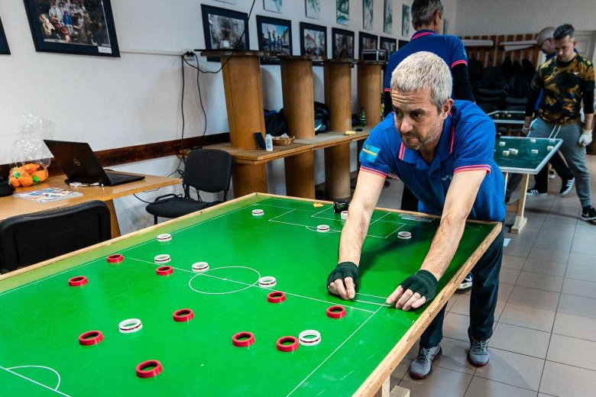
7. Gombfoci (Button Football)
Button football is typically played on a rectangular board, often homemade, with a smooth surface. The "pitch" is divided into halves, each representing a team's territory, and small goals are positioned at each end. Players control their team of buttons, representing footballers, using their index finger to flick them across the board
Basic Gameplay:
Setup
Kickoff
Movement and Passing
Shooting
Scoring
Winning

Slide 12
Thank you for your attention!

