Slide 1


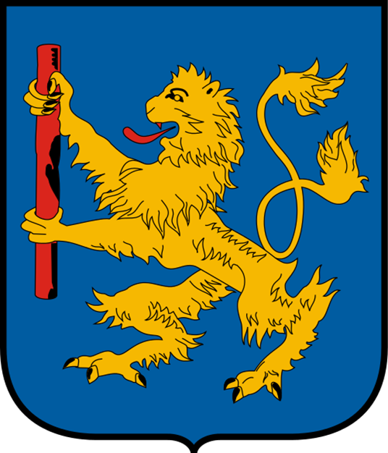



HATVAN
2022-1-HU01-KA220-SCH-000087324
Funded by the European Union. Views and opinions expressed are however those of the author(s) only and do not necessarily reflect those of the European Union or the European Education and Culture Executive Agency (EACEA). Neither the European Union nor EACEA can be held responsible for them.

Slide 2
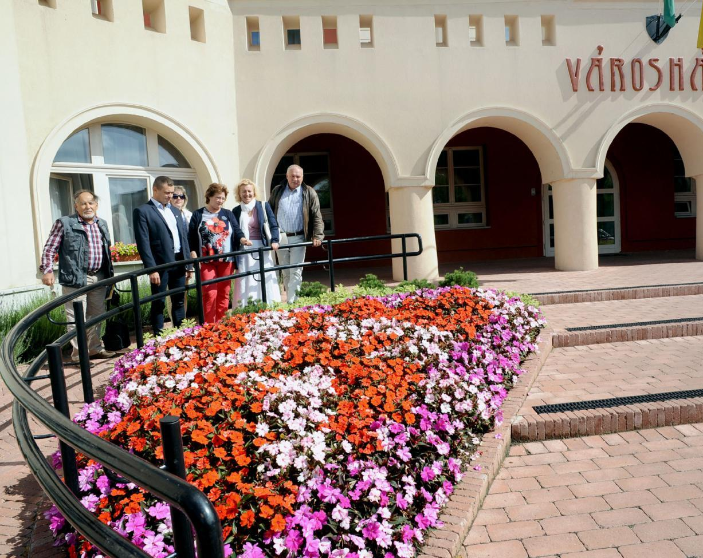
THE TOWN
Last estimated population: over 20000
2017: the most flowery town of Hungary

Slide 3
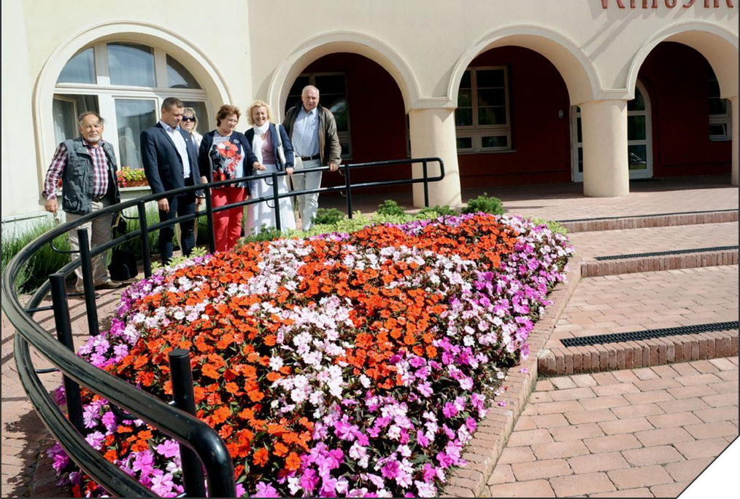
THE TOWN
Last estimated population: over 20000
2017: the most flowery town of Hungary

Slide 4
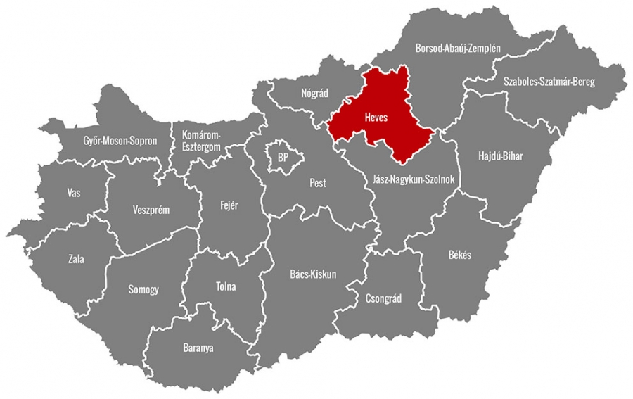
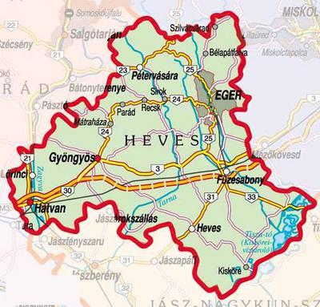
LOCATION
south-west of Heves county
the river Zagyva
territory:6630 hectares

Slide 5
ITS HISTORY
Flourishing from the Bronze Age
The title of „market town” in 1406
From1544 : paid tax to the Ottoman Empire
Earl Antal Grassalkovich bought the estate in 1734
Victorious battle against the Habsburgs on 2 April 1849

Slide 6
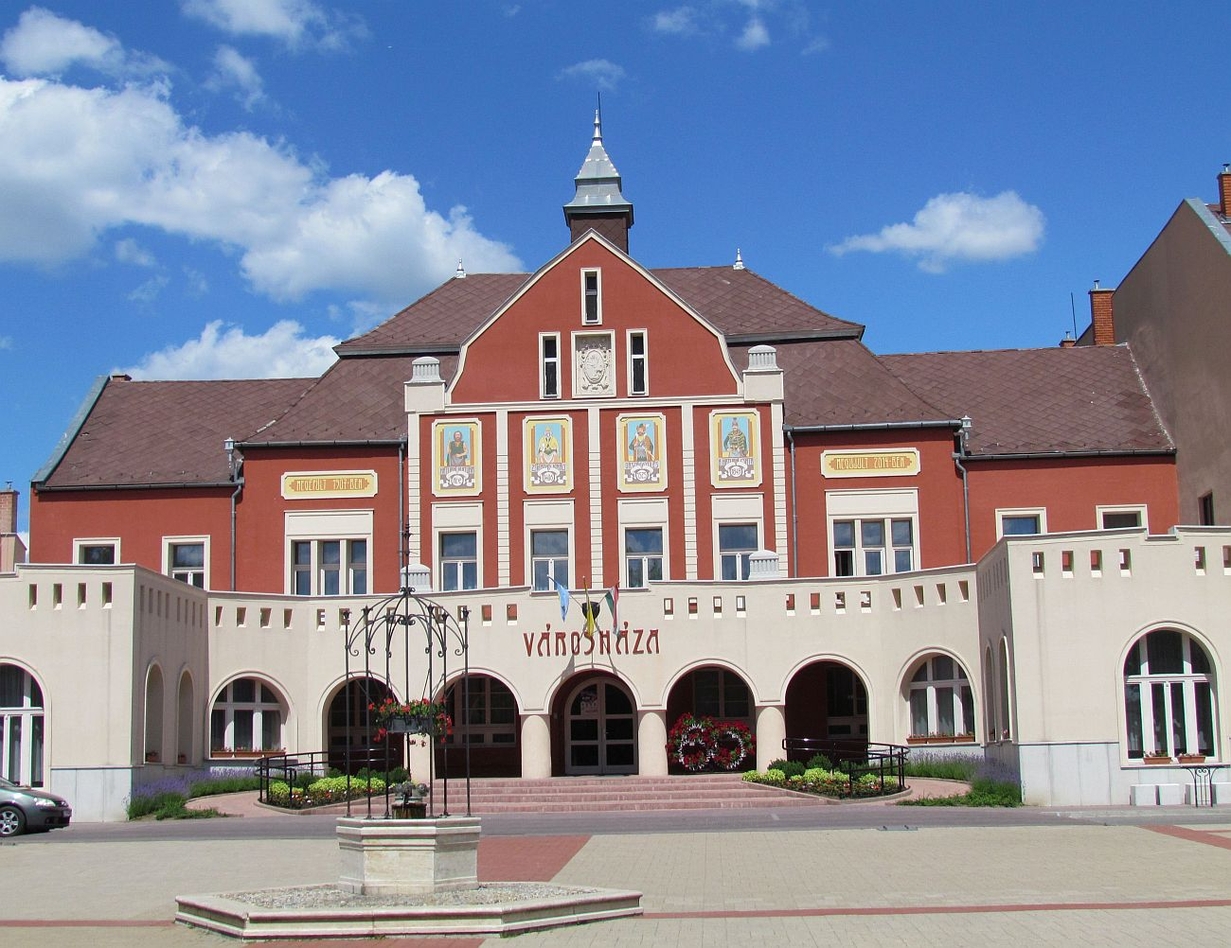
TOWN HALL

Slide 7
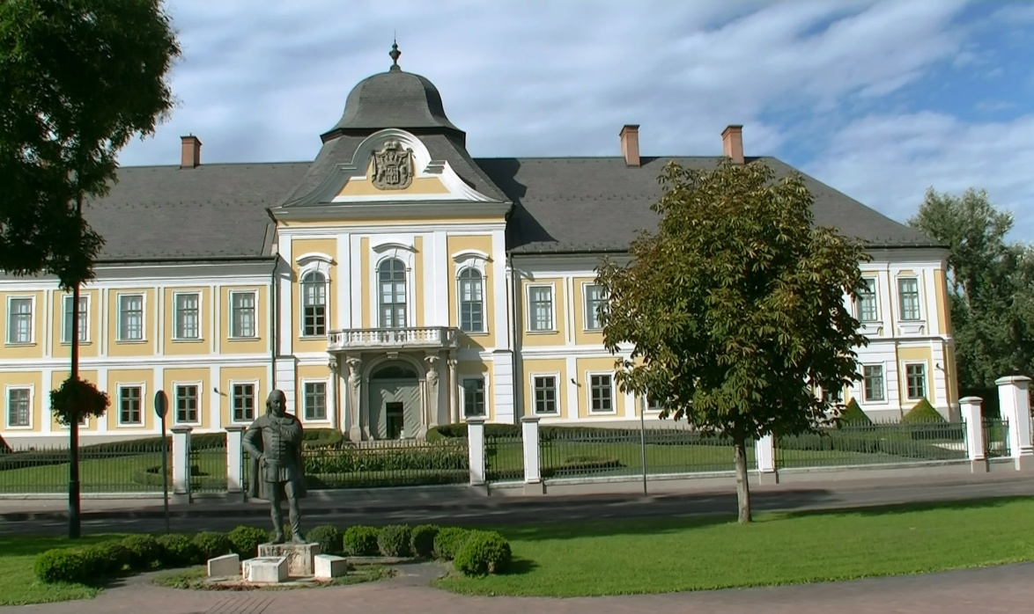
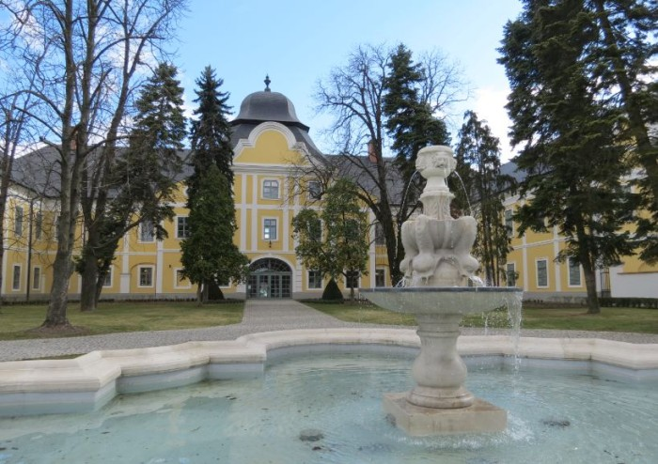
GRASSALKOVICH CASTLE
Built beteween 1754 -1763
Now: Széchenyi Zsigmond Hungarian Hunting Museum of the Capathian Basin

Slide 8
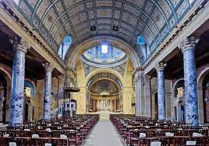
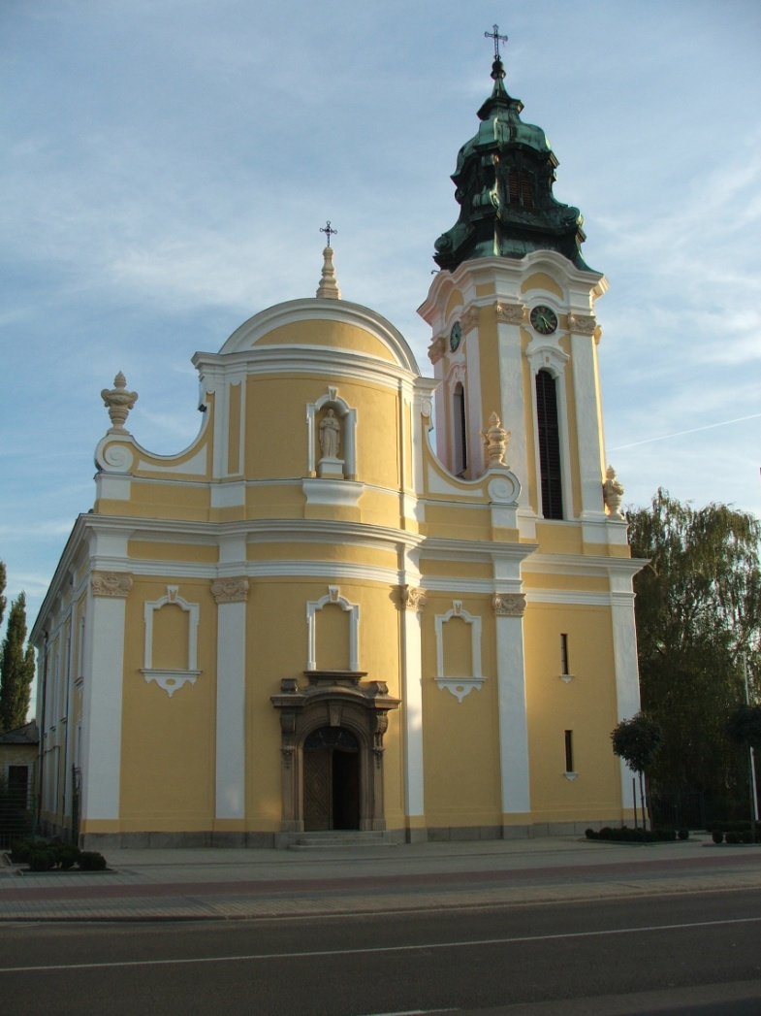
THE ROMAN CATHOLIC CHURCH IN NEW HATVAN

Slide 9
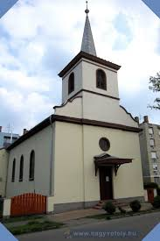
THE CALVINIST CHURCH

Slide 10
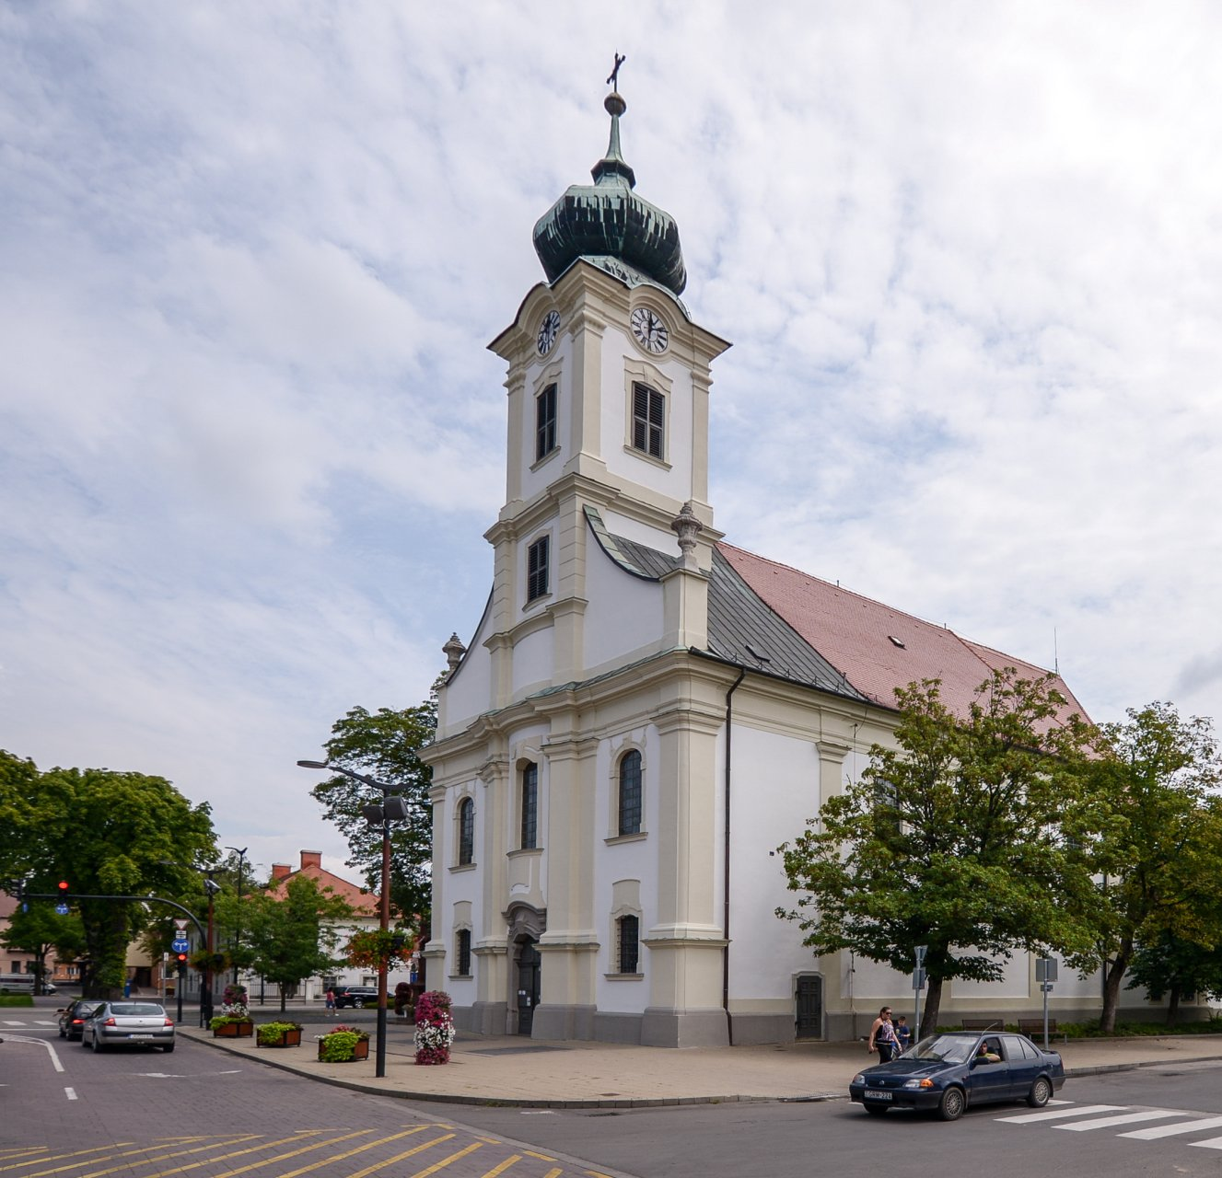
SAINT ADALBERT ROMAN CATHOLIC CHURH
Antal Grassalkovich had it built (1751-1757)

Slide 11
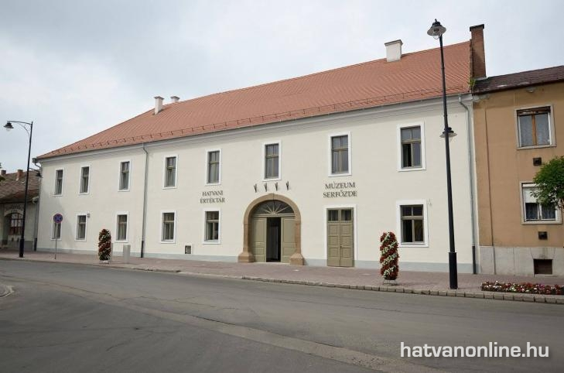
HATVANY LAJOS MUSEUM
ethnological, archeological and visual arts exhibitions
museum of local history
brewery

Slide 12
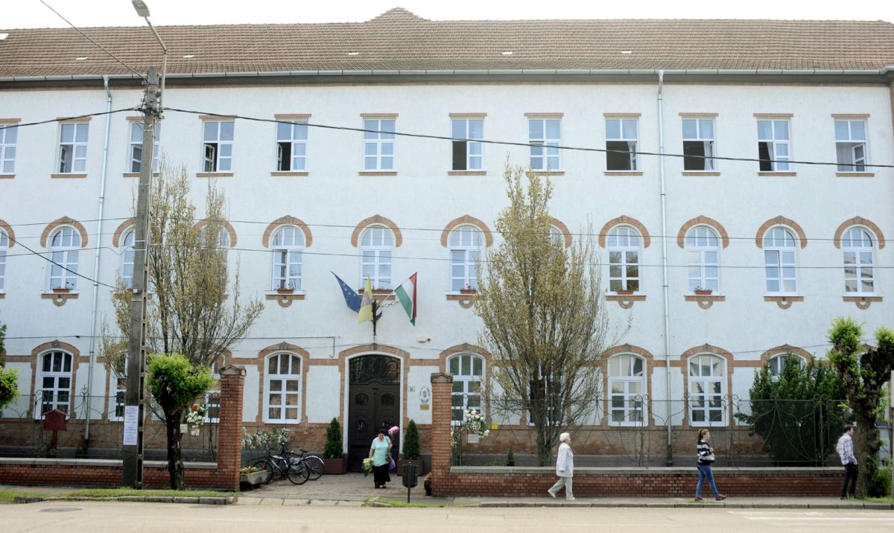
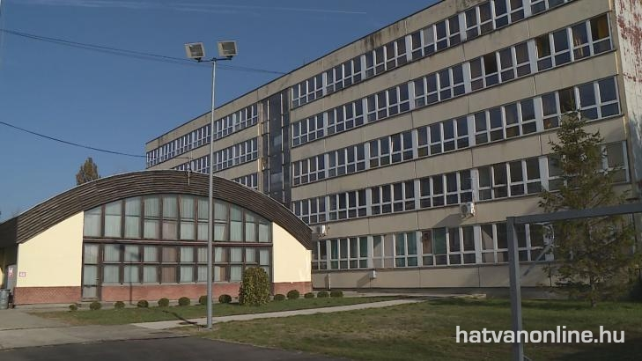
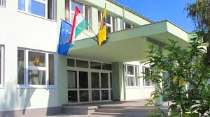
SECONDARY SCHOOLS

Slide 13

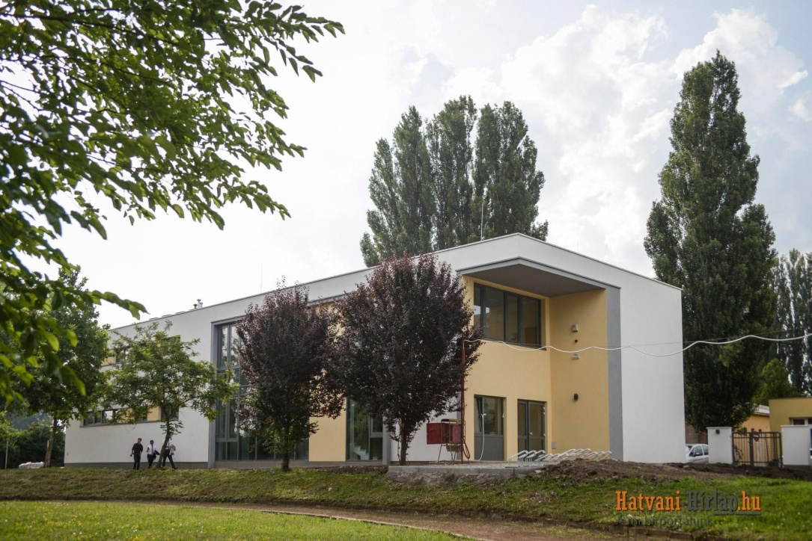
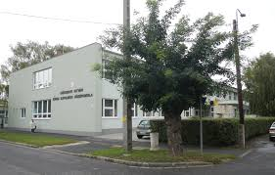
SZÉCHENYI ISTVÁN ROMAN CATHOLIC SECONDARY SCHOOL
Two buildings

Slide 14

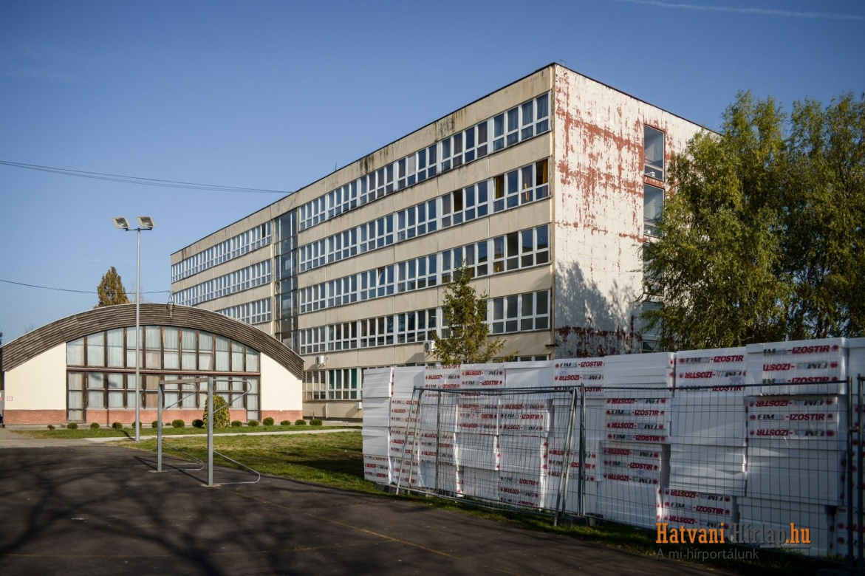
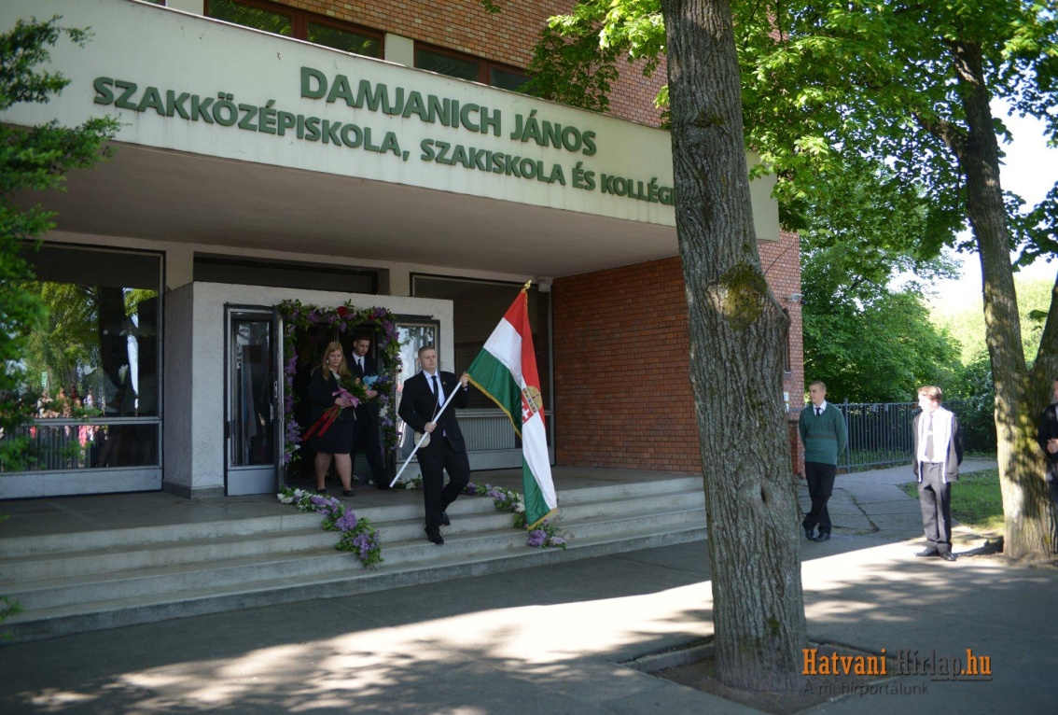
DAMJANICH JÁNOS SECONDARY SCHOOL

Slide 15

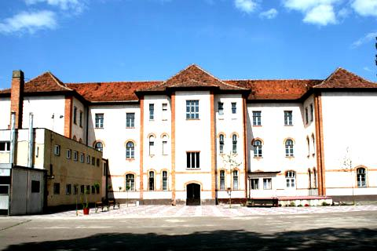
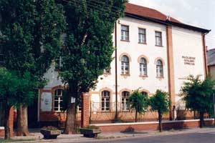
BAJZA JÓZSEF SECONDARY GRAMMAR SCHOOL

Slide 16
PRIMARY SCHOOLS
Kossuth Lajos Primary School
Roman Catholic Primary School
Szent István Primary School
Primary School No.5
Kodály Zoltán Primary School

Slide 17
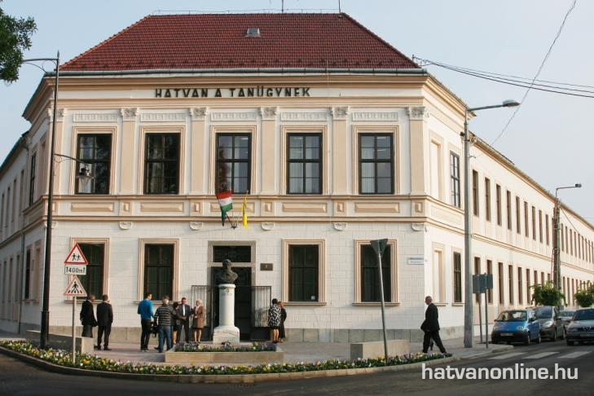

Slide 18
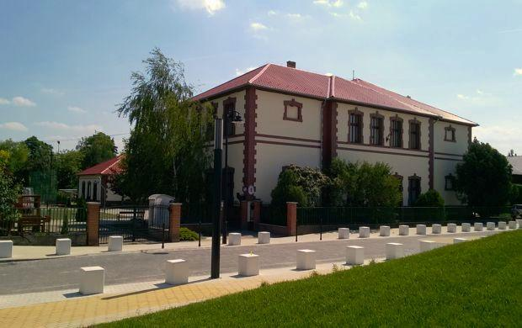
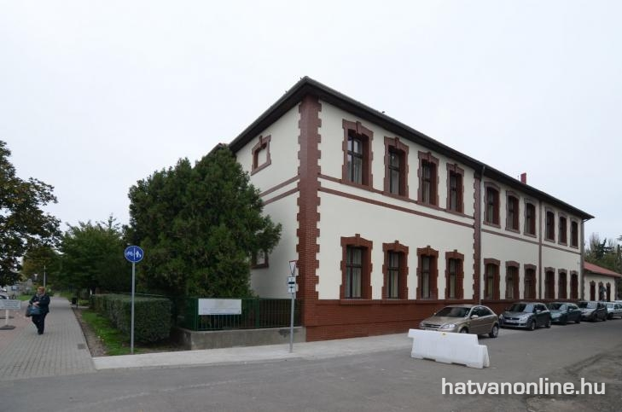
2.

Slide 19
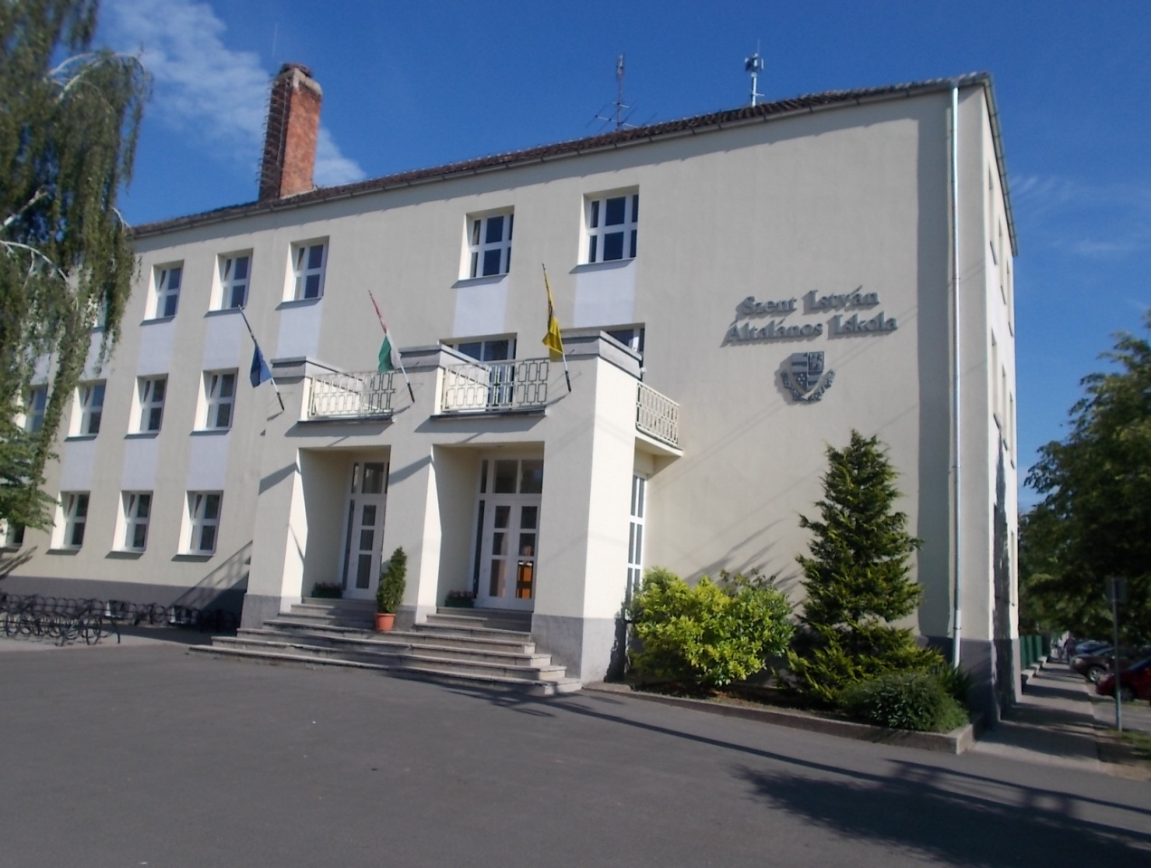
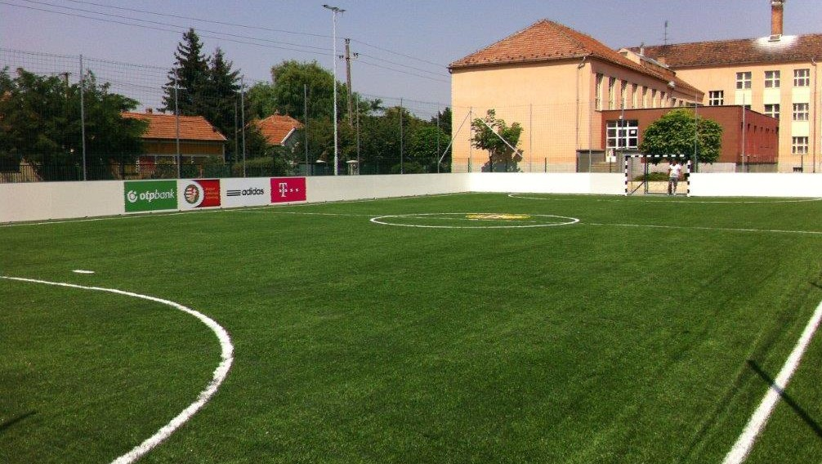
3.

Slide 20
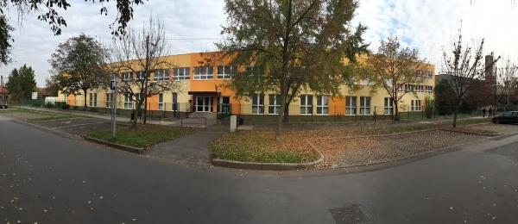
4.

Slide 21
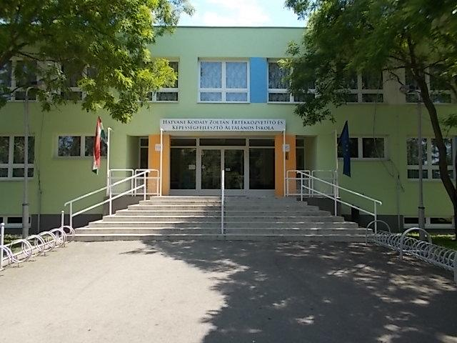
5.

Slide 22
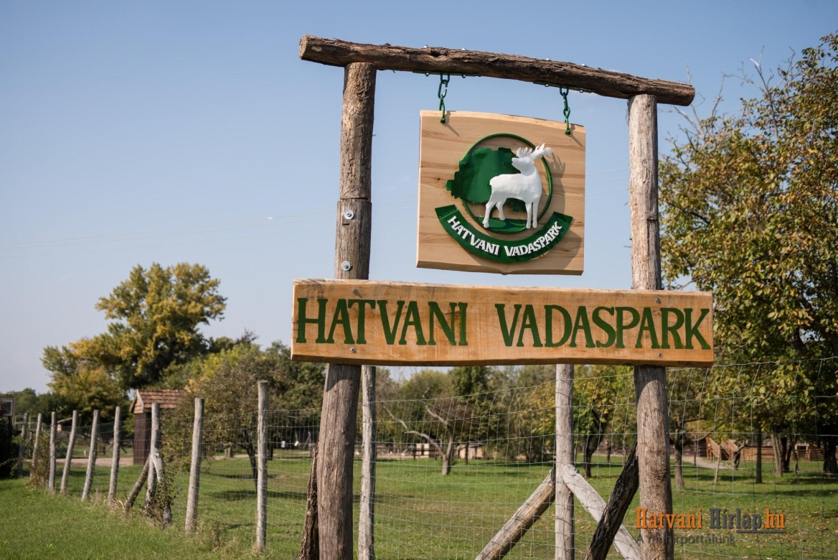
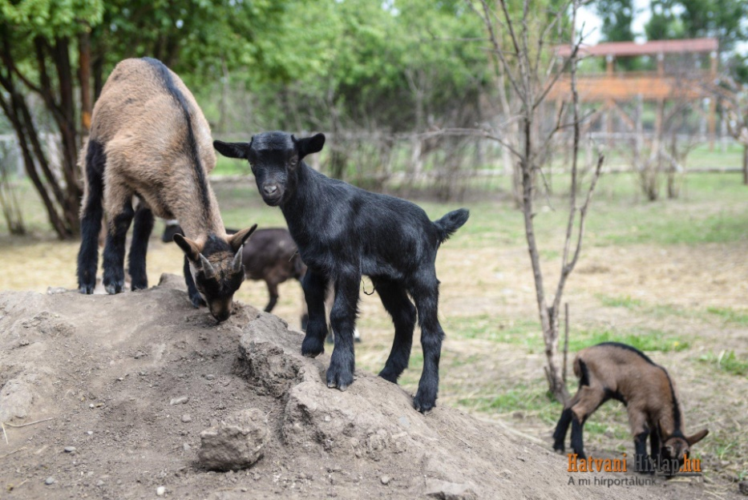
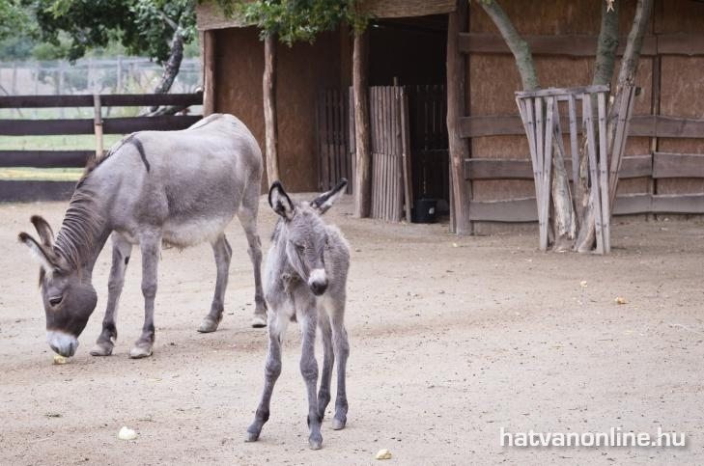
ZOO

Slide 23
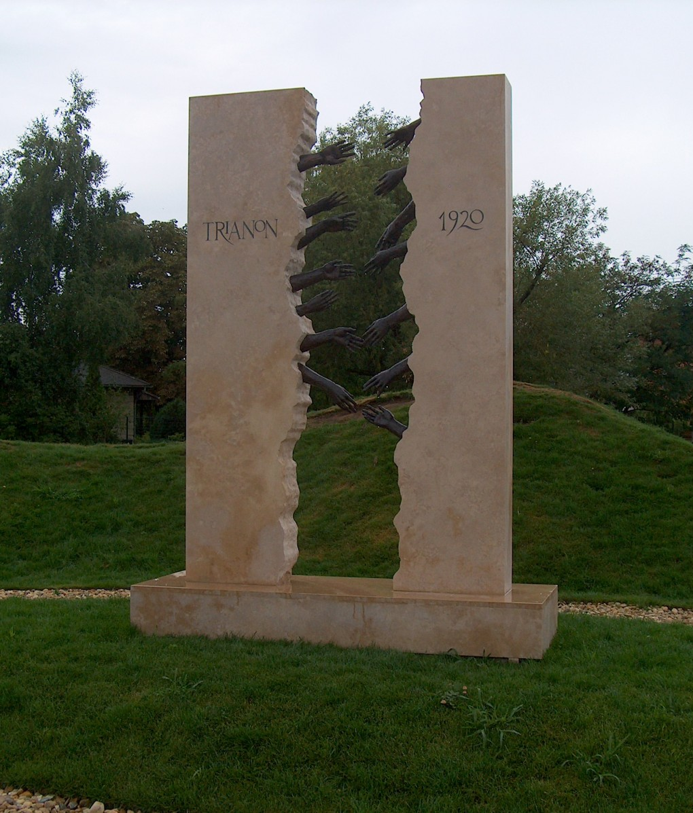
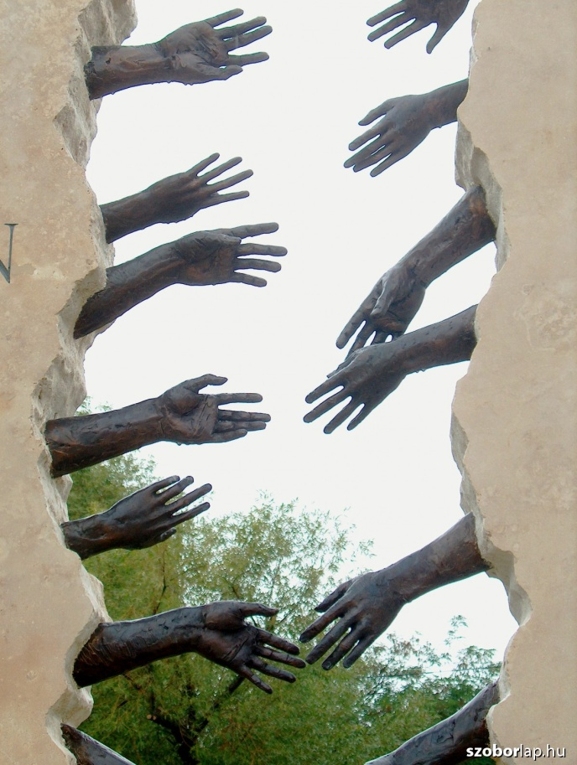
MEMORIALS
Trianon-monument

Slide 24
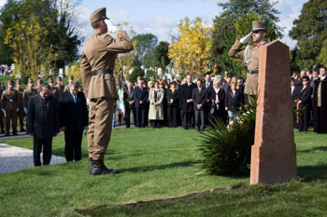
MEMORIALS
The memorial of the battle of 2 April 1849

Slide 25
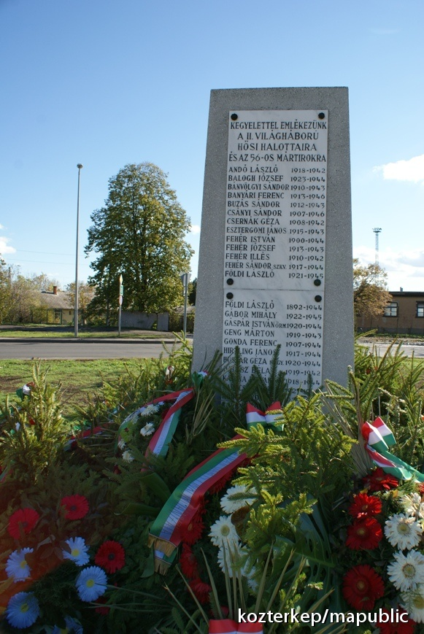
MEMORIALS
The Monument of Martyrs

Slide 26
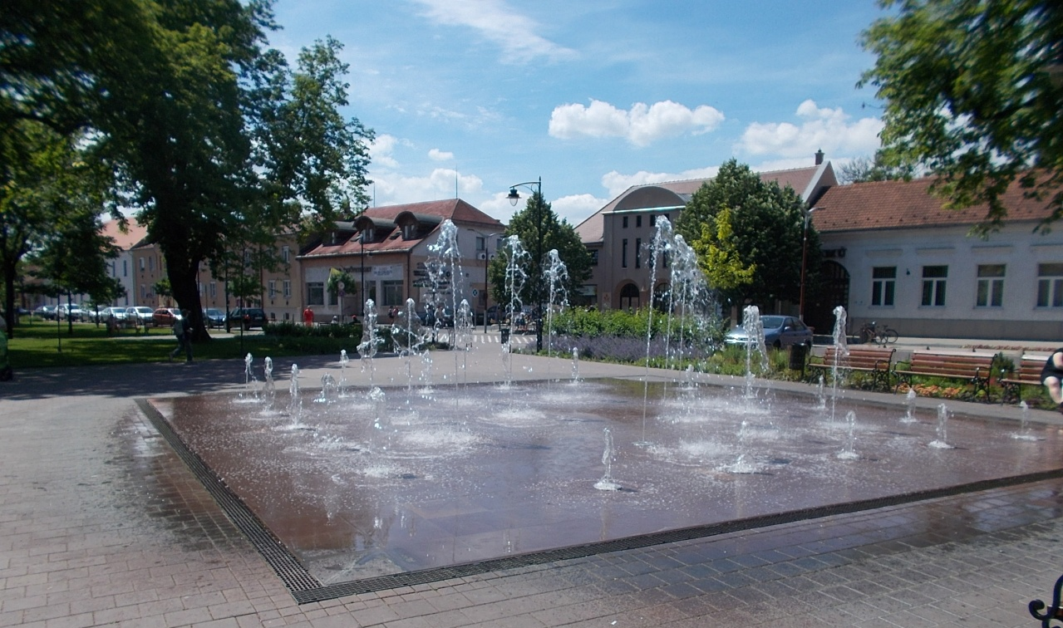
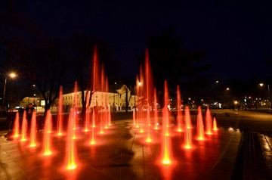
FOUNTAIN

Slide 27
Thank you for your attention!
☺

