Slide 1



„LOG IN BACK THE REAL LIFE”
Project ID: 2022-1-HU01-KA220-SCH-000087324
Funded by the European Union. Views and opinions expressed are however those of the author(s) only and do not necessarily reflect those of the European Union or the European Education and Culture Executive Agency (EACEA). Neither the European Union nor EACEA can be held responsible for them.

Slide 2

Crafting Hungary: Exploring the Riches of Hungarian Handicrafts
Made by: Forest Nkoli, Tóth Máté

Slide 3

Introduction
History of Hungarian Handicrafts
Folk Art
Embroidery
Pottery
Weaving
Contemporary Handicrafts
Famous Hungarian Handicrafts
Handicraft Markets
Learning Hungarian Handicrafts
Benefits of Hungarian Handicrafts
Conclusion

Slide 4
Introduction
Welcome to our presentation on Hungarian handicrafts! Today, we will be exploring the rich history and vibrant culture behind these unique art forms. From embroidery to pottery, weaving to folk art, Hungary has a long tradition of creating beautiful and intricate handicrafts that are admired around the world.
Whether you are an art enthusiast or simply curious about the beauty of traditional crafts, this presentation is sure to captivate your imagination. So sit back, relax, and let us take you on a journey through the fascinating world of Hungarian handicrafts.

Slide 5
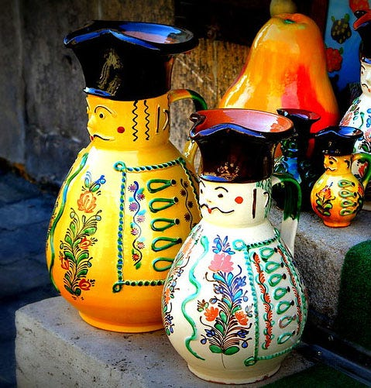
History of Hungarian Handicrafts
Hungarian handicrafts have a rich and fascinating history that dates back centuries. The country's geography, climate, and cultural influences have all contributed to the development of unique and diverse handicraft traditions.
From intricate embroidery patterns to beautifully decorated pottery, Hungarian handicrafts are a reflection of the country's artistic and cultural heritage. These crafts were not only important for their practical uses but also played a significant role in social and religious ceremonies.

Slide 6
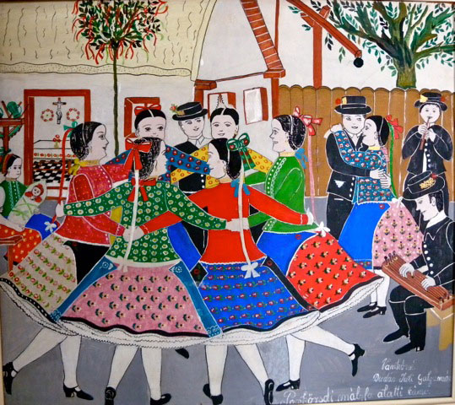
Folk Art
Folk art is an integral part of Hungarian culture, and it encompasses a wide range of artistic expressions. From embroidery to pottery to weaving, each type of folk art has its unique characteristics that make it special.
Embroidery is one of the most popular forms of folk art in Hungary. Traditional patterns such as the Matyó and Kalocsa designs are still used today, and the intricate stitching techniques are passed down from generation to generation.

Slide 7
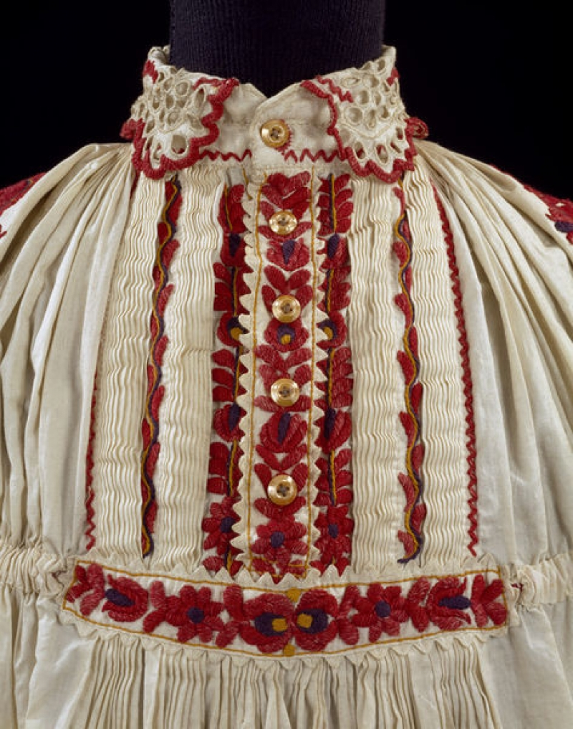
Embroidery
Embroidery is a traditional Hungarian handicraft that has been passed down from generation to generation. The intricate patterns and techniques used in Hungarian embroidery make it a unique and beautiful art form.
One of the most well-known types of Hungarian embroidery is the Matyó embroidery, which originated in the town of Mezőkövesd. This type of embroidery features colorful floral patterns and is often used to decorate clothing and household items.

Slide 8
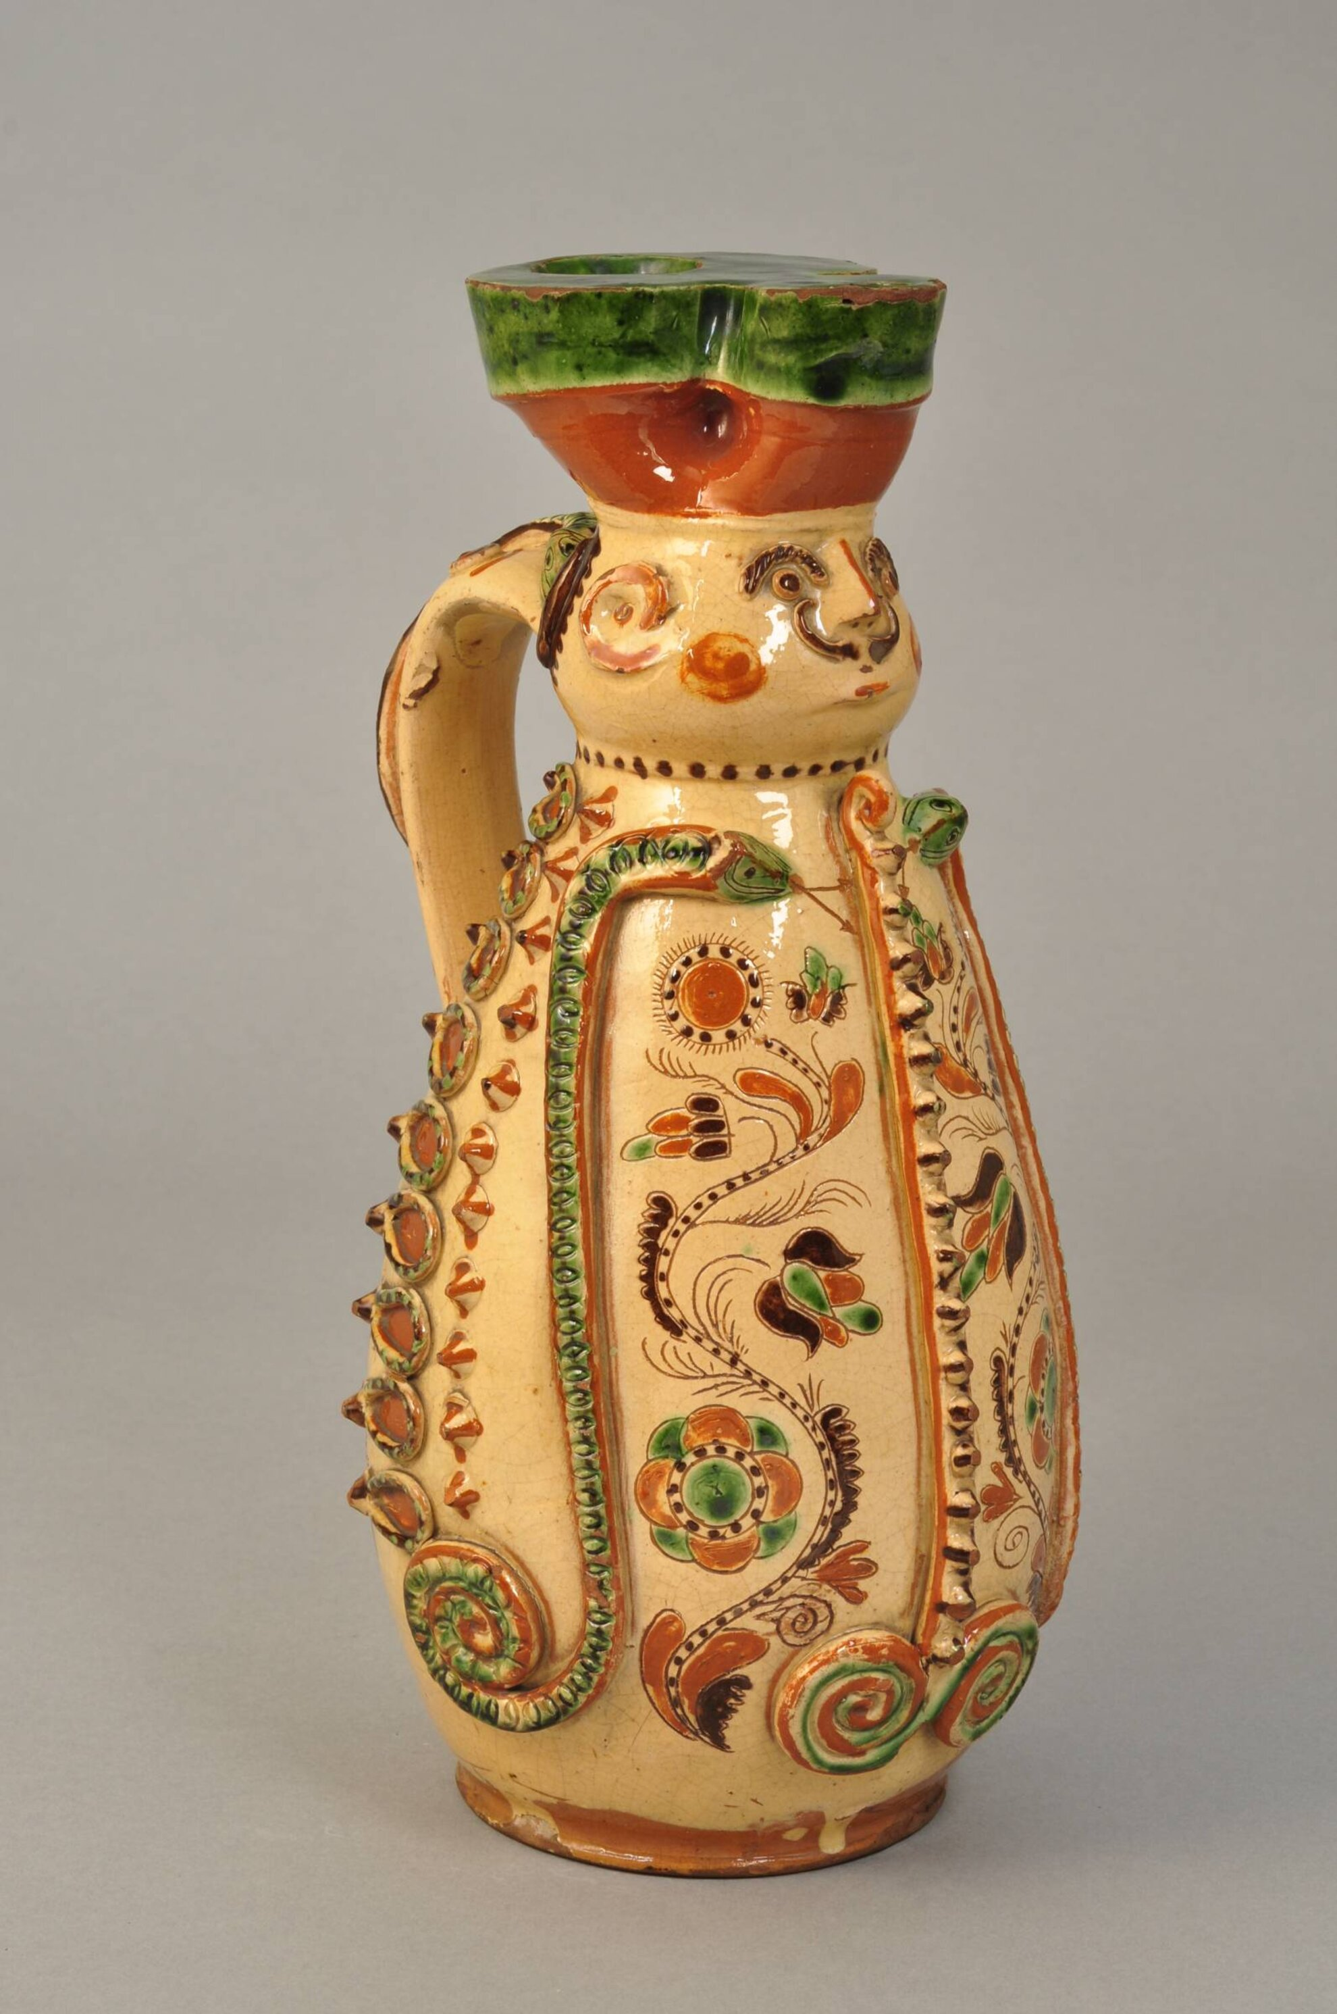
Pottery
Hungarian pottery is known for its unique shapes, colors, and decorations. The pottery has a distinct earthy feel to it that is achieved by using natural materials such as clay and sand. The shapes are often asymmetrical, adding to the charm of each piece.
The colors used in Hungarian pottery are vibrant and bold, ranging from deep blues and greens to bright oranges and yellows. The decorations are intricate and detailed, often featuring floral or geometric patterns. Each piece of pottery is truly a work of art.

Slide 9
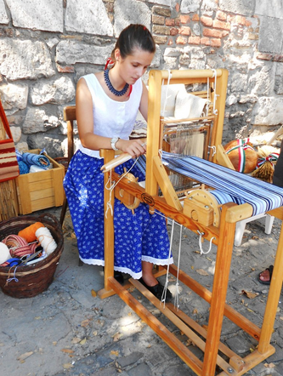
Weaving
Hungarian weaving is a traditional craft that has been practiced for centuries. The process involves carefully interlacing different materials, such as wool and linen, to create intricate patterns and designs.
One of the unique aspects of Hungarian weaving is the use of a special loom called a 'szita'. This loom allows weavers to work on multiple sections of the fabric at once, creating a more efficient and detailed final product.

Slide 10
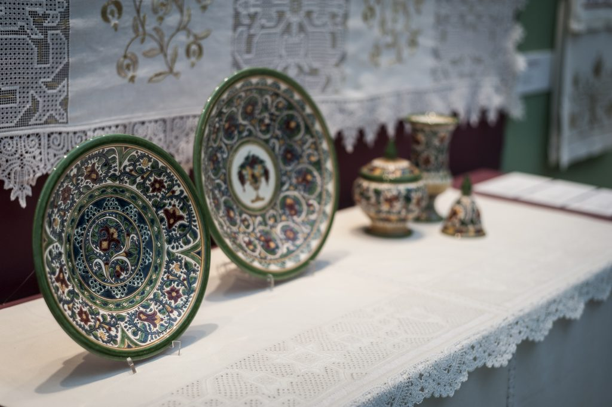
Contemporary Handicrafts
As Hungary continues to evolve, so do its handicraft traditions. Today, contemporary Hungarian artisans are blending traditional techniques with modern design principles to create stunning works of art that are both functional and beautiful.
For example, some weavers are incorporating new materials like recycled plastics into their designs.

Slide 11
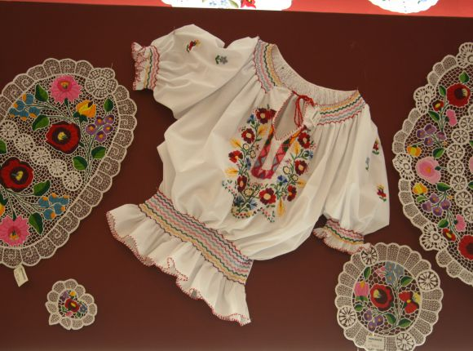
Famous Hungarian Handicrafts
Hungarian handicrafts are known for their exquisite beauty and attention to detail. Among the most famous are Kalocsa embroidery and Herend porcelain. Kalocsa embroidery is a traditional Hungarian folk art that originated in the town of Kalocsa in the late 19th century.
Both Kalocsa embroidery and Herend porcelain are highly prized by collectors and enthusiasts alike. Their unique beauty and cultural significance make them true treasures of Hungarian handicrafts.

Slide 12
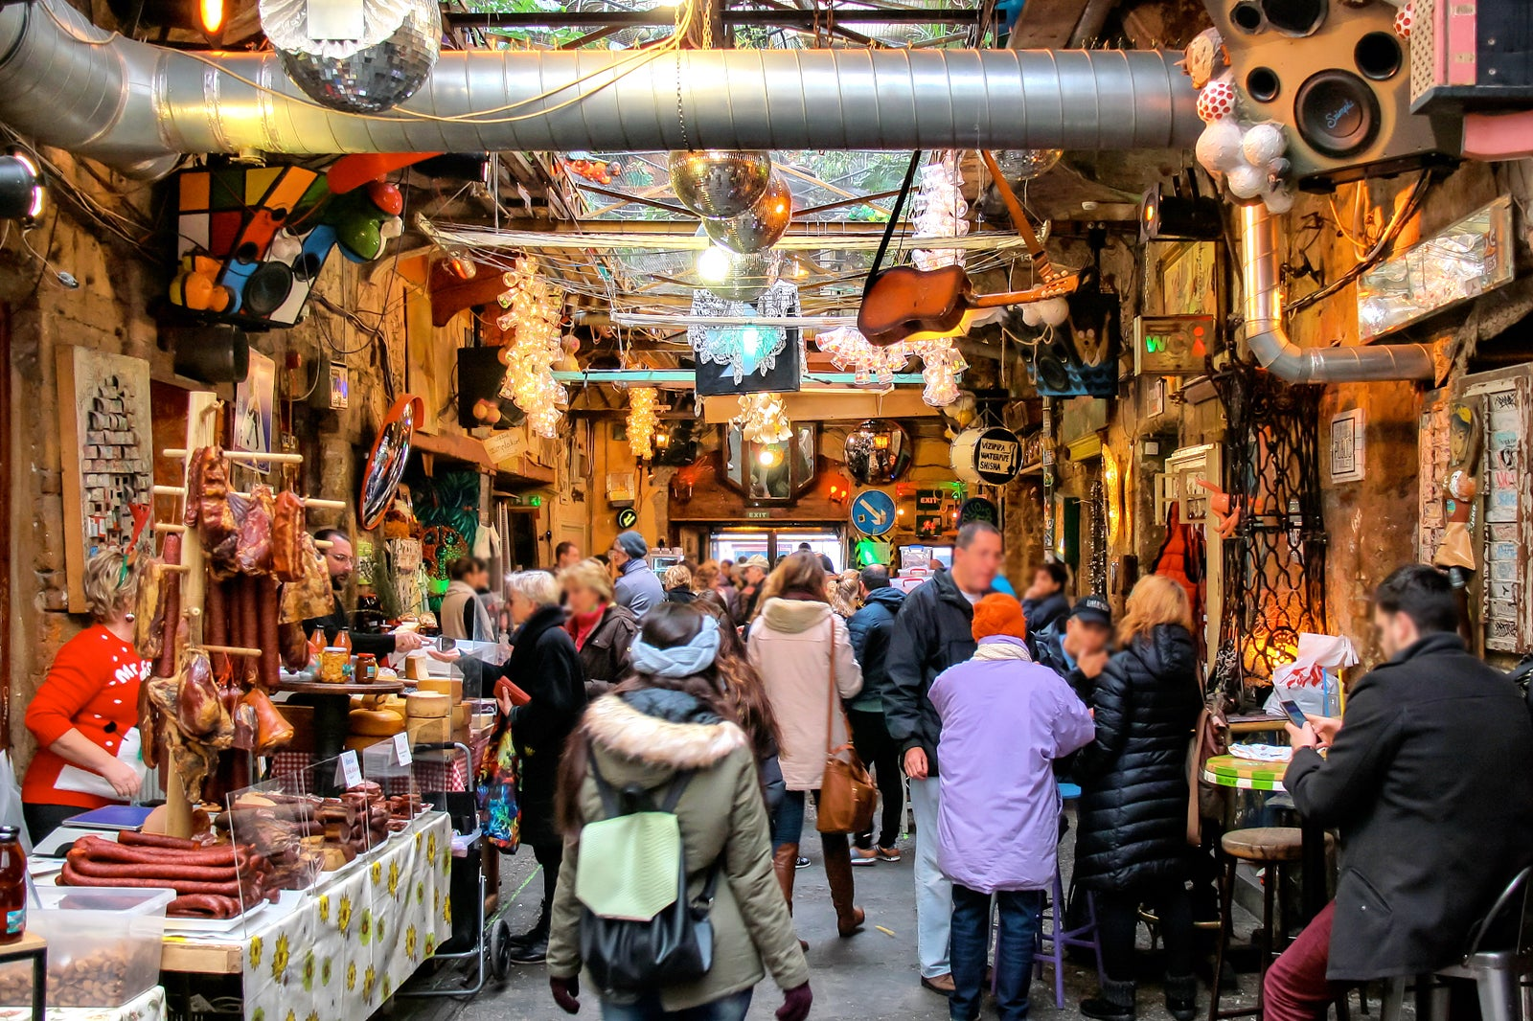
Handicraft Markets
Hungary is known for its vibrant and bustling handicraft markets, which attract visitors from all over the world. One of the most popular markets is the Easter Market in Budapest, which takes place in the beautiful Vörösmarty Square.
Another must-visit market is the Christmas Market in Szentendre, a charming town located just outside of Budapest. This market is famous for its stunning Neo-Impressionist architecture and picturesque cobblestone streets.

Slide 13
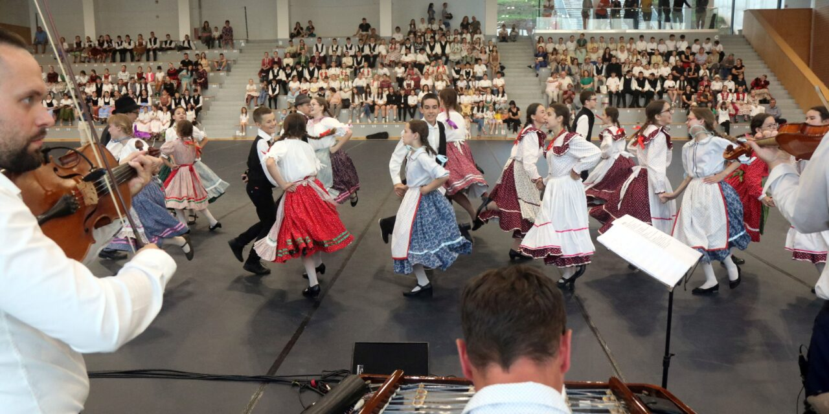
Learning Hungarian Handicrafts
Learning Hungarian handicrafts can be a fun and rewarding experience. There are many workshops and classes available throughout Hungary that offer hands-on instruction in traditional techniques such as embroidery, pottery, and weaving. These classes are taught by skilled artisans who are passionate about preserving their cultural heritage and passing on their knowledge to others.
In addition to classes, there are also many online resources available for those interested in learning more about Hungarian handicrafts. From instructional videos to downloadable patterns, these resources make it easy to get started on your own projects. Whether you're a beginner or an experienced crafter, there's always something new to learn and explore in the world of Hungarian handicrafts.

Slide 14
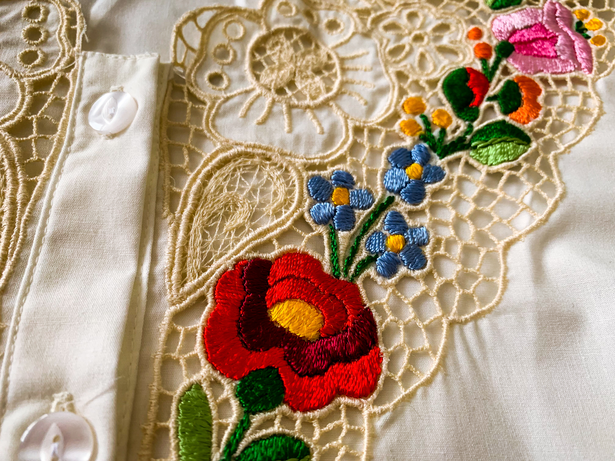
Benefits of Hungarian Handicrafts
Practicing Hungarian handicrafts can have numerous benefits for both your mental and emotional well-being. Engaging in creative activities like embroidery, pottery, and weaving can be a great way to relieve stress and promote relaxation. The process of crafting something with your own hands can be meditative and calming, allowing you to focus on the present moment and forget about any worries or anxieties you may have.

Slide 15
Conclusion
In conclusion, we have explored the rich history and cultural significance of Hungarian handicrafts.
We have also discussed the modernization of Hungarian handicrafts and how they continue to be relevant today.
So why not take a trip to one of the popular handicraft markets in Hungary, such as the Easter Market in Budapest or the Christmas Market in Szentendre? Or better yet, enroll in a workshop or class to learn these crafts firsthand.
In the end, practicing Hungarian handicrafts can bring many benefits, from stress relief to cultural preservation.

Slide 16
Thanks for your attention!

