Slide 1




Discover Almada, the city of our School
A Glimpse into Almada’s Charm and Attractions
Funded by the European Union. Views and opinions expressed are however those of the author(s) only and do not necessarily reflect those of the European Union or the European Education and Culture Executive Agency (EACEA). Neither the European Union nor EACEA can be held responsible for them.
2022-1-HU01-KA220-SCH-000087324

Slide 2
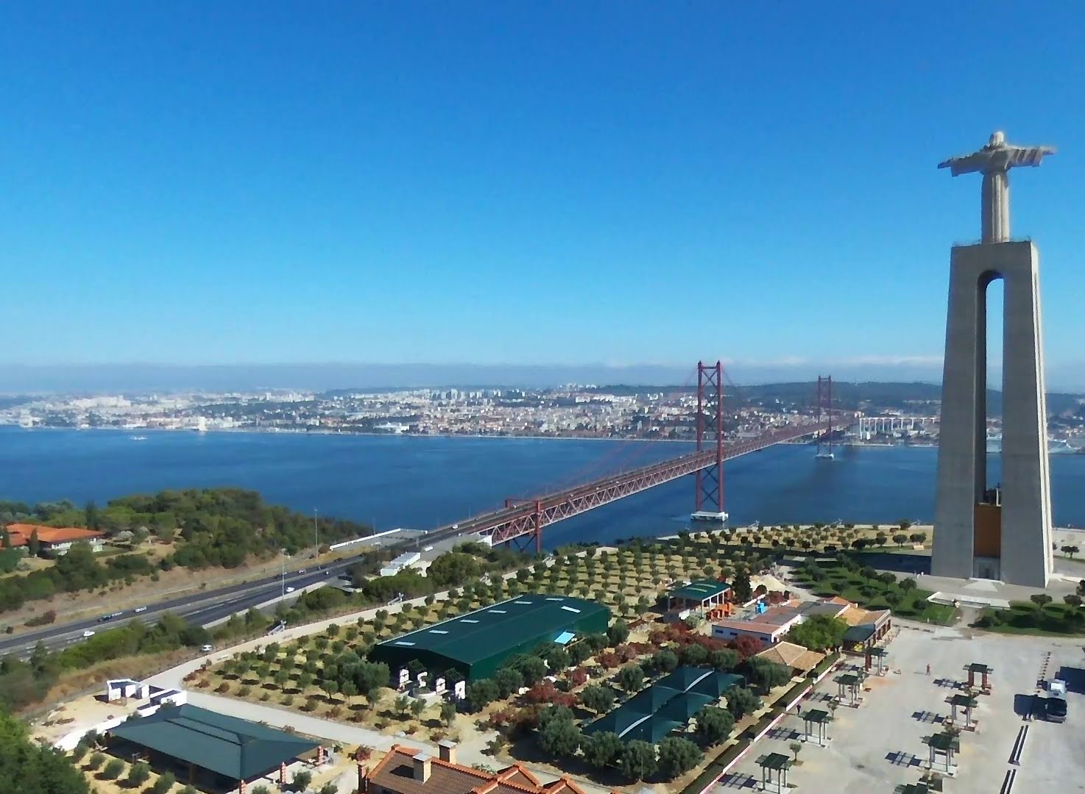
Introduction to Almada
Almada, located just across the river from Lisbon, is a blend of historical charm, stunning landscapes, and vibrant culture. Known for its scenic views, rich cultural heritage, and coastal beauty, Almada is a popular choice for both locals and tourists.

Slide 3
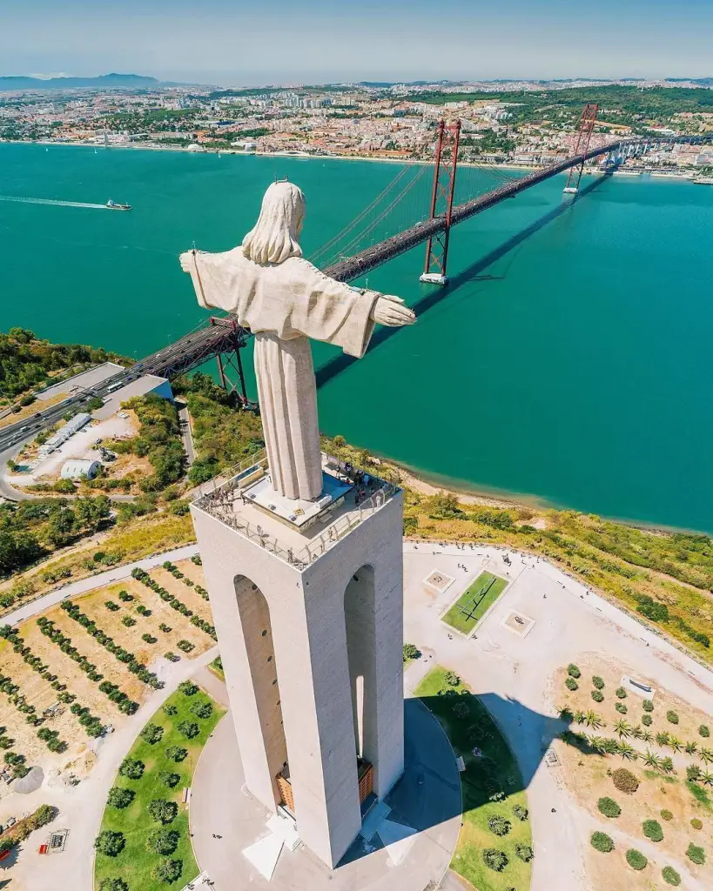
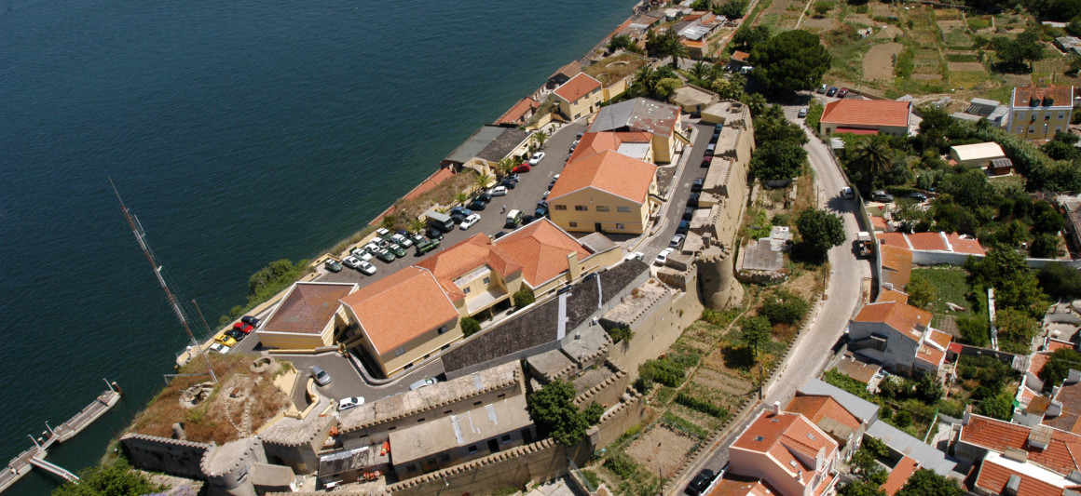
Iconic Attractions
Highlights include the Cristo Rei statue, inspired by Rio de Janeiro’s Christ the Redeemer, and Almada Castle, which dates back to medieval times.

Slide 4

Culture and Lifestyle
Almada’s festivals, like the Feira de Santiago and Festas de Nossa Senhora do Monte, showcase its cultural vibrancy. Additionally, the local markets offer a taste of traditional Portuguese crafts and cuisine.

Slide 5

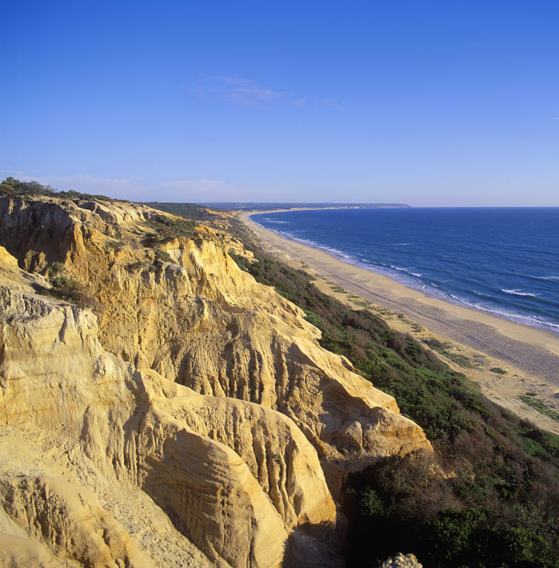
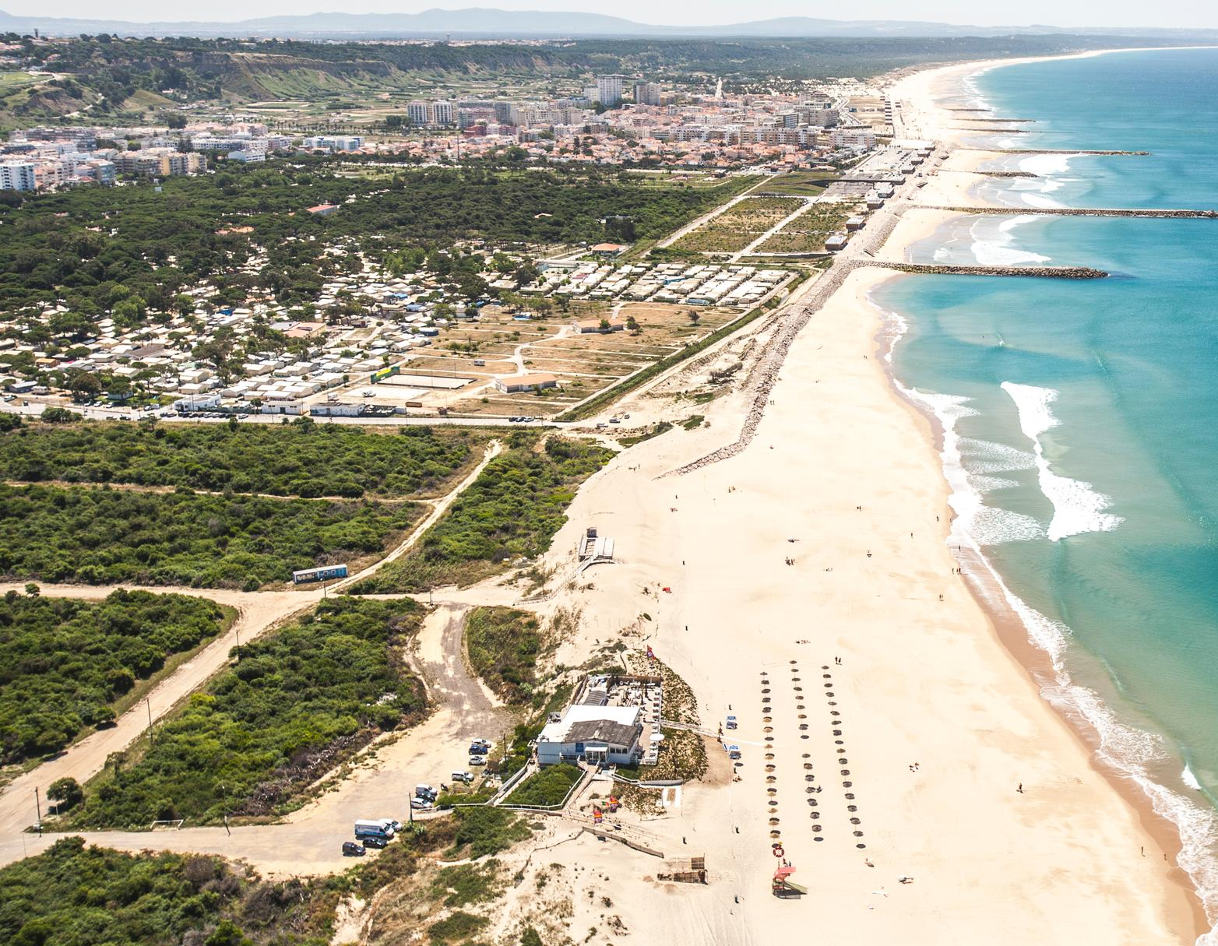
Nature and Adventure
Almada is known for Costa da Caparica’s sandy beaches, perfect for surfing and sunbathing. It’s also near Arrábida Natural Park, ideal for hiking and nature walks.

