Slide 1



„LOG IN BACK THE REAL LIFE”
Project ID: 2022-1-HU01-KA220-SCH-000087324
Funded by the European Union. Views and opinions expressed are however those of the author(s) only and do not necessarily reflect those of the European Union or the European Education and Culture Executive Agency (EACEA). Neither the European Union nor EACEA can be held responsible for them.

Slide 2
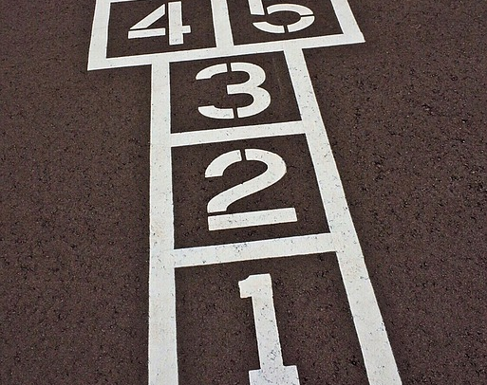
INDOOR GAMES IN TURKIYE

Slide 3
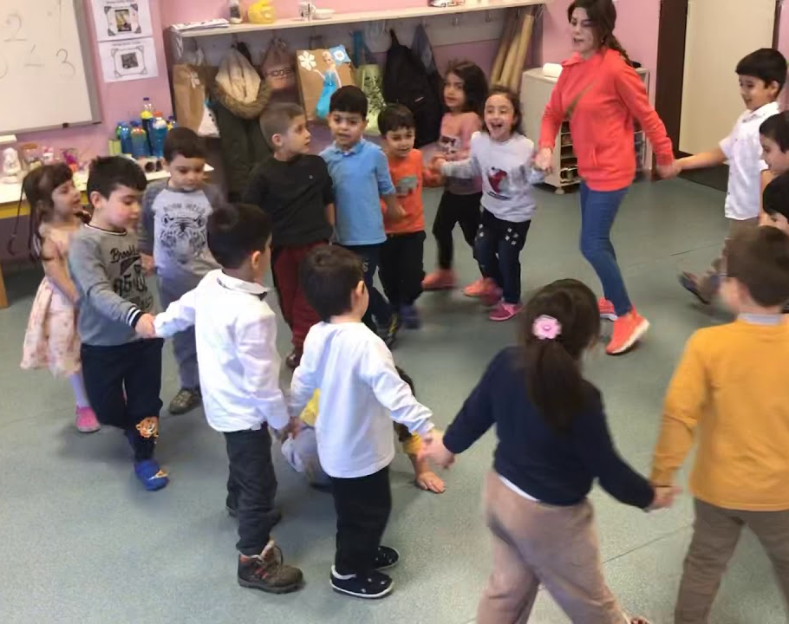
Eski Minder Game

Slide 4
A História do Jogo
We don’t know when this game was played for the first time. But because of the words used in its rhyme it is supposed to be a recent game. The name of the game comes from its rhyme. It is also known as beautiful or ugly.

Slide 5
Como jogar Eski Minder?
The game can be played either indoor as outdoor. It is known in the whole Anatoly. It needs 4 players.
The it is chosen by the group. The it stands in the middle of the circle the players make and kneels so they won’t see the players face. The players dance in the circle and sing the rhyme that goes like:
"Eski minder, yüzünü göster. Göstermezsen bir poz ver. Güzellik mi çirkinlik mi, havuz başında, heykellik mi? Hangisi? ''Beauty or ugliness? Being a statue by the pool? Which one?''

Slide 6
How to Play Eski Minder?
After singing the rhyme the it stands up and chooses one of the options that are sang in the rhyme. Beauty, Ugliness or Sculpture By The Pool. The players in the circle try posing the most similar to the chosen pose without moving and be the best out of the group.
After everyone gives a pose “Eski Minder” chooses the person who moved or if nobody moved the it tries to make them move and if still no one moves the it chooses the best pose out of the group and tags them to be the next it. And the game ends when everyone becomes “Eski Minder” at least once.

Slide 7
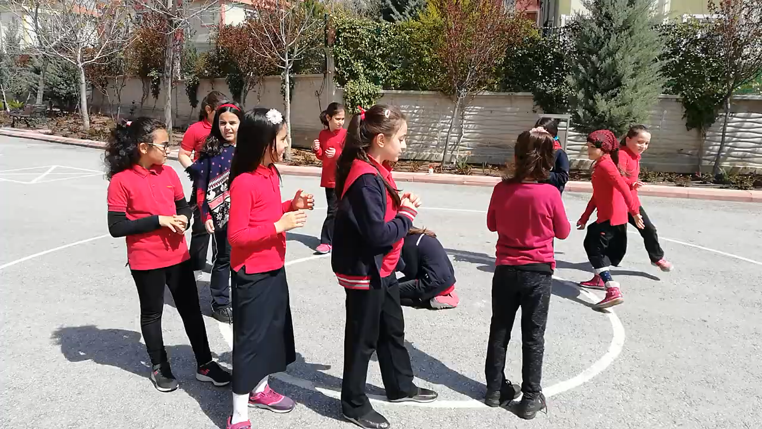

Slide 8
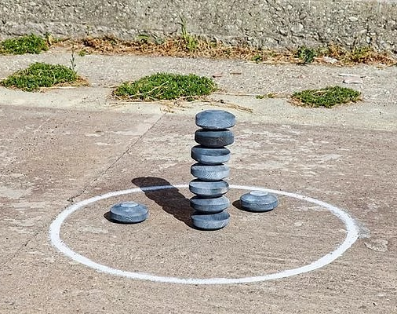
Nine Rock Street Game

Slide 9
How to Play Nine Rock Game?
This game is played with at least six players. There is no player limitation, you can play with as many people as you want.
First of all, players are divided into two groups. Usually these groups are formed by counting or tossing a coin.
Secondly, a line is drawn on the ground and nine stones are placed there,one on top of the other, from largest to smallest.

Slide 10
How to Play Nine Rock Game?
And a group of midwifes are selected. One person from the midwife group passes to the place where these stones are located and the other midwife group players waits. Other group players(non midwife) tries to knock down the stones by hitting them one by one away from the line where the stones are located.
If no one can hit the stones,it’s the other team’s turn. If one player can hit the stones,everyone in this player’s group runs away and they try to stack the stones on top each other. The midwife team tries to hit the players with the ball before the other team stacks the stones on top of each other. The player hit by the ball comes to the edge.

Slide 11
How to Play Nine Rock Game?
If the midwife team can hit everyone before the team arranges their stones, it is their turn. If the midwife team can’t hit everyone before the other team arranges their stones, other team wins and it’s their turn to hit the stones again. The game countinues like this.

Slide 12
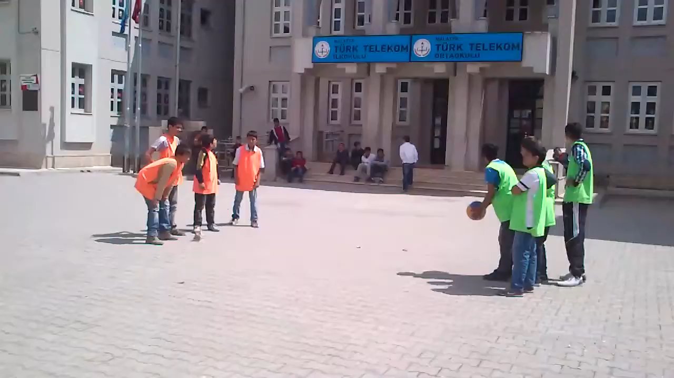

Slide 13
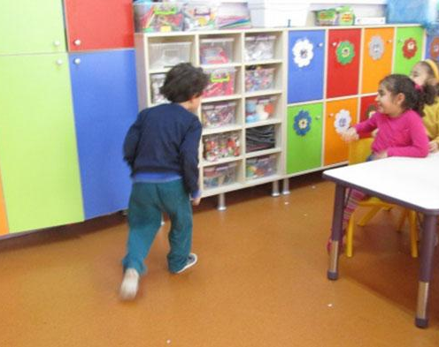
Warm–Cold Game

Slide 14
How to Play Warm – Cold Game
First of all, one player is chosen to be a midwife. Secondly, the person who was chosen as the midwife, chooses an object to hide. Then, other players wait in a different place until the midwife hides the object she/he has chosen in the place where games is played. After the midwife hides the object she/he chose, other players come and start looking for the hidden object. The midwife, if the searching players approach the hidden object she/he says “cold” if they are close to finding she/he says “hot”. Finally, person who finds a hidden object becomes the midwife. Then new midwife chooses a new object to hide it. And the game continues like this.

Slide 15
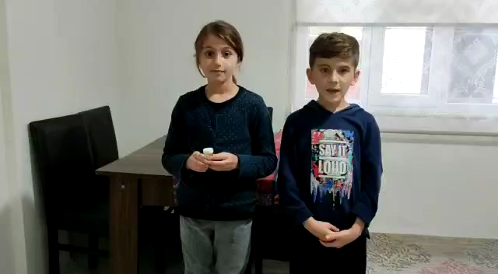

Slide 16
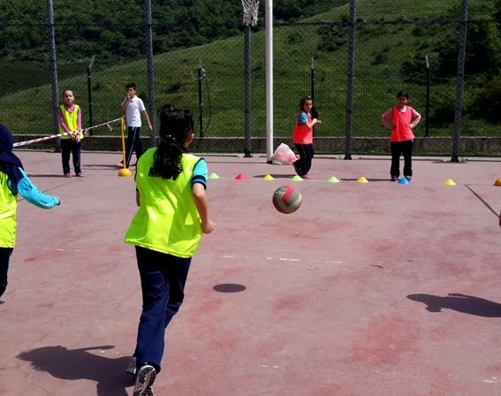
Dodge Ball Game

Slide 17
How to Play Dodge Ball?
Dodge ball is a very common game played in the streets of Turkey by both children and teens. It's very easy to play dodge ball. Of course you need more than one person to play this game and these people will be separated into two groups. First group is the ball throwers other group is the escapers from the ball the throwers will stay on the line while the escapers stand inside the line.

Slide 18
How to Play Dodge Ball?
After that the throwers try to hit the escapers with the ball the ones who got hit get eliminated. If you can hold the ball when it comes to you you earn one life point you re-add the ones who got eliminated. When there is only one player left in the middle, the shooting group tries to hit the player in the middle in 12 shots. If no player is hit in 12 shots, the middle group wins the game. If the group in the middle starts the game in the middle again. Middle player is hit after 12 shots, the shooter moves to the middle, winning the game.

Slide 19
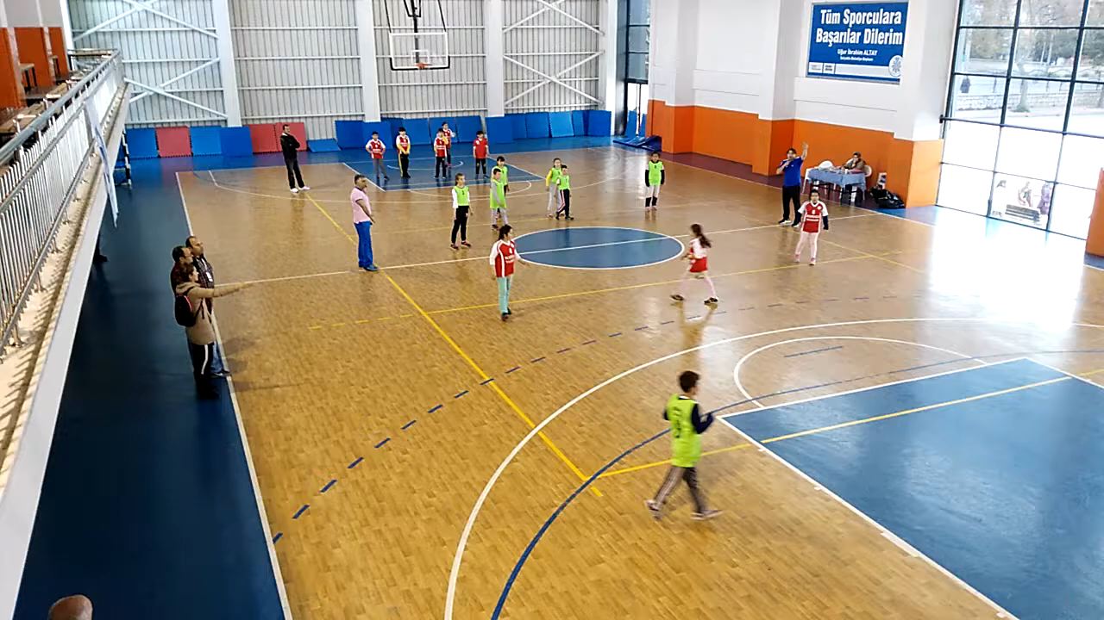

Slide 20
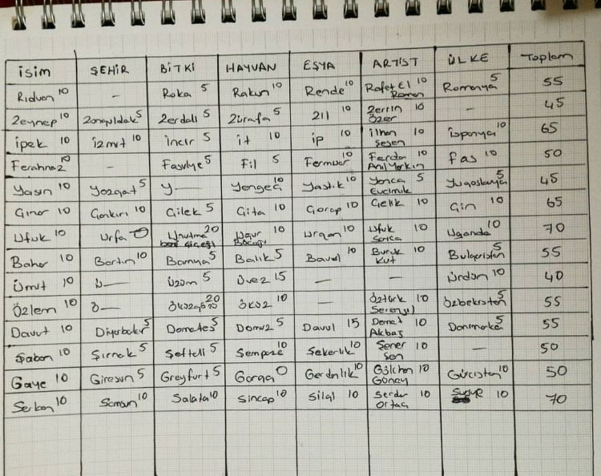
Name – City Game

Slide 21
How to Play Name – City Game?
Today, we're diving into a game of wit and creativity - the "Name and City Game." But here's the twist: not only will we showcase our inguistic skills, but we'll also be awarded points based on the uniqueness of our answers! The player with the highest total score at the end will be crowned the ultimate winner!

Slide 22
How to Play Name – City Game?
Given Letter: Each player is assigned a letter to kick off their responses.
Categories: Name, city, animal, plant, object, famous person
Scoring:
Unique Answer (No one else says the same thing): 10 points.
Common Answer (At least two players say the same thing): 5 points
Incorrect Answer: 0 points.

Slide 23
How to Play Name – City Game?
End of game: Total the Points, add up the points each player has earned throughout the game winner. The player with the highest total score is declared the ultimate champ.

Slide 24
How to Play Name – City Game?
Let's understand the game with a more detailed example:
Letter: A
Name: Adam (Unique, 10 points)
City: Athens (Unique, 10 points)
Animal: Alligator (Unique, 10 points)
Plant: Azalea (Unique, 10 points)
Object: Airplane (Unique, 10 points)
Famous Person: Albert Einstein (Unique, 10 points)

Slide 25
Thanks for watching

